Slide 1
EN.540.635 Software Carpentry Lecture 1 What is a Computer?
Notes:
Hello everyone, welcome to Software Carpentry. My name is Isaiah Chen - I am a PhD student here at Johns Hopkins, where I was an instructor for this course in a previous semester.
This class is being taught in an online or flipped classroom, where these lectures are pre-recorded. All the information for the course is located on the course website. This includes the course syllabus, lecture slides, homework assignments, labs, and other handouts.
Please take a look at the syllabus for details on the meeting times for the class, the course instructors, grading distribution, and other specifics.

Slide 2
Course Outline
Weekly Programming Challenges:
Weekly challenges will be available after class on Tuesdays and are normally due by class start time the following Tuesday (Turn in by Thursday midnight for up to 75% credit).
You are welcome to work together, but turn in your own work.
Challenges will start off easy and progress as the semester continues.
You may not have learned everything prior to a challenge – hence the word “Challenge”.

Slide 3
Course Outline
Labs:
These assignments are to be completed during the class period and will not be handed in for a grade (with a few exceptions).
Some of the later lab assignments can be handed in for extra credit (this is subject to change).

Slide 4
Course Outline
Lazor Project:
Group project that covers a lot of the topics we cover in this course.
Involves the use of Git (version control).
Learning how to work on a programming project with others.
Final Project:
Apply what you have learned to a program of your choosing.
Need to get prior approval from the instructors.
Should be more robust (require more effort) than the Lazor project.
Final presentation near the end of the semester.
Important to make sure that your work is your own!

Slide 5
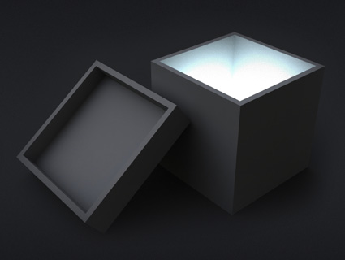
What is a Computer?
A magical box.
A machine that uses ones and zeros to do things.
It lets me use the internet.

Slide 6
Ones and Zeros
We count in decimal:
But what if we only knew the numbers 0 and 1?
Binary System!
Computers count in this:

Slide 7
Changing Base
How do you read 10,353?
Ten Thousand, Three Hundred and Fifty Three
= 1 * 10,000 + 0 * 1,000 + 3 * 100 + 5 * 10 + 3 * 1
= 1 * 10⁴ + 0 * 10³ + 3 * 10² + 5 * 10¹ + 3 * 10⁰
How about 10?
(10)₁₀ = 1 * 10¹ + 0 * 10⁰
(10)₂ = 1 * 2¹ + 0 * 2⁰ = (2)₁₀
Here, we changed to base-2 notation, where 10 is equivalent to 2.
(10101010001)₂ = 1 * 2¹⁰ + 0 * 2⁹ + 1 * 2⁸ + … + 1 * 2⁰ = (1361)₁₀
Notes:
The hexadecimal system is particularly important in computer programming, since four bits (each consisting of a one or zero) can be succinctly expressed using a single hexadecimal digit. Two hexadecimal digits represent numbers from 0 to 255, a common range used, for example, to specify colors. Thus, in the HTML language of the web, colors are specified using three pairs of hexadecimal digits RRGGBB, where is the amount of red, the amount of green, and the amount of blue.

Slide 8
Gates in Computers?
We need 1’s and 0’s… Voltage!
We need a device… THE TRANSISTOR!
GATE
Dielectric
Source
Drain
Channel/Body
Notes:
The amount of current moving from the source to the drain will dictate if the gate opens up or not.

Slide 9
Logic
We want computers to accomplish basic tasks.
They must “Think”:
AND – If two things are true, then do some task
NAND – If not AND – If two things are both not true at the same time, then do some task
OR – If at least one of two things are true, then do some task
NOR – If not OR – If neither of the two things are true, then do some task
XOR – If exactly only one of two things is true, then do some task
https://learnabout-electronics.org/Digital/dig21.php

Slide 10
Logic - AND
1
0
1
1
0
0
0
0
AND – If two things are true, then True

Slide 11
Logic - NAND
1
0
1
0
1
0
1
1
NAND – If not AND – If two things are both not true at the same time, then True

Slide 12
Logic - OR
1
0
1
1
1
0
1
0
OR – If at least one of two things are true, then True

Slide 13
Logic - NOR
1
0
1
0
0
0
0
1
NOR – If not OR – If neither of the two things are true, then True

Slide 14
Logic - XOR
1
0
1
0
1
0
1
0
XOR – If exactly only one of two things is true, then True

Slide 15
Logic - Gates
1
0
NAND
OR
XOR
1
AND
OR
NAND
OR
XOR
0
NAND
NOR

Slide 16
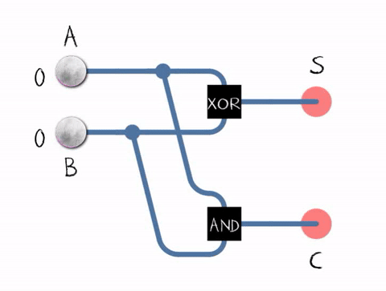
The Adder
This is a simple example of a subcomponent that can exist inside of a processor. In reality, processors can be extremely complex.
https://en.wikipedia.org/wiki/File:Halfadder.gif
Notes:
The half adder adds two single binary digits A and B. It has two outputs, sum (S) and carry (C). The carry signal represents an overflow into the next digit of a multi-digit addition. The value of the sum is 2C + S. The simplest half-adder design, pictured on the right, incorporates an XOR gate for S and an AND gate for C. The Boolean logic for the sum (in this case S) will be A′B + AB′ whereas for the carry (C) will be AB. With the addition of an OR gate to combine their carry outputs, two half adders can be combined to make a full adder.^{[1]} The half adder adds two input bits and generates a carry and sum, which are the two outputs of a half adder. The input variables of a half adder are called the augend and addend bits. The output variables are the sum and carry.

Slide 17
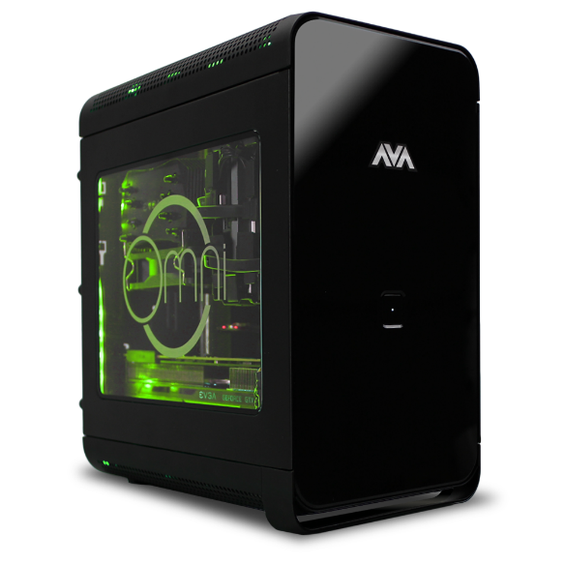
That Magical Black Box

Slide 18
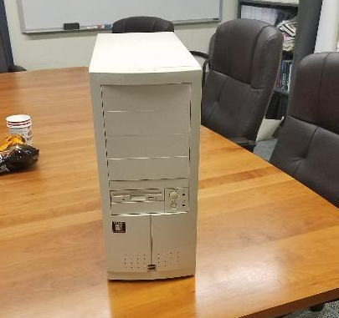
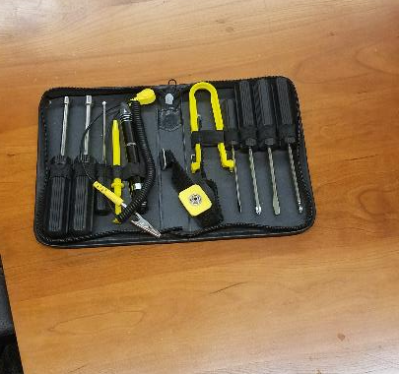
The Case

Slide 19
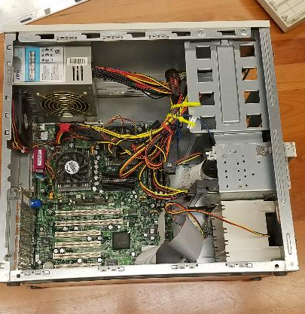
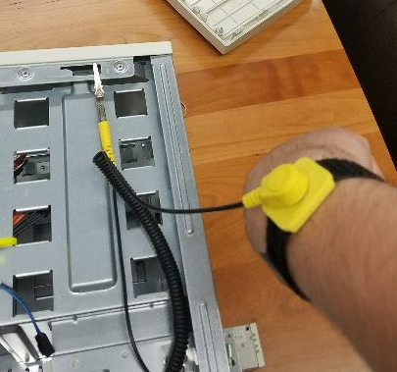
The First Look

Slide 20
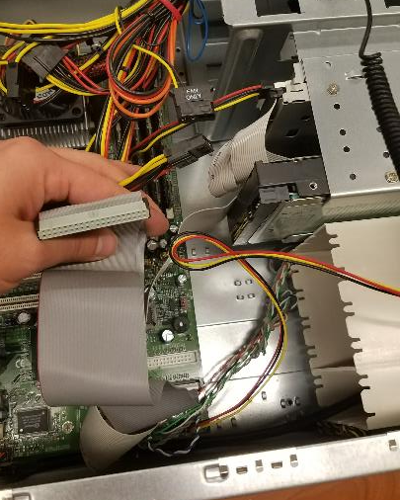
Lots of Cables

Slide 21
CPU

Slide 22
CPU Cooler

Slide 23
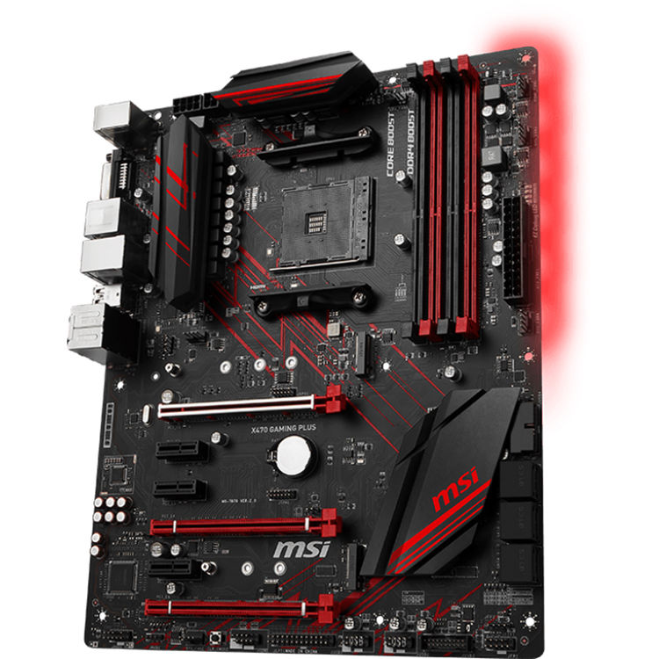
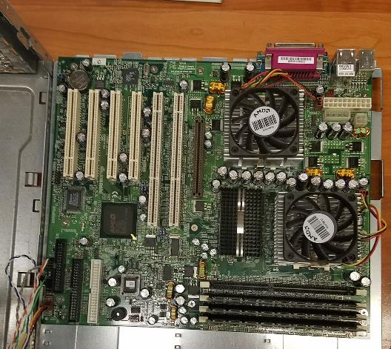
Motherboard

Slide 24
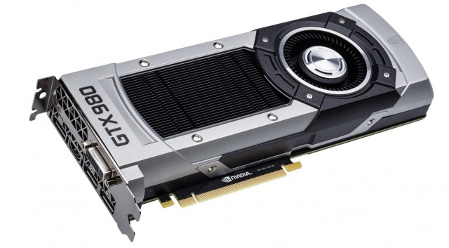
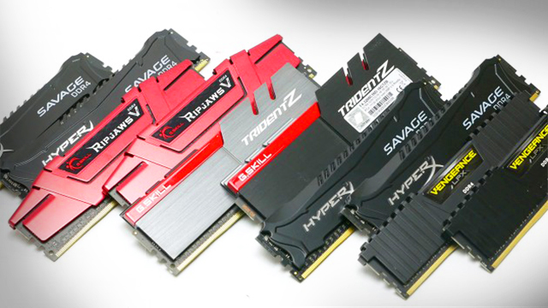
GPU and RAM

Slide 25
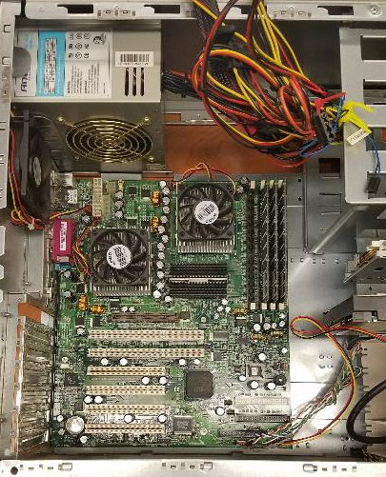
The Front Panel

Slide 26
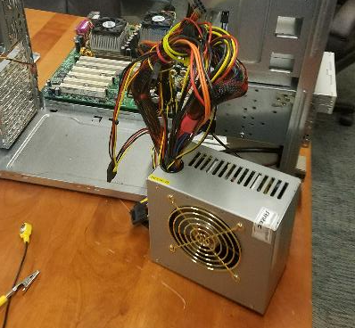
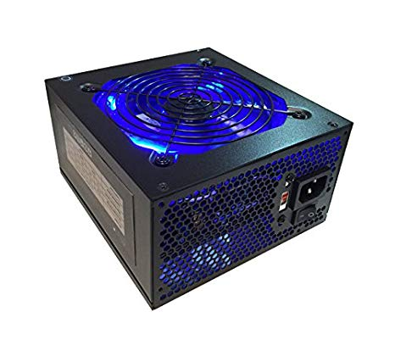
Power Supply

Slide 27
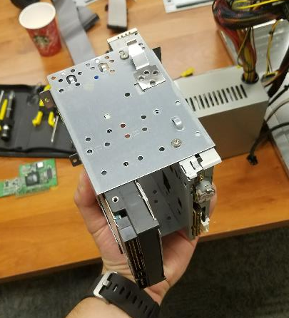
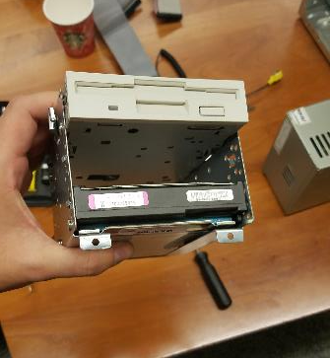
Hard Drive and Optical Drive

Slide 28
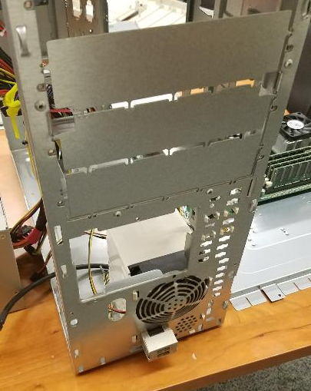
Putting it Back Together

Slide 29
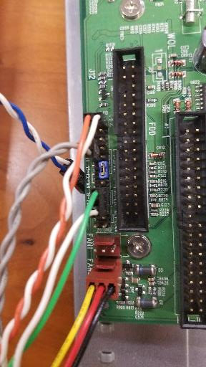
Putting it Back Together

Slide 30
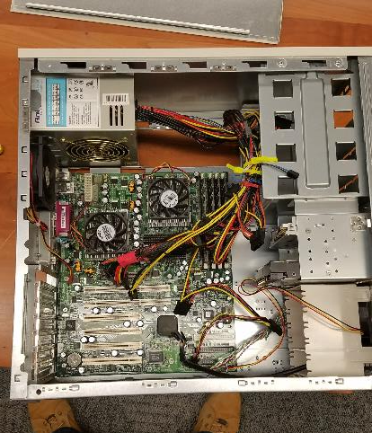
Putting it Back Together

Slide 31
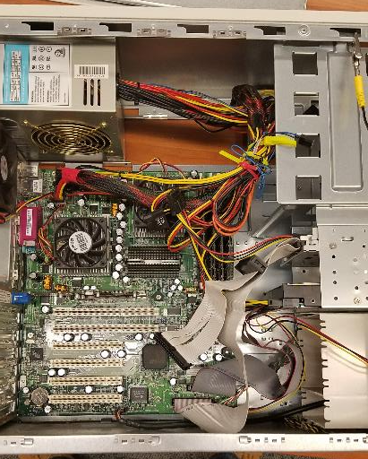
Putting it Back Together

Slide 32
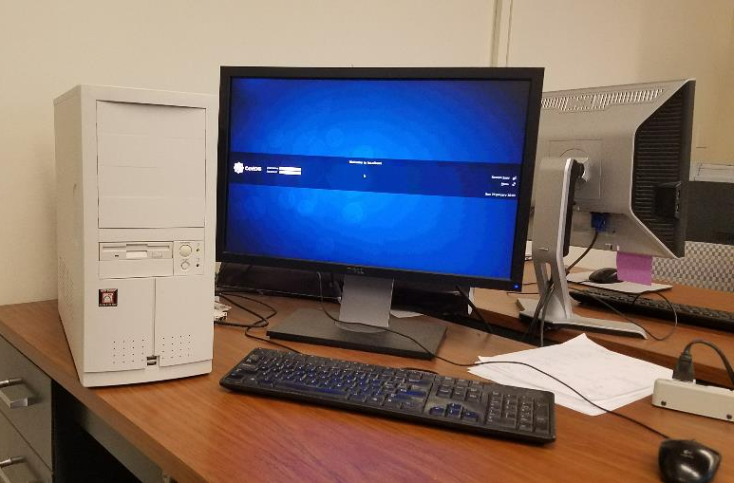
Putting it Back Together

Slide 33
Setting up your Programming Environment
There are two things you need:
Text editor
Simple text editors:
Notepad/TextEdit
Vim/Nano
Sublime Text (text editor & IDE)
Jupyter Notebook (web-based; do not turn in Jupiter notebooks!)
Integrated Development Environments (IDEs):
PyCharm
Spyder (comes with Anaconda; “input” function is buggy)
VS Code
Eclipse + PyDev

Slide 34
Setting up your Programming Environment
There are three things you need:
Command Line Interface
Windows:
Command Prompt
Windows Terminal (currently in beta) or Windows PowerShell
Windows Subsystem for Linux (WSL)
Git Bash
Anaconda PowerShell Prompt
macOS/Linux:
Terminal
iTerm

Slide 35
Setting up your Programming Environment
3. Python (note: conda is a command line tool / python package, like pip)
Anaconda (Python + conda + meta package):
Open-source distribution of Python geared towards scientific computing/data science.
Over 1500 scientific packages auto installed at once
Needs more time to install & disk space
Make sure you download for the correct OS that you are using
Go to https://www.anaconda.com/download
Macs make sure to check for CPU vs M1/M2.
Miniconda (Python + conda):
Open-source distribution of Python geared towards scientific computing/data science.
Must install each packaged you want individually
Smaller & more lightweight
Make sure you download the Python 3.10 version for the correct OS that you are using.
Go to https://docs.conda.io/en/latest/miniconda.html
Miniconda3 macOS Apple M1 64-bit pkg for M1 Macs for example

