Slide 1
EN.540.635 Software Carpentry Lecture 10 Searching Algorithms and Gradient-Based Minimization in Optimization Problems

Slide 2
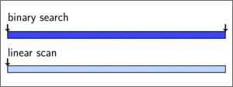
Searching
Finding the index of a value/object in a list:
In a list, where is the maximum?
In a list, where is the minimum?
In a list, where is a specific value located?
Two main ideas:
Linear searching
Binary searching

Slide 3
Linear Searching
Let’s find the smallest number larger than 20 in this list
Check if N > 20
Check if N < N_{prev}
∞
331
21
-3
123
84
34
0
-23
75
2
0
1
2
3
4
5
6
7
8
9
20

Slide 4
Linear Searching
Let’s find the smallest number larger than 20 in this list
Check if N > 20 yes
Check if N < N_{prev} yes
331
331
21
-3
123
84
34
0
-23
75
2
0
0
1
2
3
4
5
6
7
8
9
20

Slide 5
Linear Searching
Let’s find the smallest number larger than 20 in this list
Check if N > 20 yes
Check if N < N_{prev} yes
331
331
21
-3
123
84
34
0
-23
75
2
0
0
1
2
3
4
5
6
7
8
9
20

Slide 6
Linear Searching
Let’s find the smallest number larger than 20 in this list
Check if N > 20 yes
Check if N < N_{prev} yes
21
331
21
-3
123
84
34
0
-23
75
2
1
0
1
2
3
4
5
6
7
8
9
20

Slide 7
Linear Searching
Let’s find the smallest number larger than 20 in this list
Check if N > 20 no
Check if N < N_{prev} yes
21
331
21
-3
123
84
34
0
-23
75
2
1
0
1
2
3
4
5
6
7
8
9
20

Slide 8
Linear Searching
Let’s find the smallest number larger than 20 in this list
Check if N > 20 yes
Check if N < N_{prev} no
21
331
21
-3
123
84
34
0
-23
75
2
1
0
1
2
3
4
5
6
7
8
9
20

Slide 9
Linear Searching
Let’s find the smallest number larger than 20 in this list
Check if N > 20 yes
Check if N < N_{prev} no
21
331
21
-3
123
84
34
0
-23
75
2
1
0
1
2
3
4
5
6
7
8
9
20

Slide 10
Linear Searching
Let’s find the smallest number larger than 20 in this list
Check if N > 20 yes
Check if N < N_{prev} no
21
331
21
-3
123
84
34
0
-23
75
2
1
0
1
2
3
4
5
6
7
8
9
20

Slide 11
Linear Searching
Let’s find the smallest number larger than 20 in this list
Check if N > 20 no
Check if N < N_{prev} yes
21
331
21
-3
123
84
34
0
-23
75
2
1
0
1
2
3
4
5
6
7
8
9
20

Slide 12
Linear Searching
Let’s find the smallest number larger than 20 in this list
Check if N > 20 no
Check if N < N_{prev} yes
21
331
21
-3
123
84
34
0
-23
75
2
1
0
1
2
3
4
5
6
7
8
9
20

Slide 13
Linear Searching
Let’s find the smallest number larger than 20 in this list
Check if N > 20 yes
Check if N < N_{prev} no
21
331
21
-3
123
84
34
0
-23
75
2
1
0
1
2
3
4
5
6
7
8
9
20

Slide 14
Linear Searching
Let’s find the smallest number larger than 20 in this list
Check if N > 20 no
Check if N < N_{prev} yes
21
331
21
-3
123
84
34
0
-23
75
2
1
0
1
2
3
4
5
6
7
8
9
DONE
20

Slide 15
Binary Searching
Requires a sorted binary tree
331
21
-3
123
84
34
0
-23
75
2
0
1
2
3
4
5
6
7
8
9

Slide 16
Binary Searching
Requires a sorted binary tree
Check if N > 20
Check if N < N_{prev}
21
1
0
75
6
8
-23
2
34
123
7
9
5
3
-3
84
331
2
4
0

Slide 17
Binary Searching
Requires a sorted binary tree
Check if N > 20 yes
Check if N < N_{prev} yes
21
1
0
75
6
8
-23
2
34
123
7
9
5
3
-3
84
331
2
4
0
∞
20

Slide 18
Binary Searching
Requires a sorted binary tree
Check if N > 20 yes
Check if N < N_{prev} yes
21
1
0
75
6
8
-23
2
34
123
7
9
5
3
-3
84
331
2
4
0
21
20
1

Slide 19
Binary Searching
Requires a sorted binary tree
Check if N > 20 no
Check if N < N_{prev} yes
21
1
0
75
6
8
-23
2
34
123
7
9
5
3
-3
84
331
2
4
0
21
20
1

Slide 20
Binary Searching
Requires a sorted binary tree
Check if N > 20 no
Check if N < N_{prev} yes
DONE
21
1
0
75
6
8
-23
2
34
123
7
9
5
3
-3
84
331
2
4
0
21
20
1

Slide 21
Comparing Linear and Binary Search
Linear search took 20 comparisons to find the smallest number larger than 20, while the binary search only took 6!
Should we only ever use binary?
What situations is linear better in?

Slide 22
Practice
We can write our own linear and binary searching algorithms in Python.
There are several other searching algorithms besides linear and binary search:
Jump search
Interpolation search
Exponential search
Recursive searching methods

Slide 23
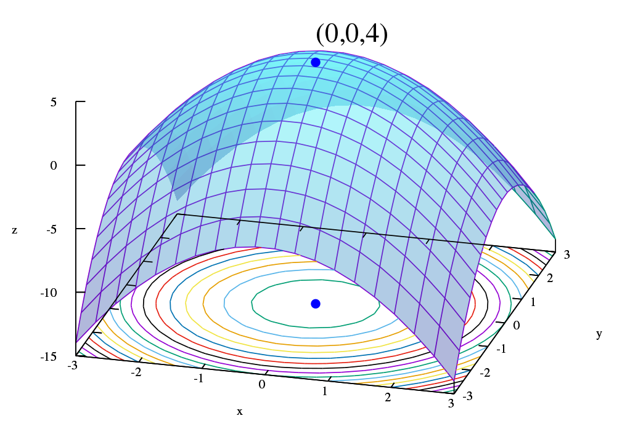
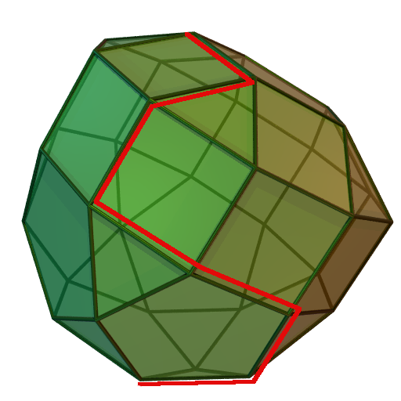
Optimization
Optimization allows us to find the best values for a given set of mathematical constraints.
A common example is curve fitting.
Useful in computational research, as well as data analysis for experimental work.
In Python, there are optimization functions that are typically bundled together in software packages.

Slide 24
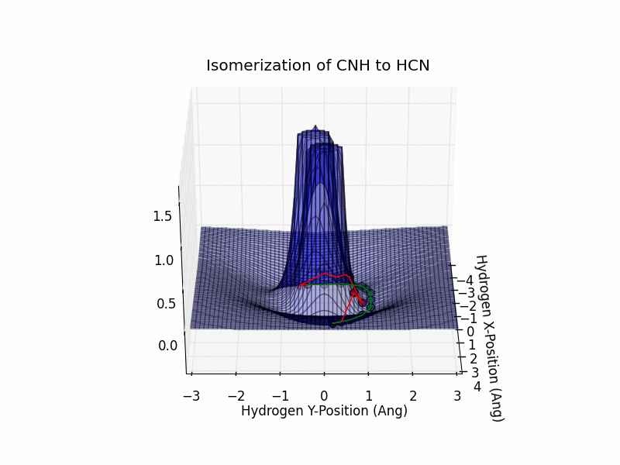
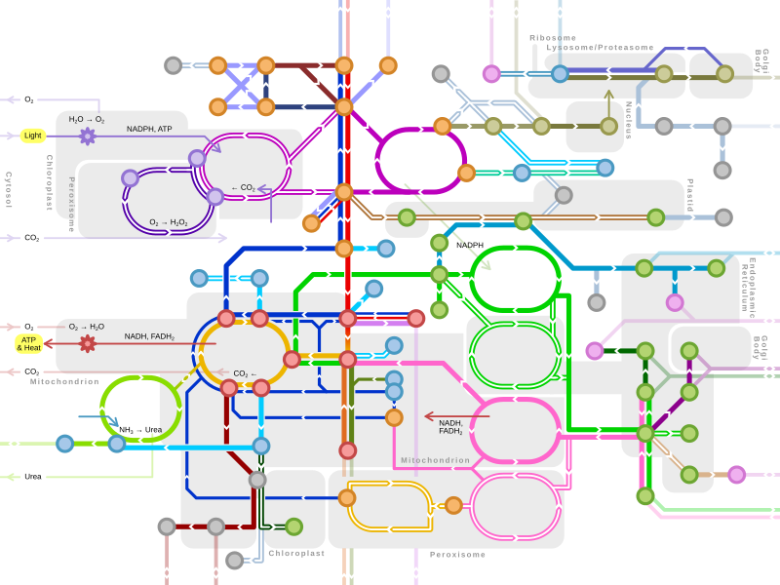
Optimization Examples
Nudged elastic band (NEB):
Optimizing Reaction Fluxes in a Metabolic Network:

Slide 25
Optimization Techniques and Algorithms
In this class, we’ll be focusing on some iterative methods that make use of Hessians and gradients.
Some examples include:
Newton’s method
Quasi-Newton methods
Conjugate gradient
Gradient descent/steepest descent

Slide 26
General Formulation for Gradient-based Problems
We have a function f(x), and we want to find a value x such that f(x) is minimized.
Typically, f(x) is (twice) differentiable, convex, and exists within the Euclidean space ℝ^{n}, where n is the dimension. There may also be a set of constraints that we have to adhere to.
In an iterative optimization method, we guess an initial value x₀ and the update our value using the gradient in some way until we converge at the minimum:
x_{k + 1} = x_{k} + s_{k}∇f(x_{k})

Slide 27
Example of a Quasi-Newton Method
Choose a starting point, x₀
Calculate the search by approximating the inverse Hessian, H⁻¹
Calculate the change in x by the following expression:
x_{k + 1} = x_{k} – [H⁻¹]_{k}∇f(x_{k})
Determine x_{k+1} from the expression above.
Check if the method has converged – we see if the gradient is equal to 0.
Repeat from step 2 until we have converged.

Slide 28
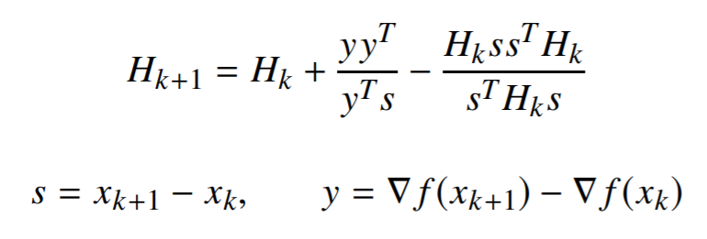
Other Gradient-Based Methods
There are other methods where there are different ways to approximate the inverse Hessian (or not use it at all).
Gradient descent/steepest descent:
Broyden-Fletcher-Goldfarb-Shanno (BFGS):

Slide 29
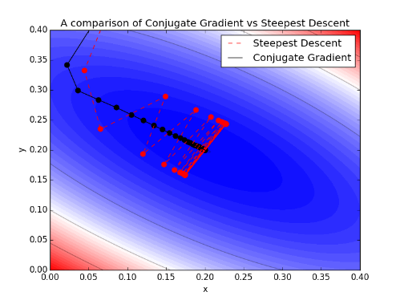
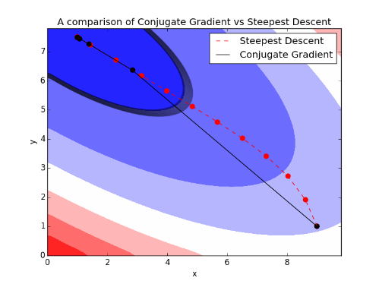
Conjugate Gradient
Conjugate Gradient:
$$|\left.s_{i}\right\rangle =−|\left.g_{i}\right\rangle +β|\left.s_{i−1}\right\rangle$$
$$β=\frac{\left\langle g_{i}\right.|\left.g_{i}\right\rangle }{\left\langle g_{i−1}\right.|\left.g_{i−1}\right\rangle }$$
Fletcher-Reeves Method

Slide 30
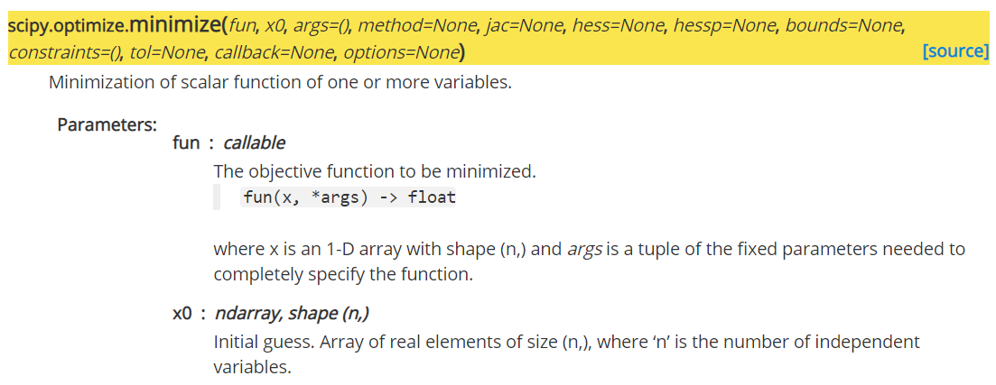
SciPy’s Optimize Function
SciPy has an optimize function that has many different solving algorithms built in.

