Slide 1
EN.540.635 Software Carpentry Lecture 10 Efficiency | Big O | Compiled Languages
Notes:
We ill be talking about some advanced topics today, the previous instructor used to call these the esoteric section of the class. You don’t need to know all of these topics in depth: we believe that being introduced to these topics and being aware of them can help you write better programs and help you branch out into other areas of computing and programming

Slide 2
Efficiency
It is possible to write a program which could technically run forever, even though it is not technically wrong
An efficient program is related to how the implemented algorithm uses computational resources:
Memory
Time
You will not be writing your own algorithm; you will be implementing algorithms already developed for other problems
Notes:
As of yet, we haven’t had to pay a lot of attention to writing fast code. If you guys have been introduced to the LAZOR project or read through the handout, there is clause in it that says that your code should be able to spit out solution in 2 mins. So in this case we want your program to be time efficient. The clause also states that it should be able to do so without using multiprocessing which when you try to run your program on more that one core/processor on your machine. The codes that your write should use logic and the flow of it should be so that it’s not slow.
It’s possible to write a script so inefficient that it gives you an answer in say an hour.
Efficiency is dependent on the computational resources available to you. The memory available and the processing time. In the past the computers weren’t as powerful so there were limits on the amount of memory that they could use and the power of the processors available. Right now we don’t worry that much about the limits on the memory that we are using because a lot of us have multiple gigabytes available to us.
Code efficiency is directly linked with algorithmic efficiency. You will not be writing or developing your own algorithms, at least not in this class. We’ll leave that to the computer scientists. We’ll implementing alogrithms that have already been developed for specific tasks in different parts of our code, with the language of choice.

Slide 3
Order of Growth
To compare the speed or time efficiency of algorithms, we might try comparing the time they take to complete
The above metric is influenced by:
Speed of the machine
Python implementation
Input size
Efficiency in the end depends on the number of steps needed to execute on a given size of input
Notes:
As a measure of the speed of our program, we could just time our program, similar to the way we compared the iterative and recursive approaches. Using and importing the time module, we could measure the time it took for execution. This might seem like a reasonable metric, but this depends on the processing power of your CPU (9th gen intel i5 vs 10th gen intel i5)
Order of growth of an algorithm is a way of saying/predicting how execution time of a program and the space/memory occupied by it changes with the input size.
Input size could be the size of your list, or the size of the integer that you’re trying to check if it’s prime or not
Function that maps the size of the input to the number of step required to process it. Assumption -> each basic step takes constant time, the time that it takes for the computer to access it’s memory for different variables is the same and that the computer completes the steps sequentially.
The most common example given in computer science is sorting or searching of lists. The time taken to sort a list or search through a list depends on the number elements inside the list

Slide 4
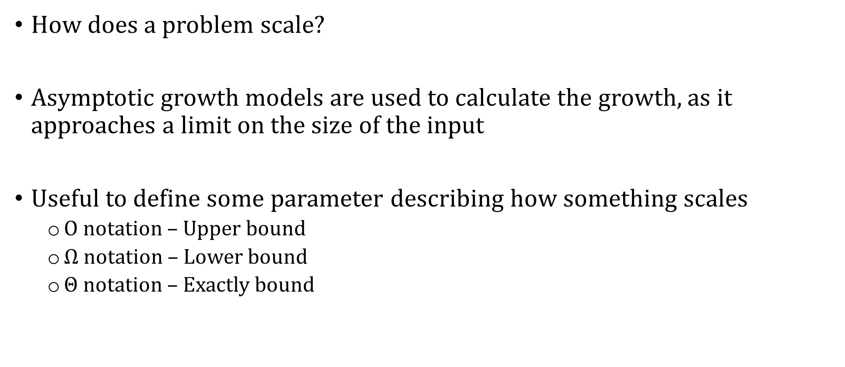
Order of Growth
How does a problem scale?
Asymptotic growth models are used to calculate the growth, as it approaches a limit on the size of the input
Useful to define some parameter describing how something scales
$O$ notation – Upper bound
$Ω$ notation – Lower bound
$Θ$ notation – Exactly bound
Notes:
There can be many metric to determine the order of growth. When we talk about growth mostly mean what will happen if the input size becomes really large that is when the limit approaches infinity. Thinking back to our Recursion lecture:
Popular ones include
Big O denotes the worst case scenario
Continuing the searching example, the worst case for searching through a list is that it’s not there. Worst case is the max time over all possible inputs of a given size
The omega notation gives you the best case scenario, what if the element you’re looking for is the first thing that you check against
And the theta notation gives you an idea of

Slide 5


Big O Notation
Worst case scenario and is the conventional notation used by computer scientists studying algorithms
Fit Functions
$$y=4 ∗x$$
$$y={12}^{99999} ∗x$$
$$y=4 ∗\log_{10}{4x}$$
$$y=x^{4}+12$$
$$y=x ∗\log_{10}\left(x+4\right)+x$$
Big O Notation
$$O(N)$$
$$O(N)$$
$$O\left(\log\left(N\right)\right)$$
$$O\left(N^{4}\right)$$
$$O\left(Nlog\left(N\right)\right)$$
Notes:
The big O notation is the conventional notation for programming.
fact_iter: count the steps

Slide 6
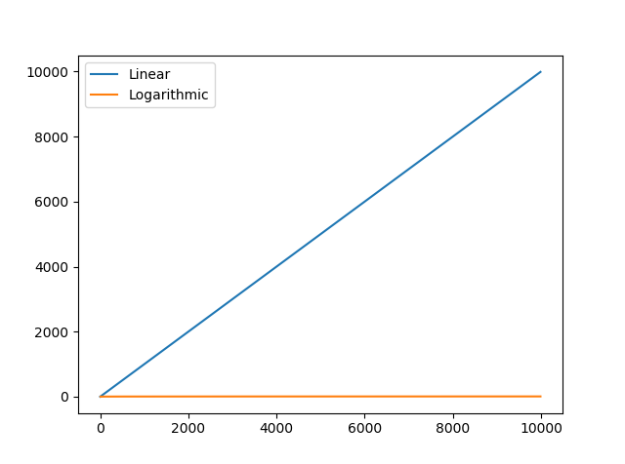
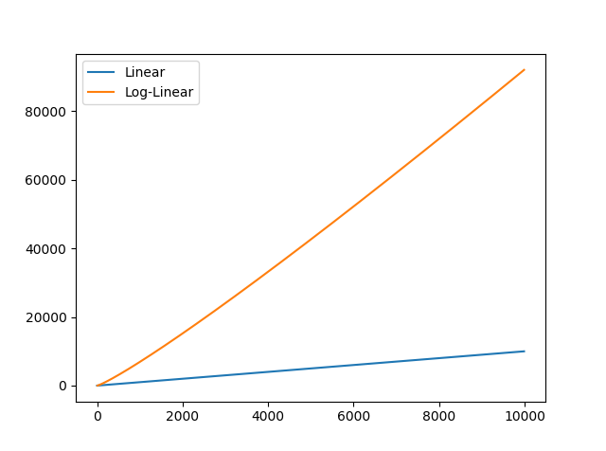
Examples

Slide 7
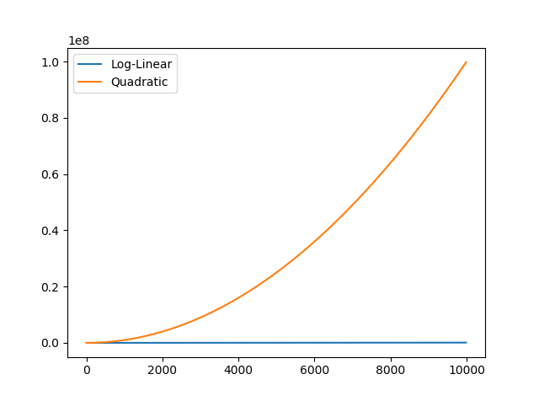
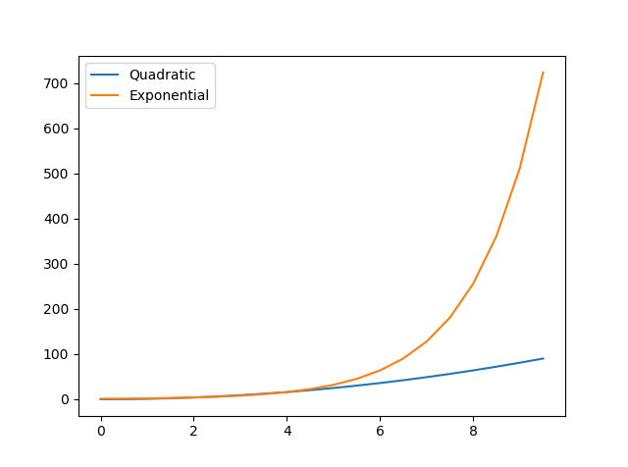
Examples

Slide 8

Sorting Algorithms
How can we sort the following array:
Insertion $O\left(N^{2}\right)$
Merge $O\left(Nlog\left(N\right)\right)$
Quick $O\left(N^{2}\right)$
Bubble $O\left(N^{2}\right)$
Radix $O\left(wN\right)→O\left(N\right), O\left(Nlog\left(N\right)\right),$worse
More*
5
38
23
0
9
27
1
*Seizure Warning!

Slide 9
Bubble Sort
5
38
23
0
9
27
1
5
38
23
0
9
27
1
5
23
38
0
9
27
1
5
23
0
9
27
38
1
5
23
0
9
38
27
1
5
23
0
38
9
27
1
5
23
0
9
27
1
38
Iteration 1
5
23
0
9
27
1
38
5
23
0
9
27
1
38
5
0
23
9
27
1
38
5
0
9
23
1
27
38
5
0
9
23
27
1
38
5
0
9
23
27
1
38
Iteration 2

Slide 10
Bubble Sort
Iteration 3
0
5
9
1
23
27
38
5
0
9
23
1
27
38
Iteration 4
0
1
5
9
23
27
38
0
5
1
9
23
27
38
Iteration 5, 6, 7

Slide 11
Insertion Sort
5
38
23
0
9
27
1
5
38
23
0
9
27
1
5
23
38
0
9
27
1
0
5
9
23
27
38
1
0
5
9
23
38
27
1
0
5
23
38
9
27
1
0
1
5
9
23
27
38

Slide 12
Merge Sort
5
38
23
0
9
27
1
5
38
23
0
9
27
1
5
38
23
0
9
27
1
5
38
23
0
9
27

Slide 13
Merge Sort
5
38
23
0
9
27
1
5
38
0
23
9
27
0
5
23
38
1
9
27
0
1
5
9
23
27
38

Slide 14
Computational Complexity
NP
EXP
NP Complete
P
P stands for Polynomial time -> O(n^{k})
Examples: GCD and Prime Check
Notes:
There’s a whole field that tries to categorize different algorithms and the different types of problems P (Polynomial Time)
Definition: Class of problems that can be solved efficiently by a computer — meaning the time to solve grows polynomially with input size (e.g., nnn, n2n^2n2, n3n^3n3)
In plain terms: These are problems we know how to solve quickly.
Example problems:
Sorting numbers (e.g., quicksort)
Shortest path in a graph (Dijkstra’s algorithm)
Matrix multiplication
Key idea: We can find the answer fast.
✅ NP (Nondeterministic Polynomial Time)
Definition: Class of problems where a solution — if given — can be verified quickly (in polynomial time), but we don’t necessarily know how to find the solution quickly.
In plain terms: Hard to solve, but easy to check once someone gives the answer.
Example problems:
Sudoku solution checking
Traveling Salesman Problem (given a route, verify it's minimal distance)
Factoring large numbers (basis of modern cryptography)
Key idea: We can verify the answer fast, but may not find it fast (as far as we know).
✅ NP-Complete
Definition: The hardest problems in NP — if you can solve one NP-Complete problem efficiently, you can solve all NP problems efficiently.
They satisfy both:
They are in NP (solutions can be verified quickly)
Every NP problem can be reduced to them in polynomial time
In plain terms: Hardest “check-fast but maybe not solve-fast” problems. If one NP-Complete problem falls into P, P = NP.
Example problems:
Traveling Salesman Problem (decision version)
3-SAT
Knapsack problem
Graph coloring
Subset-sum problem
Key idea: These are the toughest puzzles — solving them efficiently would change computing forever.

Slide 15
NP Problems
The problem can be verified in polynomial time:
Problems with Efficient Algorithms for Verifying Proofs
As the input size grows, it becomes harder to solve the problem, but given a guess it is not that difficult to check the guess
Examples: Prime Factorization, Sudoku, Protein Folding, etc
There’s a $1,000,000 prize for something called the ‘P vs NP’ problem (which is itself an NP problem)
Fun video for more information

Slide 16
How does Python work?
Code gets written (in a .py file or the command line).
On execution (running the code), it gets parsed (compiled), verifying syntax and code.
source code is translated to something called byte code (.pyc files)
Finally, the python interpreter is called, running your code
The python interpreter is called the Python Virtual Machine

Slide 17
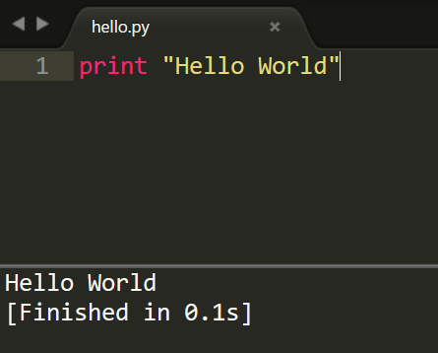
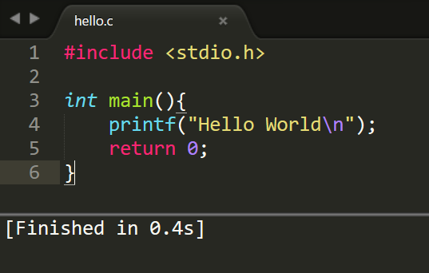
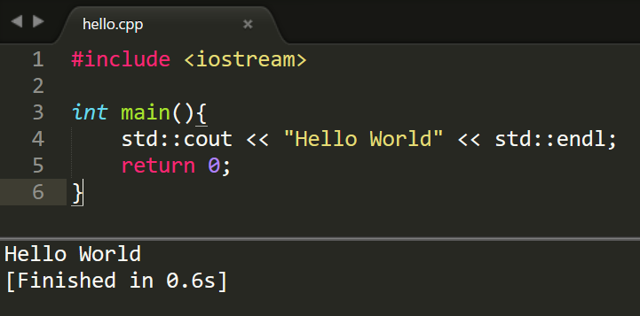
Hello World: Python vs C vs C++

Slide 18
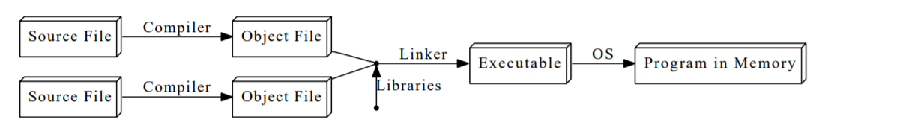
How do C/ C++ work?
Have the compiler/linker installed ( gcc and g++ )
Compile using the following command:
gcc –c hello.c
This generates the hello.o object file.
Now, link the object file into an executable:
gcc –o hello hello.o
Now, you can run the code hello.exe
Credit: MIT OpenCourseware
Include I/O Functions
Start your Main Function
Print to Screen
End the Function

Slide 19
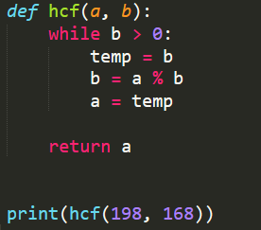
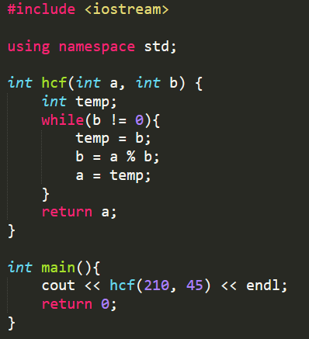
Highest Common Factor
Variable Declaration
Semicolons and Parentheses
Namespace specification

Slide 20
Python vs C++: Summary
Python
C++
Commands are executed by the interpreter, after being compiled into ‘byte code’
Source file can be compiled once, and then the byte code can be run on any machine with the interpreter
Dynamically typed: interpreter checks the variable types
Source file in compiled into machine language
The source file must be compiled on different machines
Statically typed: programmer must ensure type compatibility

Slide 21
Memory Management
We can see that in C and C++, the user is ‘declaring variables’, and thus manually allocating memory before the variables were initialized
Deallocating memory:
Once done with the variable, the user is also responsible for freeing up the memory once occupied
Forgetting to deallocate can result in memory leaks for long-running applications
Deallocating memory space before your program is done with it can cause it to crash

Slide 22
Python Garbage Collection
Automatic memory management is available in Python, known as the Garbage Collector
It works by reference counting: when the number of references to a particular variable becomes 0, the memory is freed
This method uses extra memory to keep track of references, and can also stop the program during runtime to collect all the objects not being used
Python also uses another mechanism called Generational garbage collection

