Slide 1
EN.540.635 Software Carpentry Lecture 11 Efficiency | Big O | Sorting Algorithm

Slide 2
Efficiency
It is possible to write a program which could technically run forever, even though it is not technically wrong
An efficient program is related to how the implemented algorithm uses computational resources:
Memory
Time
You will not be writing your own algorithm; you will be implementing algorithms already developed for other problems

Slide 3
Order of Growth
To compare the speed or time efficiency of algorithms, we might try comparing the time they take to complete
The above metric is influenced by:
Speed of the machine
Python implementation
Input size
Efficiency in the end depends on the number of steps needed to execute on a given size of input

Slide 4
Order of Growth
How does a problem scale?
Asymptotic growth models are used to calculate the growth, as it approaches a limit on the size of the input
Useful to define some parameter describing how something scales
$O$ notation – Upper bound
$Ω$ notation – Lower bound
$Θ$ notation – Exactly bound

Slide 5
Big O Notation
Worst case scenario and is the conventional notation used by computer scientists studying algorithms
Fit Functions
$$y=4 ∗x$$
$$y={12}^{99999} ∗x$$
$$y=4 ∗\log_{10}{4x}$$
$$y=x^{4}+12$$
$$y=x ∗\log_{10}\left(x+4\right)+x$$
Big O Notation
$$O(N)$$
$$O(N)$$
$$O\left(\log\left(N\right)\right)$$
$$O\left(N^{4}\right)$$
$$O\left(Nlog\left(N\right)\right)$$

Slide 6
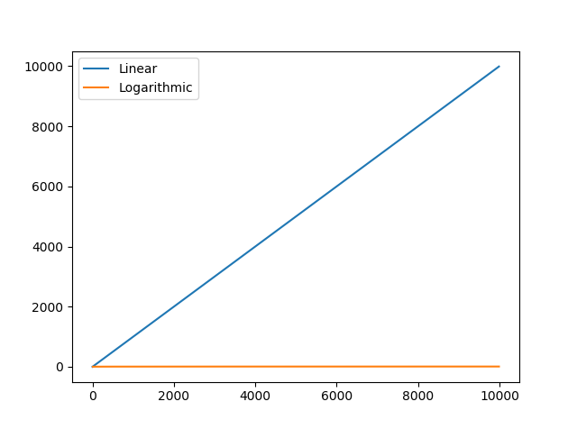
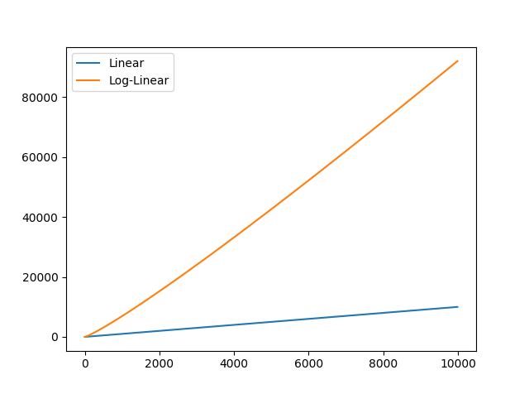
Examples

Slide 7
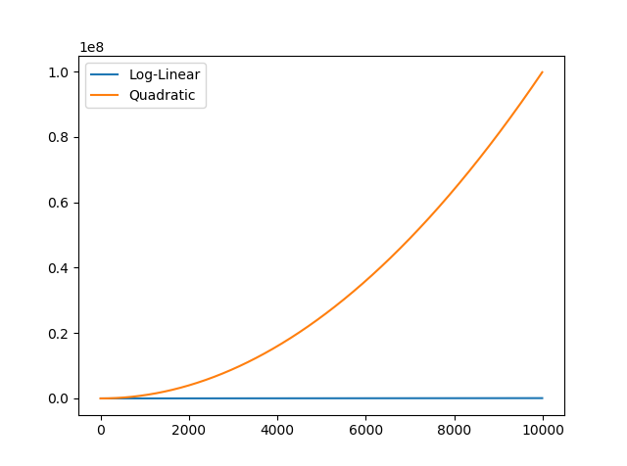
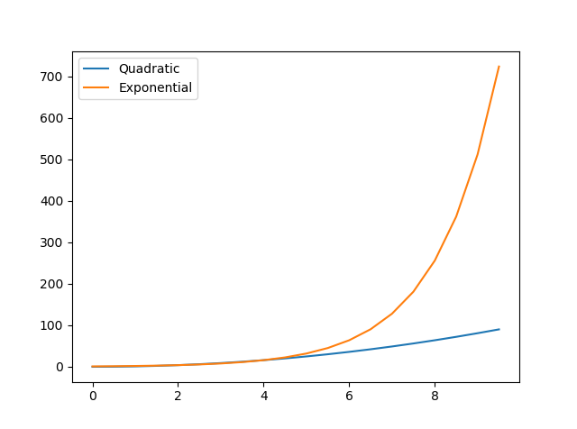
Examples

Slide 8
Sorting Algorithms
How can we sort the following array:
Insertion $O\left(N^{2}\right)$
Merge $O\left(Nlog\left(N\right)\right)$
Quick $O\left(N^{2}\right)$
Bubble $O\left(N^{2}\right)$
Radix $O\left(wN\right)→O\left(N\right), O\left(Nlog\left(N\right)\right),$worse
More*
5
38
23
0
9
27
1
*Seizure Warning!

Slide 9
Bubble Sort
5
38
23
0
9
27
1
5
38
23
0
9
27
1
5
23
38
0
9
27
1
5
23
0
9
27
38
1
5
23
0
9
38
27
1
5
23
0
38
9
27
1
5
23
0
9
27
1
38
Iteration 1
5
23
0
9
27
1
38
5
23
0
9
27
1
38
5
0
23
9
27
1
38
5
0
9
23
1
27
38
5
0
9
23
27
1
38
5
0
9
23
27
1
38
Iteration 2

Slide 10
Bubble Sort
Iteration 3
0
5
9
1
23
27
38
5
0
9
23
1
27
38
Iteration 4
0
1
5
9
23
27
38
0
5
1
9
23
27
38
Iteration 5

Slide 11
Insertion Sort
5
38
23
0
9
27
1
5
38
23
0
9
27
1
5
23
38
0
9
27
1
0
5
9
23
27
38
1
0
5
9
23
38
27
1
0
5
23
38
9
27
1
0
1
5
9
23
27
38

Slide 12
Merge Sort
5
38
23
0
9
27
1
5
38
23
0
9
27
1
5
38
23
0
9
27
1
5
38
23
0
9
27

Slide 13
Merge Sort
5
38
23
0
9
27
1
5
38
0
23
9
27
0
5
23
38
1
9
27
0
1
5
9
23
27
38

