Slide 1
EN.540.635 Software Carpentry Lecture 12 Data Mining, APIs, and an Introduction to Machine Learning

Slide 2
What is Data Mining?
Data mining is defined as the exploration and analysis of large quantities of data (an intersection of statistics, machine learning, and artificial intelligence).
The goal is to extract meaningful conclusions and find patterns that exist in data.
Applications:
Consumer research and marketing
Finance
Healthcare
Telecommunications
Manufacturing and engineering
Bioinformatics
Notes:
Data mining as a discipline was introduced in the 90s as (Knowledge Discovery in Databases – KDD).
Applications:
Consumer research and marketing – online shopping is a good example. They can learn about customer preferences along with purchase history, demographics, location, and other data to personalize shopping experiences (Items suggested for you).
Finance – companies use financial data to make decisions about customer segmentation and targeting (for example, using it to make decisions about credit limits or giving out loans). Fraud detection is also a significant focus.
Healthcare – try to improve patient care and reduce costs
Telecommunications – fraud detection and network fault isolation.
Manufacturing and engineering – companies who do experimental or computational research generate a large amount of data. Data mining techniques can be used to analyze it. Can also be applied in the context of a manufacturing or a chemical plant.
Bioinformatics – same context as manufacturing and engineering.

Slide 3
Data Mining Processes
Notes:
Data mining happens in 3 general steps:
Pre-processing (data retrieval and cleaning, select the data to be mined)
Mining – perform an algorithm to parse through data
Evaluation – return a desired result.

Slide 4
Common Classes of Tasks
Anomaly Detection:
identification of unusual data
Association Rule Learning:
searching for relationships between variables
Clustering:
discovering groups and structures that are similar
Classification:
applying a classifier to data
Regression:
find a function that can be used to model data
Summarization:
provide a more compact representation of a data set
Fayyad et al., From Data Mining to Knowledge Discovery in Databases, AI Magazine (1996).
Notes:
Examples:
Anomaly detection – fraud detection
Association rule learning – marketing (market basket analysis)
Clustering – grouping data, market segmentation
Classification – email filter
Regression – predictive modeling
Summarization – generating visual representations and reports

Slide 5
Example – Sentiment Analysis
Automated process used to identify positive, negative, and/or neutral opinions from text.
Examples of text include social media posts, product reviews, survey responses, etc.

Slide 6
Example – Sentiment Analysis
Here, we propose a data mining scenario:
Twitter is a widely-used social network where users give their opinions and thoughts on a broad range of topics.
There are millions of tweets posts sent out per day – meaning that there is a large amount of data generated and stored on Twitter’s servers.
Given a certain keyword, we parse through a collection of tweets containing that keyword and then we want to find out which other terms appear most frequently and perform sentiment analysis on the given keyword.

Slide 7
Example – Sentiment Analysis
Here, we propose a data mining scenario:
Twitter X is a widely-used social network where users give their opinions and thoughts on a broad range of topics.
There are millions of tweets posts sent out per day – meaning that there is a large amount of data generated and stored on Twitter’s X’s servers.
Given a certain keyword, we parse through a collection of tweets containing that keyword and then we want to find out which other terms appear most frequently and perform sentiment analysis on the given keyword.

Slide 8
How do we Access Tweets?
Application Programming Interface (API):
A set of functions and procedures (protocol) allowing the creation of applications that access the features or data of an operating system, application, or other service.
Abstract the underlying implementation so that the client only has access to necessary functions and nothing else.
Many companies have APIs for interfacing with their own codebase. For example, X has APIs for streaming and searching for posts.

Slide 9
Example – Sentiment Analysis
Pointwise Mutual Information – measure of how associated two words are:
Semantic Orientation – the difference between a word’s associations with positive and negative words:
V+ corresponds to a list of positive words.
V- corresponds to a list of negative words.
$$SO\left(w\right)=\sum_{w′ ∈ V^{+}}{PMI(w, w^{′})}−\sum_{w′ ∈ V^{−}}{PMI(w, w^{′})}$$

Slide 10
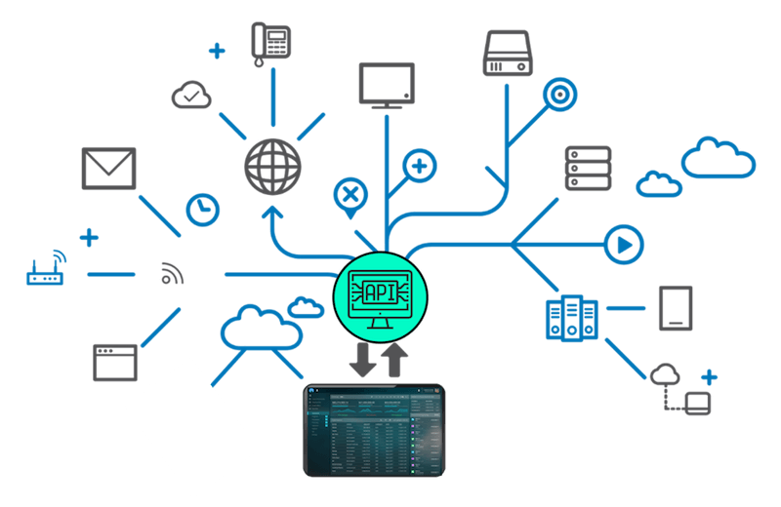
Application Programming Interfaces
APIs allow for different software/applications to communicate with one another (programming, internet, operating systems).
Common examples:
Ridesharing (Uber, Lyft)
Application development (iOS, Android)
Mobile weather applications
Web development (embedding applications)
Internal vs. External APIs

Slide 11
Simple Example of Using APIs

Slide 12
Summary
With data mining, we can learn from large amounts of data and gain insights on patterns that occur in the data.
Can we extend data mining techniques further?

Slide 13
AI, ML, Deep Learning
Artificial Intelligence
Machine
Learning
Deep
Learning
Notes:
Can machines think ?
Famous question posed by Alan Turing in his 1950 paper Computing Machinery and Intelligence.
Introduces Turing test, early concepts of genetic algorithms and reinforcement learning.
He writes the word think and machine are too ambiguous and general. He goes on to formulate another question which is related to the first question but is expressed in unambiguous words.
This new question can be described through a game called the ‘Imitation game’.
It involves a man (A), a woman(B) and an interrogator (C) who may be of either gender.
Interrogator © stays in a room separate from the other two. The interrogator knows the two ppl by labels X and Y and it is the objective of the interrogator to predict which of the other two is a man (A) and which is the woman (B).
Now if suppose ‘A’ is male and ‘B’ is female, it is the job of A to confuse the interrogator and trick the interrogator into predicting that A is female and B is male.
It is the job of ’B’ to assist the interrogator into making the right prediction maybe by saying I am female and ‘A’ is male but ‘A’ can revert and say that I am female and ‘B’ is male.
Now we can reformulate the above question as “What will happen if machine takes the place of ‘A’?” “Will the interrogator decide wrongly as often when the game is played like this as he does when the game is played between a man and a woman ?”
OpenAI GPT Chatbot : https://chat.openai.com/auth/login
Artificial Intelligence :
Symbolic AI
Encompasses approaches that do not involve learning. For a long time experts believed human level intelligence could be obtained by crafting a large set of explicit rules. This was called Symbolic AI. Dominant paradigm from 1950 to 1980 until overtaken by machine learning and deep learning.
Symbolic AI was useful in cases where all the rules governing the process are known and can be logically coded using symbols and relations.
In cases where a fixed set of explicit rules cannot be determined symbolic AI fails. (Ex: Image classification, language translation, speech recognition).
However there is a resurgence in symbolic AI and attempt to reconcile symbolic AI with deep learning to combat the short comings of deep learning such as poor interpretability and generalization, data inefficiency (requires large volumes of data to achieve super human intelligence)

Slide 14
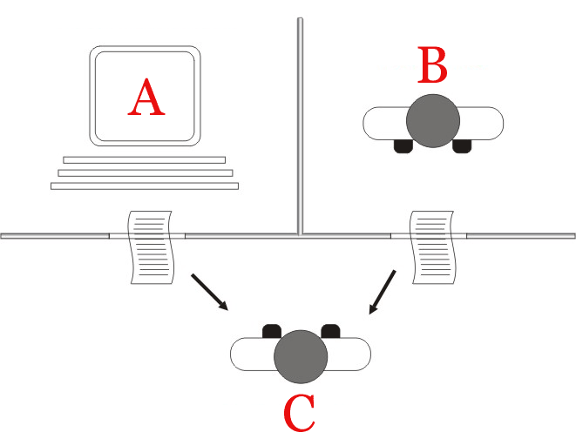
Artificial Intelligence
Theory and development of computer systems to perform tasks requiring human intelligence [1]
Artificial Intelligence
Can machines think ? [1]
Symbolic AI
Expert Systems
Machine
Learning
Neuro
Symbolic AI
Deep
Learning
[1] Turing, A. M. I.—COMPUTING MACHINERY AND INTELLIGENCE. Mind LIX, 433–460 (1950).
[2] Russell, S. J., Norvig, P. & Davis, E. Artificial intelligence: a modern approach. (Prentice Hall, 2010).
[3] Garnelo, M. & Shanahan, M. Reconciling deep learning with symbolic artificial intelligence: representing objects and relations. Current Opinion in Behavioral Sciences 29, 17–23 (2019).
Notes:
Can machines think ?
Famous question posed by Alan Turing in his 1950 paper Computing Machinery and Intelligence.
Introduces Turing test, early concepts of genetic algorithms and reinforcement learning.
He writes the word think and machine are too ambiguous and general. He goes on to formulate another question which is related to the first question but is expressed in unambiguous words.
This new question can be described through a game called the ‘Imitation game’.
It involves a man (A), a woman(B) and an interrogator (C) who may be of either gender.
Interrogator © stays in a room separate from the other two. The interrogator knows the two ppl by labels X and Y and it is the objective of the interrogator to predict which of the other two is a man (A) and which is the woman (B).
Now if suppose ‘A’ is male and ‘B’ is female, it is the job of A to confuse the interrogator and trick the interrogator into predicting that A is female and B is male.
It is the job of ’B’ to assist the interrogator into making the right prediction maybe by saying I am female and ‘A’ is male but ‘A’ can revert and say that I am female and ‘B’ is male.
Now we can reformulate the above question as “What will happen if machine takes the place of ‘A’?” “Will the interrogator decide wrongly as often when the game is played like this as he does when the game is played between a man and a woman ?”
OpenAI GPT Chatbot : https://chat.openai.com/auth/login
Artificial Intelligence :
Symbolic AI
Encompasses approaches that do not involve learning. For a long time experts believed human level intelligence could be obtained by crafting a large set of explicit rules. This was called Symbolic AI. Dominant paradigm from 1950 to 1980 until overtaken by machine learning and deep learning.
Symbolic AI was useful in cases where all the rules governing the process are known and can be logically coded using symbols and relations.
In cases where a fixed set of explicit rules cannot be determined symbolic AI fails. (Ex: Image classification, language translation, speech recognition).
However there is a resurgence in symbolic AI and attempt to reconcile symbolic AI with deep learning to combat the short comings of deep learning such as poor interpretability and generalization, data inefficiency (requires large volumes of data to achieve super human intelligence)

Slide 15
Artificial Intelligence
Theory and development of computer systems to perform tasks requiring human intelligence [1]
Artificial Intelligence
Can machines think ? [1]
Symbolic AI
Expert Systems
Symbolic AI : Collection of methods that carry out logical reasoning by symbolic representations of problems. [2]
Machine
Learning
Neuro
Symbolic AI
Expert Systems : Computer programs that emulate human decision making through large bodies of conditional statements (Rule based systems)
Deep
Learning
Neuro-symbolic AI : Combines strength of symbolic AI with deep learning architectures.[3]
[1] Turing, A. M. I.—COMPUTING MACHINERY AND INTELLIGENCE. Mind LIX, 433–460 (1950).
[2] Russell, S. J., Norvig, P. & Davis, E. Artificial intelligence: a modern approach. (Prentice Hall, 2010).
[3] Garnelo, M. & Shanahan, M. Reconciling deep learning with symbolic artificial intelligence: representing objects and relations. Current Opinion in Behavioral Sciences 29, 17–23 (2019).
Notes:
Can machines think ?
Famous question posed by Alan Turing in his 1950 paper Computing Machinery and Intelligence.
Introduces Turing test, early concepts of genetic algorithms and reinforcement learning.
He writes the word think and machine are too ambiguous and general. He goes on to formulate another question which is related to the first question but is expressed in unambiguous words.
This new question can be described through a game called the ‘Imitation game’.
It involves a man (A), a woman(B) and an interrogator (C) who may be of either gender.
Interrogator © stays in a room separate from the other two. The interrogator knows the two ppl by labels X and Y and it is the objective of the interrogator to predict which of the other two is a man (A) and which is the woman (B).
Now if suppose ‘A’ is male and ‘B’ is female, it is the job of A to confuse the interrogator and trick the interrogator into predicting that A is female and B is male.
It is the job of ’B’ to assist the interrogator into making the right prediction maybe by saying I am female and ‘A’ is male but ‘A’ can revert and say that I am female and ‘B’ is male.
Now we can reformulate the above question as “What will happen if machine takes the place of ‘A’?” “Will the interrogator decide wrongly as often when the game is played like this as he does when the game is played between a man and a woman ?”
OpenAI GPT Chatbot : https://chat.openai.com/auth/login
Artificial Intelligence :
Symbolic AI
Encompasses approaches that do not involve learning. For a long time experts believed human level intelligence could be obtained by crafting a large set of explicit rules. This was called Symbolic AI. Dominant paradigm from 1950 to 1980 until overtaken by machine learning and deep learning.
Symbolic AI was useful in cases where all the rules governing the process are known and can be logically coded using symbols and relations.
In cases where a fixed set of explicit rules cannot be determined symbolic AI fails. (Ex: Image classification, language translation, speech recognition).
However there is a resurgence in symbolic AI and attempt to reconcile symbolic AI with deep learning to combat the short comings of deep learning such as poor interpretability and generalization, data inefficiency (requires large volumes of data to achieve super human intelligence)

Slide 16
Machine Learning
Use and development of computer systems that are able to learn and adapt without following explicit instructions. (Oxford dictionary)
Artificial Intelligence
Symbolic AI
Expert Systems
IMPORTANT ML LINGO
Fuzzy Logic
Machine
Learning
Feature : Measurable property
Labels : Value associated with a feature or set of features
Neuro
Symbolic AI
Dataset : Set of features and labels.
Training set : Set of features and labels the model is trained on.
Deep
Learning
Test set : Set of features and labels that we use to evaluate the model predictions.
Hyperparameters : Model parameters

Slide 17
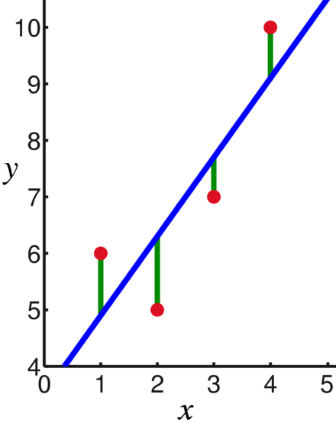
Linear Regression
The goal:
Given sampled points, can we find a best-fit line?
The process:
Using two parameters (m and b), find the line that minimizes the deviation.

Slide 18
Numerical Data!
Task : Predict the number of fruits sold
Fruit (Feature 1) | Day of week (Feature 2) | Price (in $) (Feature 3) | Num sold (Label)
‘apple’ | ‘Monday’ | 1 | 20
‘banana’ | ‘Monday’ | 0.30 | 20
‘apple’ | ‘Tuesday’ | 1 | 10
‘pear’ | ‘Wednesday’ | 1.5 | 5
‘oranges’ | ‘Thursday’ | 1.5 | 10
Artificial Intelligence
Symbolic AI
Expert Systems
Training Set
Fuzzy Logic
Machine
Learning
Test Set
Neuro
Symbolic AI
Note :
A machine learning algorithm can only work with numerical data.
Need to convert all the categories of fruits and days of weeks into numerical vectors (One hot encoding)
Deep
Learning

Slide 19
Supervised Learning
We have a dataset with inputs and desired outputs.
We train a model to predict the output from the input (normally using optimization techniques to minimize an error function).
We use a different data set to test the model and see how accurate it is.

Slide 20
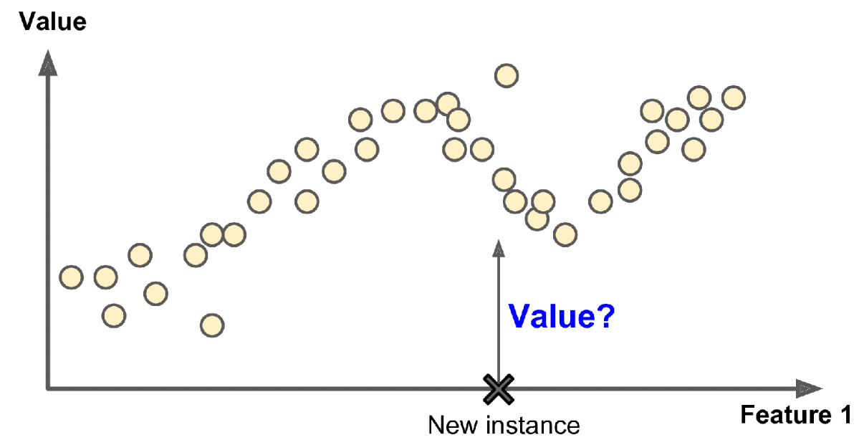
Supervised Learning
Classification
Artificial Intelligence
Symbolic AI
Expert Systems
Machine
Learning
Fuzzy Logic
Regression
Neuro
Symbolic AI
Unsupervised
learning
Reinforcement
learning
Supervised
learning
Deep
Learning
[1] Géron, A. Hands-On Machine Learning with Scikit-Learn, Keras, and TensorFlow. 1150.
Notes:
Machine Learning :
Supervised Learning
An analogy to supervised learning is where the teacher (i.e you) teaches the student (i.e the computer) what is the right answer.
Supervised learning typically involves performing either or both classification or regression.
The goal of classification is to predict the class a feature or set of features belong to. The example shown is for a spam filter which classifies email into two classes (‘spam’ or ‘not spam’). Here the contents of the email would be the features and the class is the label. The model essentially learns a decision boundary that separates the feature space into the two classes.
The goal of regression is to predict a numeric value for a given feature or set of features. In the example shown we have a set of points for each of which we have the corresponding label/value. This is our training set. We want to train the model to predict the value at a new instance. The model learns a function to fit the given data. Using this learned function, the model can essentially predict the value for any new instance.

Slide 21
Unsupervised Learning
We have a data set with only inputs.
The algorithm finds patterns in the data and reacts accordingly.
Examples:
Clustering analysis
Principal component analysis
Notes:
Dimensionality reduction through PCA – linear mapping of the data to a lower-dimensional space.

Slide 22
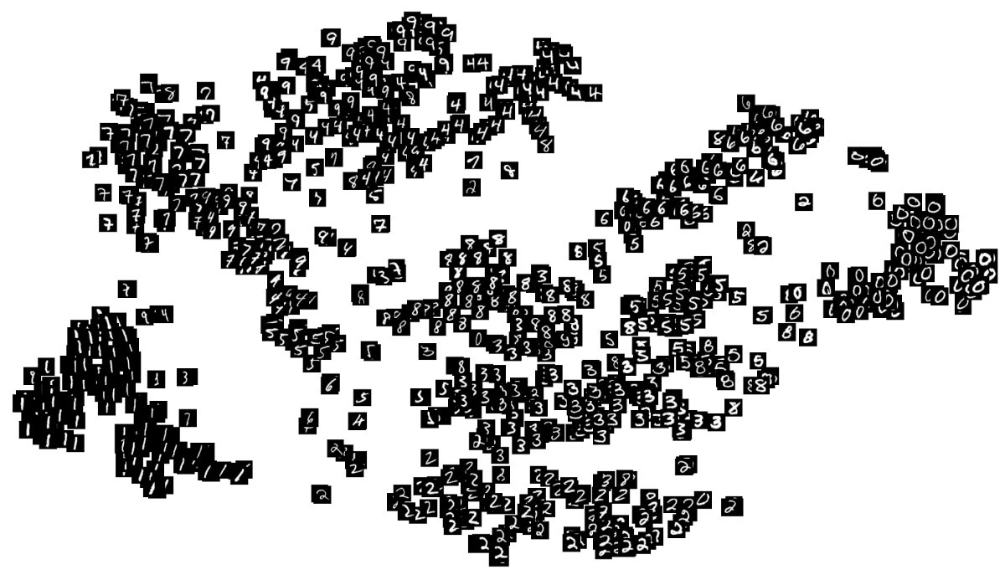
Unsupervised Learning
Artificial Intelligence
Symbolic AI
Expert Systems
Machine
Learning
Fuzzy Logic
Neuro
Symbolic AI
Unsupervised
learning
Reinforcement
learning
Supervised
learning
Deep
Learning
Notes:
Machine Learning :
Unsupervised Learning
An analogy to Unsupervised Learning is where we ask the student(i.e computer) to identify relevant patterns in the data without providing it any labels.
In the example shown we train the model on a set of images of handwritten numbers 0-9 and we give it the take segregate the images into different classes. Note we are not specifying explicitly what number each image corresponds to. The model learns to segregate images into different classes based on the way each number is written.
Unsupervised learning useful in cases where we want to learn patterns from a large amount of data but we may not have labels for all the features in the dataset.

Slide 23
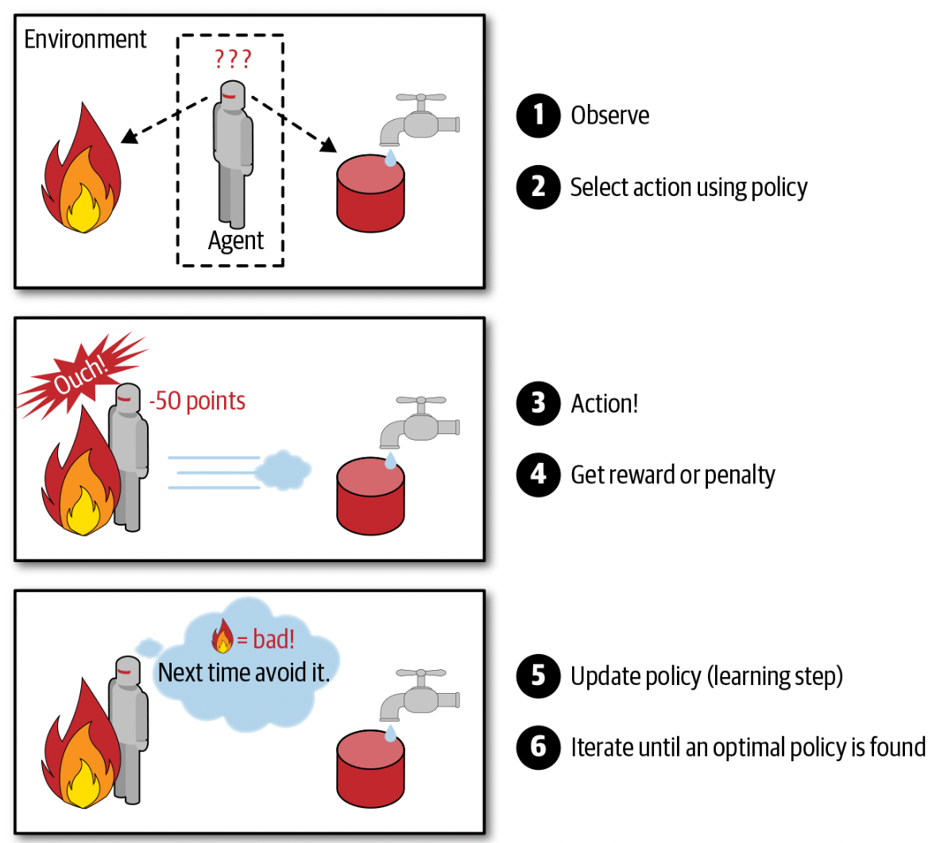
Reinforcement Learning
Artificial Intelligence
Symbolic AI
Expert Systems
Machine
Learning
Fuzzy Logic
Neuro
Symbolic AI
Unsupervised
learning
Reinforcement
learning
Supervised
learning
Deep
Learning
[1] Géron, A. Hands-On Machine Learning with Scikit-Learn, Keras, and TensorFlow. 1150.
Notes:
Machine Learning :
Reinforcement Learning:
This is like how humans learn by trial and error.
Here you have a model called the agent. The agent interacts with the environment through actions. Here we can see the action of the agent is to touch the fire.
Based on the action of the agent we reward or penalize the agent.
It must learn by itself (without supervision) what is the best action to take at a given state. The actions to take at each state are specified through something called the policy. Through training the agent will learn the optimal policy that allows it maximize the cumulative rewards over time.

Slide 24
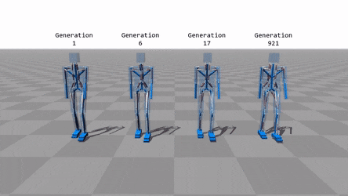
Unsupervised Learning
Artificial Intelligence
Symbolic AI
Expert Systems
Machine
Learning
Fuzzy Logic
Neuro
Symbolic AI
Unsupervised
learning
Reinforcement
learning
Supervised
learning
Deep
Learning
Notes:
Many robots implement Reinforcement Learning algorithms to learn how to walk. DeepMind’s AlphaGo program is also a good example of Reinforcement Learning: it made the headlines in May 2017 when it beat the world champion Ke Jie at the game of Go. It learned its winning policy by analyzing millions of games, and then playing many games against itself. Note that learning was turned off during the games against the champion; AlphaGo was just applying the policy it had learned.

Slide 25
Deep Learning
Artificial Intelligence
Machine
Learning
Deep
Learning

Slide 26
Deep Learning
A subset of machine learning based on artificial neural networks in which multiple layers of processing are used to extract progressively higher level of features from data (Oxford dictionary)
Artificial Intelligence
A simple neural network
X1
h1
h3
X1, X2, X3 are features
Machine
Learning
X2
h5
y
h1, h2, h3, h4 are called
hidden nodes
h2
h4
X3
y is label
h1
Neural
networks
Conv Nets
X1
$$w_{11}$$
Deep
Learning
$$act(w_{11}X1+$$
$$w_{21}X2+w_{31}X3)$$
X2
$$w_{12}$$
$$w_{11}X1+w_{12}X2+w_{13}X3$$
Act.
sum
$$w_{13}$$
RNN
X3
Training a neural network is simply learning the appropriate weights

Slide 27
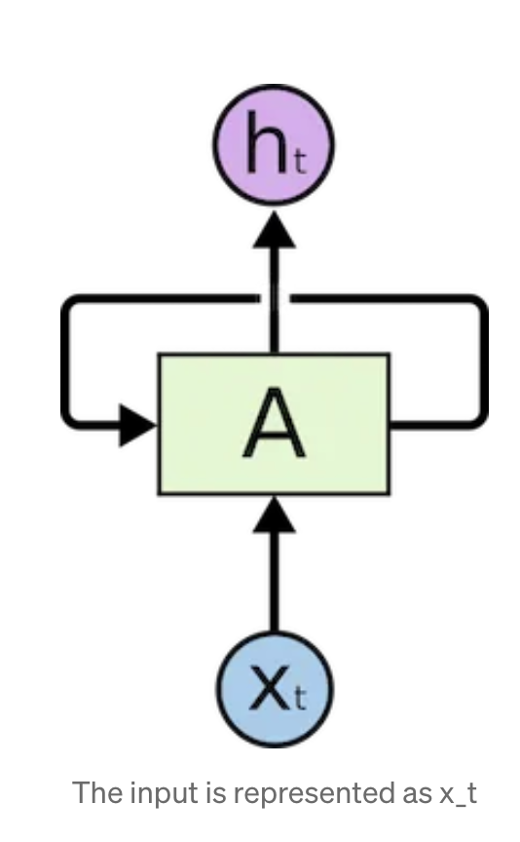
Recurrent Neural Net
Artificial Intelligence
Machine
Learning
Neural
networks
Conv Nets
Deep
Learning
RNN

Slide 28
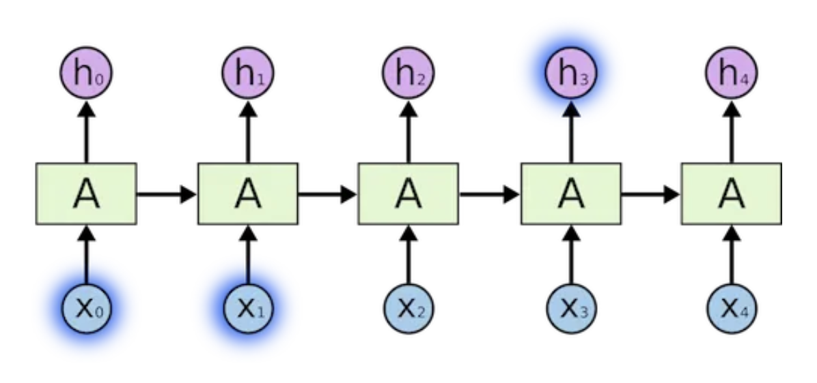
Recurrent Neural Nets … are Inefficient
Artificial Intelligence
Machine
Learning
Neural
networks
Conv Nets
Deep
Learning
RNN

Slide 29
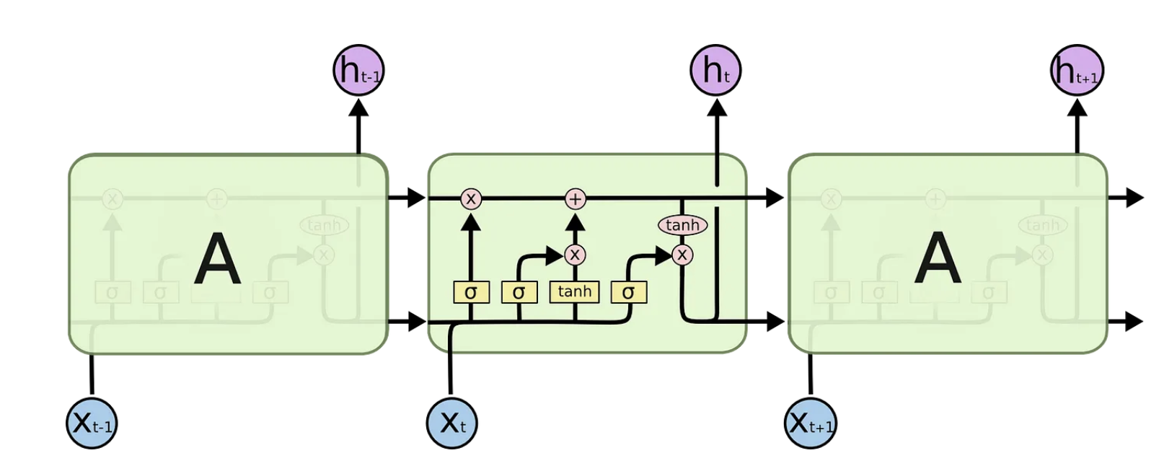
Long-Short Term Memory
Artificial Intelligence
Machine
Learning
Neural
networks
Conv Nets
Deep
Learning
Cannot parallelize
No explicit modeling of long & short range dependencies
Distance between positions is linear
RNN

Slide 30
…Attention
Artificial Intelligence
Machine
Learning
https://www.youtube.com/watch?v=fjJOgb-E41w&ab_channel=GoogleCloudTech
Neural
networks
Conv Nets
Deep
Learning
RNN

Slide 31
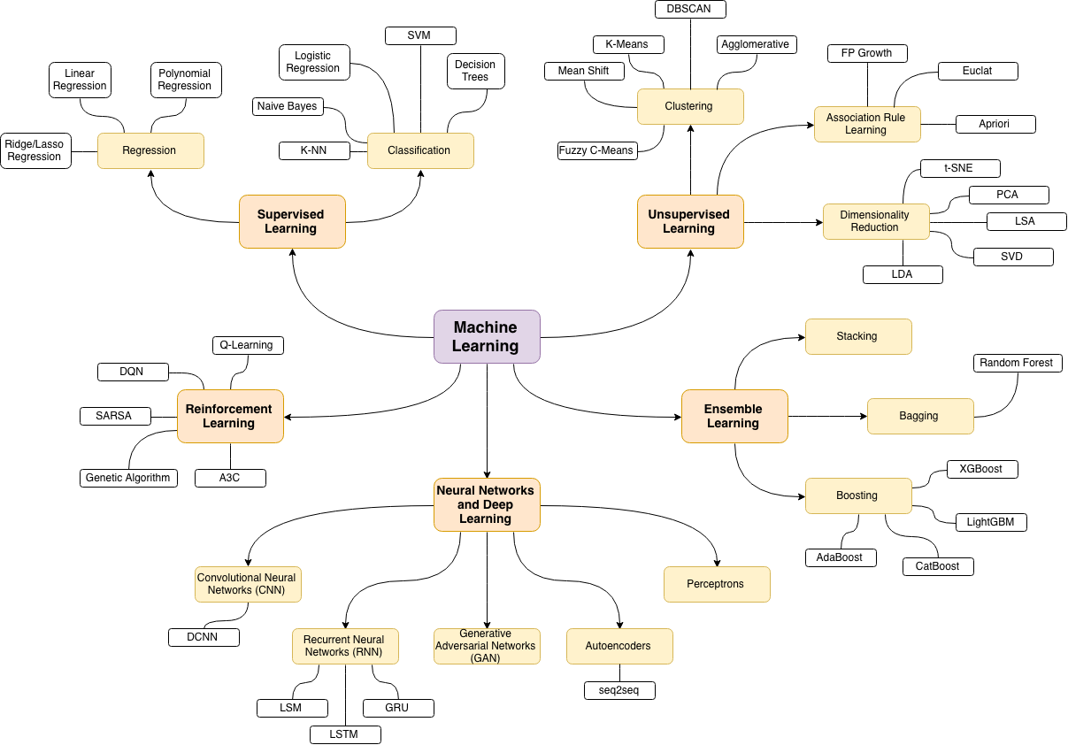
Machine Learning… in a Nut Shell
https://github.com/trekhleb/homemade-machine-learning

Slide 32
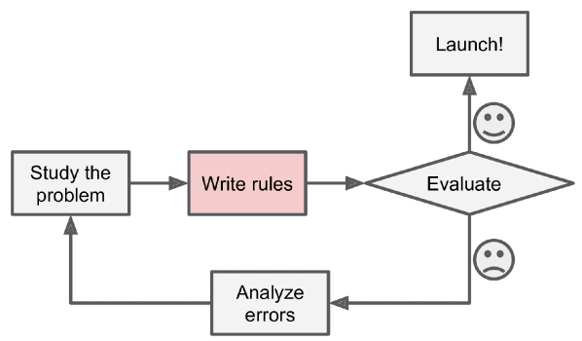
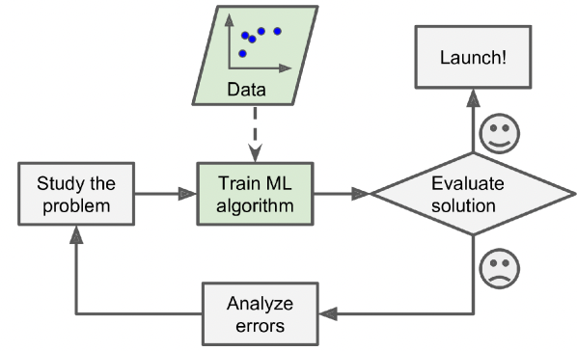
Why Machine Learning is useful ?
Simplified traditional program workflow
Simplified machine learning program workflow
Requires defining conditional statements
No hard coded rules, model learns patterns from the data.
Building model takes a significant amount of time.
Building model is fast due to well documented python libraries
Must rewrite model code to incorporate new data.
A well trained model is generalizable to perform a task on new data.
Cannot solve problems with no analytical or numerical solution.
Can perform complex tasks such as image recognition, language translation and can generate new insights from the data.
[1]. Géron, A. Hands-On Machine Learning with Scikit-Learn, Keras, and TensorFlow. 1150.

Slide 33
1. Identify the problem you want to solve
4. Select a learning algorithm
Based on type of problem, amount of data available and interpretability
Try a combination of different models
Preprocessed Dataset from 2
Data
Available?
NO
TRAIN SET
5. Train model on train set
TEST SET
YES
6. Test model accuracy on test set
2. Understand the data
What are the different data types ?
Number of data points ?
Are there any missing data ?
What is the distribution of your features and labels ?
Tune model hyperparameters
Generate data
7. Analyze model errors
Check for overfitting or underfitting
Compare your results with others in the community
NO
3. Create a data pipeline
Write scripts that can automate the process of extracting data
If categorical variables are present use a proper encoding scheme.
Standardize the data.
Satisfied with results ?
Change model ?
Revisit the problem (Go to step 1)
NO : (
NO : (
YES
YES !
Machine Learning project workflow
8. Publish Your model !

Slide 34
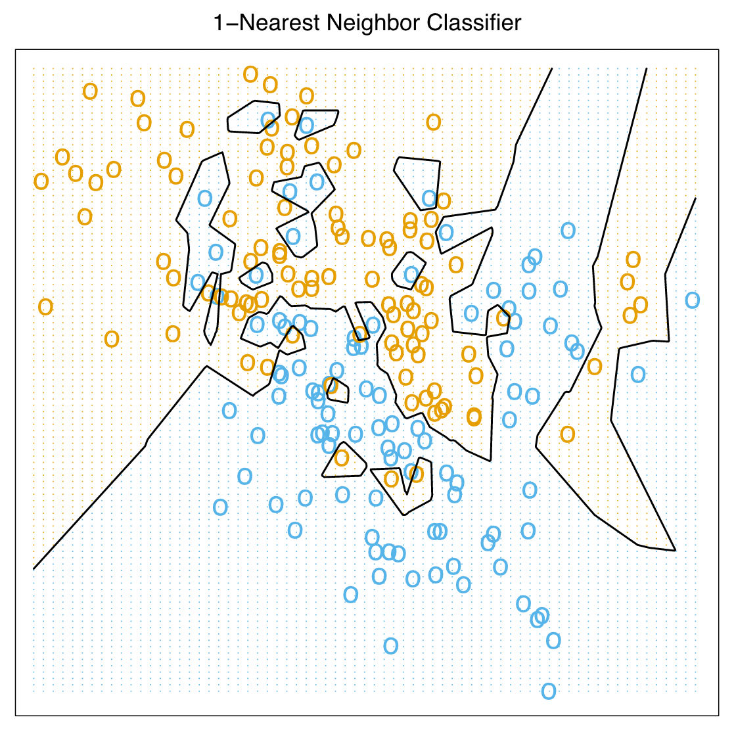
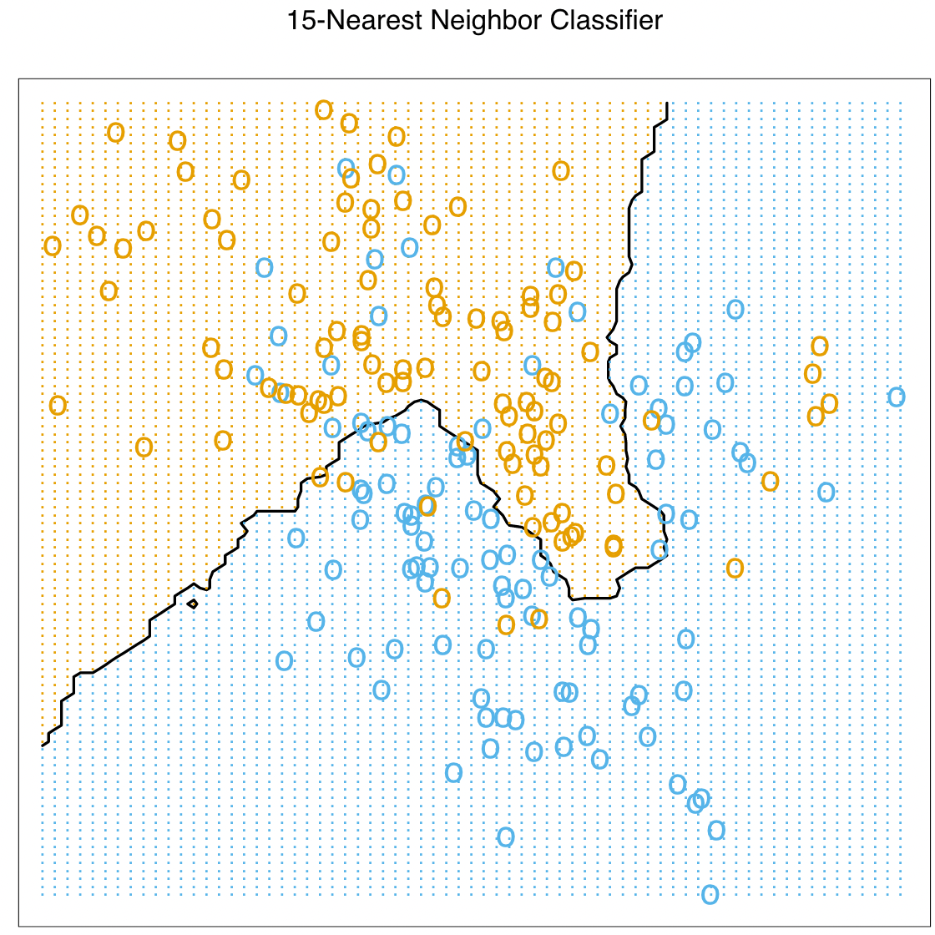
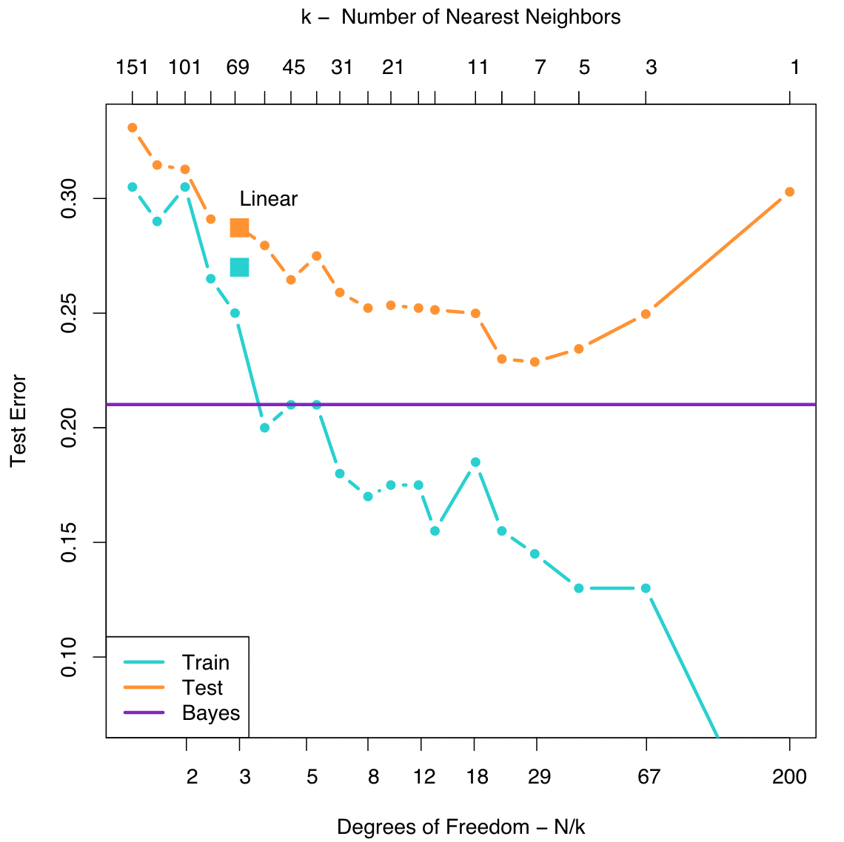
Challenges
Challenges related to data collection
1. Insufficient quantity
2. Non representative
3. Poor quality data
4. Irrelevant features (GIGO)
Challenges related to training machine learning model
Overfitting on training data
Underfitting on training data
Bias Variance Tradeoff
1. Tibshirani, S. & Friedman, H. Valerie and Patrick Hastie. 764.
Notes:
Non –representative : Training data must be representative of new data you want to generalize to !
Irrelevent features : Features that are not correlated with the output, have too much noise, have the same value for all the datapoints are not so much useful for performing a classification or regression task.
K-Nearest Neighbours :
Points of similar class group together.
Here based on each datapoint in the training set we find the ‘k’ nearest neighbours.
In case of overfitting we consider only the 1st nearest neighbors we get this very complex decision boundary function that fits to the noise in the data. This is called overfitting.
By considering more nearest neighbors we get a much more cleaner decision boundary that tries to is close to the optimal decision boundary for separating the blue and orange classes.
We can find the optimal decision boundary by varying our model hyperparameter which is the number of nearest neighbors and compare the classification test error we get in each case.
Higher the value of ‘k’ the more we are approximating our decision boundary until eventually it becomes linear.
By decreasing the value of ‘k’ even further we risk at the chance of overfitting due to increased model complexity.

Slide 35
Common Machine Learning Modules/Toolboxes
Keras
Neural network library.
High-level abstractions, easy to use.
scikit-learn
Designed to work with NumPy and SciPy.
Has basic regression, classification, and clustering algorithms.
TensorFlow
Google’s internal software library for machine learning applications.
Similar to Keras, but a bit harder to use.
Theano
Efficient optimization of mathematical expressions using multi-dimensional arrays.
PyTorch
Based on Torch library (developed by Facebook).
Used for computer vision and natural language processing.
Shogun
Focus on kernel methods.
Originally developed for bioinformatics purposes.

Slide 36
Common Algorithms
Linear Regression
Logistic Regression
Support Vector Machines
Decision Trees
Random Forests
Naïve Bayes Classification
Boosting
Clustering
Principal Component Analysis
Singular Value Decomposition
Independent Component Analysis
Neural Networks
Generative Adversarial Networks
Bayesian Optimization
Gaussian Process Regression

Slide 37
Resources to start on your ML journey !
Textbooks
Machine Learning : A Probabilistic Approach by Kevin P. Murphy
Excellent book that dives right into the math of some common machine learning algorithms
Elements of Statistical Learning by Trevor Hastie and Robert Tibshirani and Jerome Friedman
A more advanced level introduction to machine learning. Skips a lot of the derivation parts. (Not for faint hearted !)
Hands on Machine Learning with Scikit-Learn, Keras and Tensorflow by Aurelien Geron
Great book to start with ! Guided tutorials and explanations to building and training machine learning models without diving too much into the math.
Deep Learning with Python by Francois Chollet
https://www.deeplearningbook.org by Ian goodfellow and Yoshua Bengio and Aaron Courville
Excellent book to follow for building and training neural networks !
Neural net visualization
Tensorflow documentation
PyTorch documentation
Youtube video links by 3Blue1Brown on Deep Learning
But what is a neural network ? | Chapter 1, Deep Learning
Gradient Descent, how neural networks learn | Chapter 2, Deep Learning
What is backpropagation really doing ? | Chapter 3, Deep Learning
Backpropagation calculus | Chapter 4, Deep Learning
Courses at Johns Hopkins for Upper Level Undergraduates
EN.601.475 (01) Machine Learning -> CSE
EN.540.405 (01) Machine Learrning -> ChemBE
EN.601.475 (01) Machine Learning for Medical Applns -> ECE
EN.540.405 (01) Machine Learning : Deep Learning -> CSE
Notes:
Robert Tibshirani is a professor in the department of Statistics and Biomedical data science at Stanford University.
Francois Chollet creator of Keras deep learning library and main contributor to Tensorflow
Ian goodfellow creator of Generative Adversarial Network (GAN).

