Slide 1
EN.540.635 Software Carpentry Lecture 13 A Primer in LaTeX

Slide 2
Introduction
LaTeX is a markup language used to create documents of “high typographical quality”

Slide 3
Word vs LaTeX
Microsoft Word is a “typesetting system” of the type What You See Is What You Get (WYSIWYG), while LaTeX belongs to What You See Is What You Mean (WYSIWYM)

Slide 4
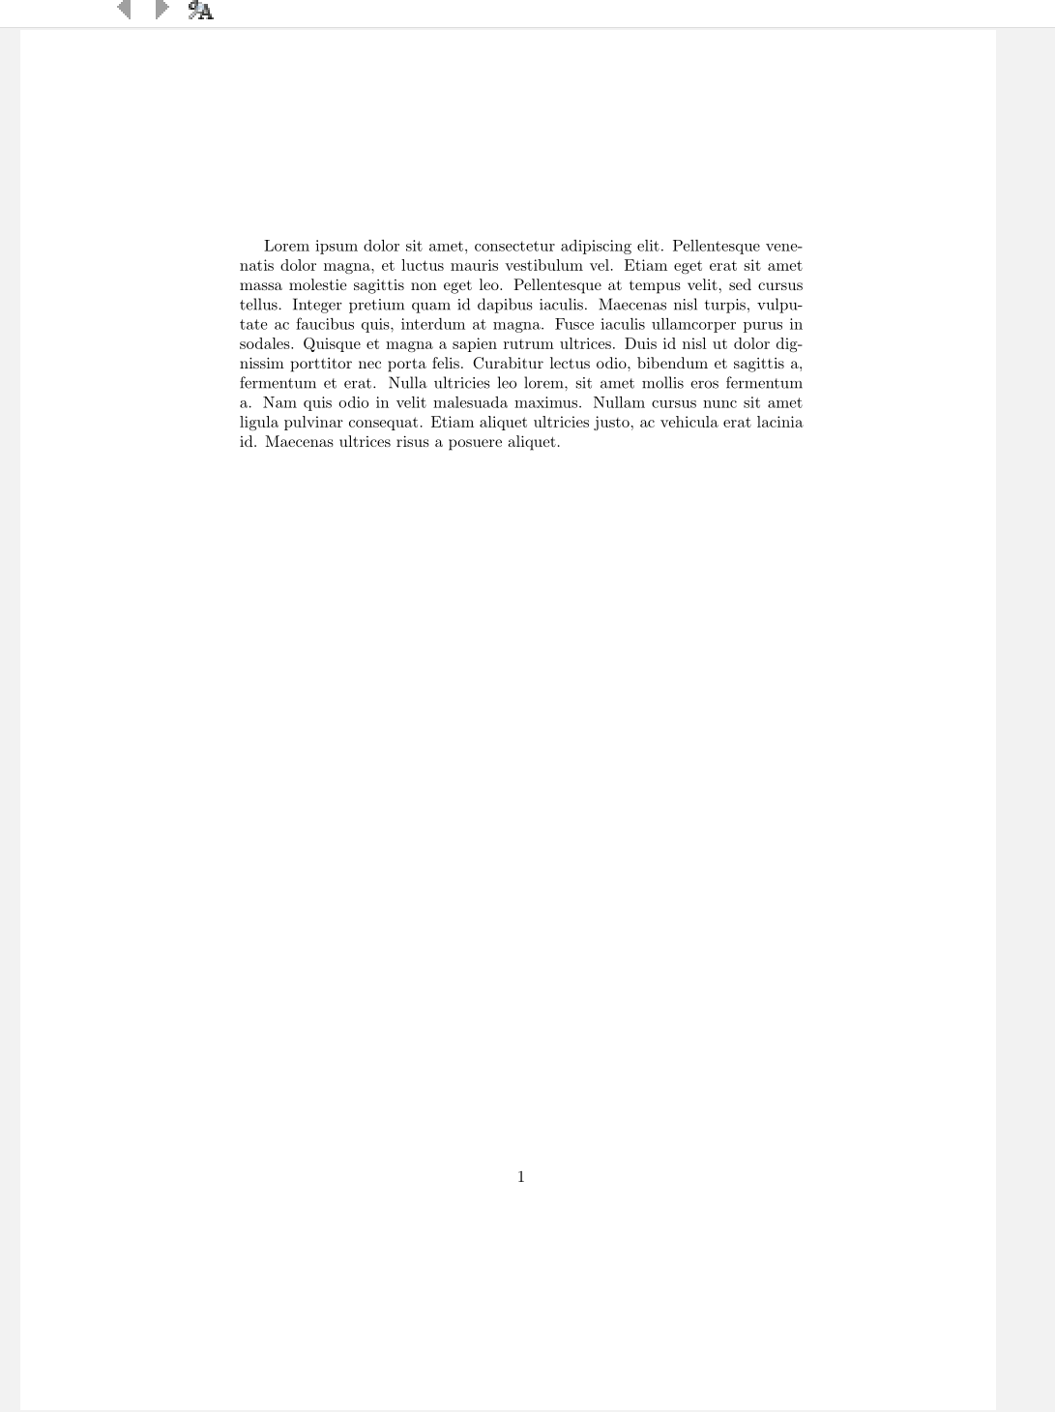
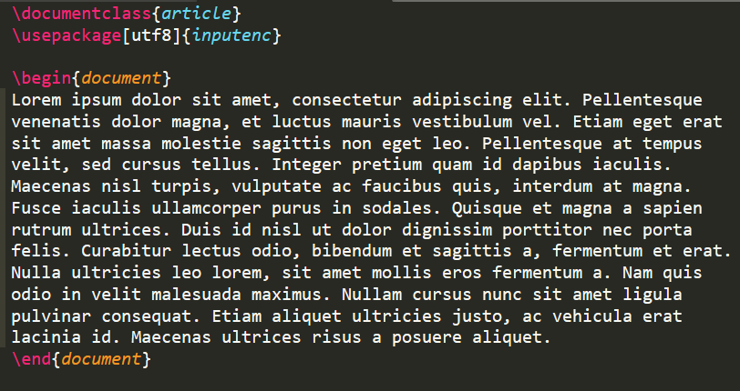
LaTeX- “Code”

Slide 5
Getting Started: Installation
Install a LaTeX distribution:
MiKTeX/proTeXt/TeX Live for Windows
MacTeX for MacOS

Slide 6
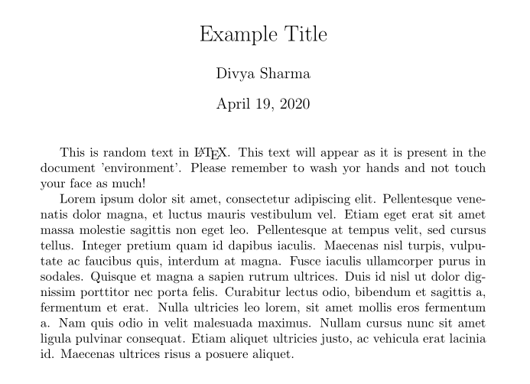
Getting Started: Sublime
Command Palette
Package Control: Install Package
Search for LaTeXTools
Optional: Install SumatraPDF

Slide 7
Getting Started: Overleaf
Online LaTeX editor
https://www.overleaf.com/
Numerous templates for different document types:
CV/Resume
Homework Assignments
Reports
Thesis

Slide 8
LaTeX Document Classes
article – For scientific journals, presentations, etc
IEEEtran – For articles with the IEEE Transactions format
proc – Proceedings
report – Longer reports (chapters, small books, thesis)
book – Books
slides – Slides
memoir – Memoirs
letter – Letters
beamer – Presentations

Slide 9
Basics: Document structure
Preamble
Document “settings”
This text does not appear in the final document
Load extra packages
“Document” environment

Slide 10
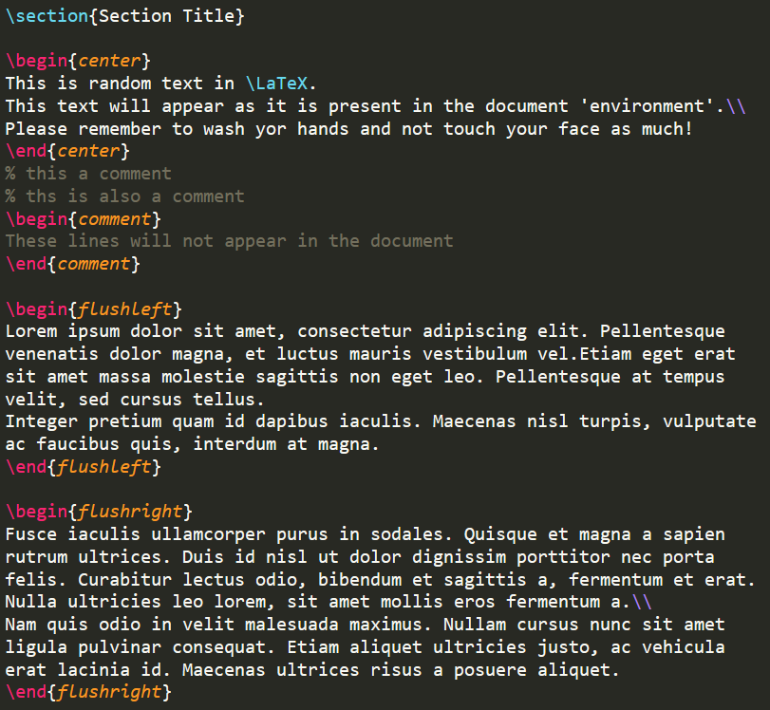
Basics: Text
Paragraphs and Alignment
\begin{center}
\begin{flushleft} or \begin{flushright}
Newlines
‘\\’Comments
Lines starting with %
The ‘comment’ environment
Sections

Slide 11
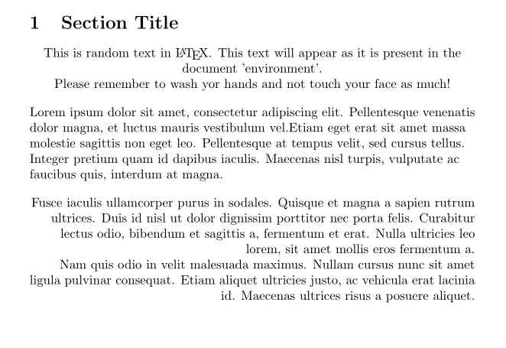
Basics: Text

Slide 12
Basics: Text
Lists
\begin{enumerate}
\begin{itemize}
Font formatting
Font size: \tiny, \small, \large, \Large, \LARGE, \huge, \Huge
Font style:
Boldface: \textbf
Italicized: \textit or \emph
Small Caps: \textsc
Underlined: \underline

Slide 13
Basics: Mathematics
Inline Math should be enclosed within ‘$’ signs
Useful package “amsmath”:
\begin{equation}
\begin{align}
\begin{matrices}
Greek letters: \alpha, \epsilon, \rho, etc
Maths symbols: \int, \oint, \sum, \prod

Slide 14
Basics

Slide 15
Basics: Figures
The package ‘graphicx’ must be used
A figure with the correct path can be included and captioned as follows:
Figures can also be organized by grabbing from a folder!

Slide 16
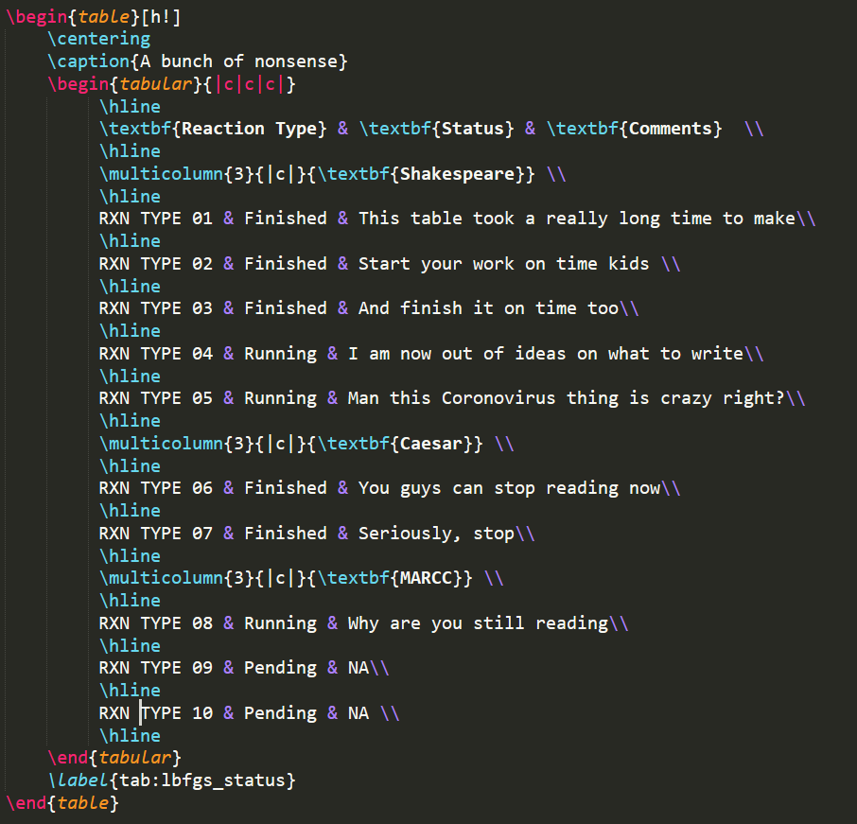
Basics: Tables
Tables can created using the table and tabular environments

Slide 17
Basics

Slide 18
Basics: Citations using Bibtex
Include the correct package for e.g. \usepackage[“settings”]{biblatex}
Make a file with all your bibtex entries
Cite whenever you want with \cite{}
Call:
\bibliographystyle{}
\bibliography{}
Insert the bibliography
Styles Here

Slide 19
Basics: Citations using Bibtex

Slide 20
Advanced and Useful Packages
Make your own commands and environments (\newcommand)
Redefine a previously existing command (\renewcommand)
Make plots and figures in LaTeX (\usepackage{tikz})
Embed/import code from file into TeX file (\usepackage{listings})
Fancy headers and footers (\usepackage{fancyhdr})
Hyperlinking (\usepackage{hyperref})

Slide 21
Resources
https://www.overleaf.com/learn/how-to/Creating_a_document_in_Overleaf
https://en.wikibooks.org/wiki/LaTeX/Introduction
https://www.latex-tutorial.com/

