Slide 1
EN.540.635
Software Carpentry
Lecture 2
Linux | SSH & SCP

Slide 2
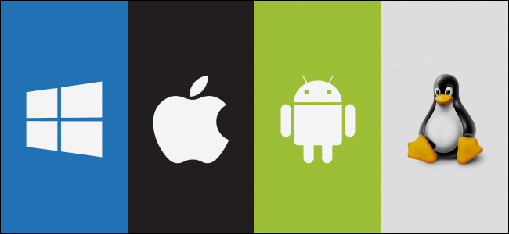
Operating System
Software that allows the user and the application on a computer to interact with the computer hardware
Common components include:
  Kernel
  Networking
  Security
  User Interface
… and many others.

Slide 3
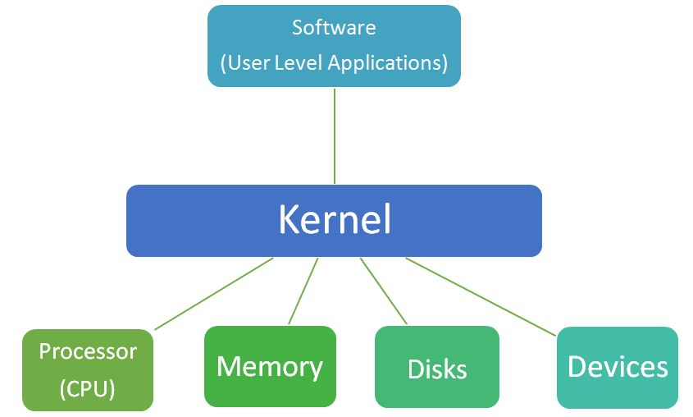
Kernel
It is the central component of an Operating System
The kernel performs the following tasks
  Process Management
  Memory Management
  I/O requests/ System Calls
  Device Management

Slide 4
You switch on your computer …
The CPU executes firmware code stored in non volatile memory.
  Examples of firmware code are BIOS and UEFI.
Fimware locates the OS specific bootloader.
Bootloader locates the kernel file on storage device and unzips it
Kernel loaded into the RAM file.
Last action by Bootloader : call kernel’s main() function.
Kernel takes over control and you see the login page.
Ref : OpenCSF.
Notes:
Firmware : A hardware component of a motherboard that can persistently store small pieces of code. Non – volatile memory : Read Only Memory (ROM)
BIOS : Basic Input Output System
UEFI : Unified Extensiable Firmware interface
Bootloader : Piece of code responsible for locating and initializing the kernel. Bootloader also responsible for dual booting.
Linux – GRUB , Windows – BOOTMGR , MacOS – BootX

Slide 5
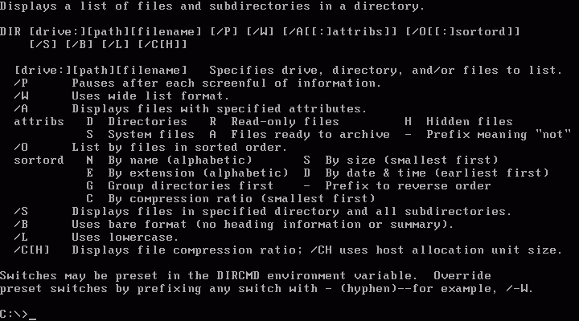
MS DOS
Source Code
Notes:
MS-DOS first OS released by Microsoft in August 1981.
Built off of 86-DOS code written by Tim Paterson
Microsoft needed an operating system for the IBM personal computer. Hired Tim Paterson in 1981 and bought 86-DOS for $25,000. Rebranded it to MS-DOS.
Designed specifically to run on microprocessors using the 8086 instruction set.
After release of Windows 3.0 in 1990 marked the end of the command line driven OS.

Slide 6





The Linux Kernel
An Open-Source Kernel, released by Linus Torvalds on September 17th, 1991
Common “Linux” operating systems:
Ubuntu
CentOS
Fedora
Debian
Arch Linux

Slide 7
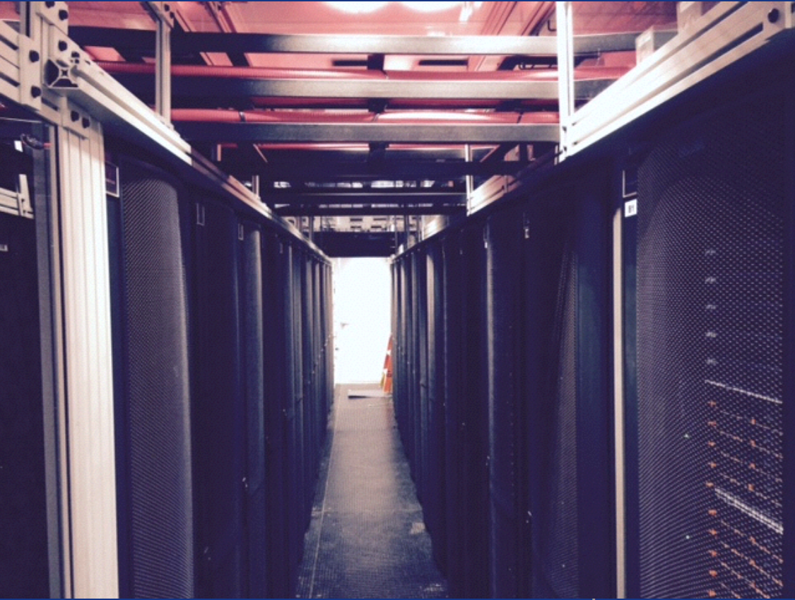


ARCH: Rockfish
Advanced Research Computing at Hopkins
arch.jhu.edu

Slide 8
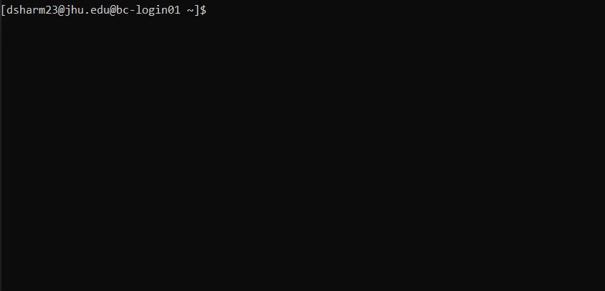
Linux Command Line (Terminal): Bash Shell
The ‘shell’ is part of the OS that allows the user to directly interface with the kernel
Linux commonly uses the bash shell (stands for ‘Bourne again shell’)
Can change your default shell by typing
chsh –s /bin/shell_name

Slide 9
Common Commands
Command | Description | Usage
ls | List files in current folder | ls; ls –l; ls -la
cd | Change directory | cd ..; cd <name_of_dir>
mkdir | Create Directory | mkdir <name_of_dir>
cat | Returns content of file as output | cat <fptr>
head | Returns the beginning few lines of a file | head <fptr>; head –n <no_of_lines> <fptr>
tail | Returns the last few lines of a file | tail <fptr>; tail –n <no_of_lines> <fptr>
rm | Deletes file/folder | rm <fptr>; rm –f <name_of_dir>
touch | Create or change timestamps of a file | touch <name_of_file>
Commands are case sensitive!
https://explainshell.com

Slide 10
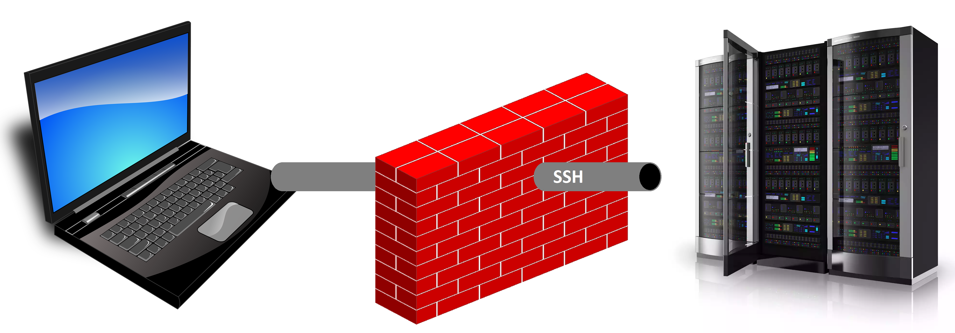
Networking: SSH and SCP
Secure Shell (SSH) is a cryptographic network protocol for operating network services securely over an unsecured network.
SCP (secure copy) is a command-line utility that allows you to securely copy files and directories between two locations.

Slide 11
Connecting using SSH and SCP
Open up a terminal
Use the SSH command as follows
Use scp to Download or upload files as follows

Slide 12
Instructions
Make sure you have SSH capability in your laptop either using terminal or an SSH client
For the next Homework, make sure you have python 3.10 set up
You should be able to run saved python scripts, either from the terminal or using an IDE

