Slide 1
EN.540.635 Software Carpentry Lecture 3 Introduction to Python (Hello World, Variables, Conditionals, Loops, and Functions)

Slide 2
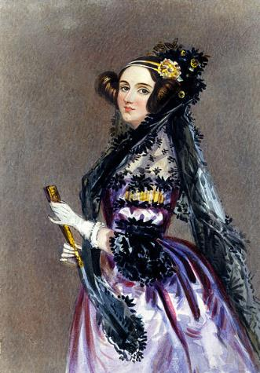
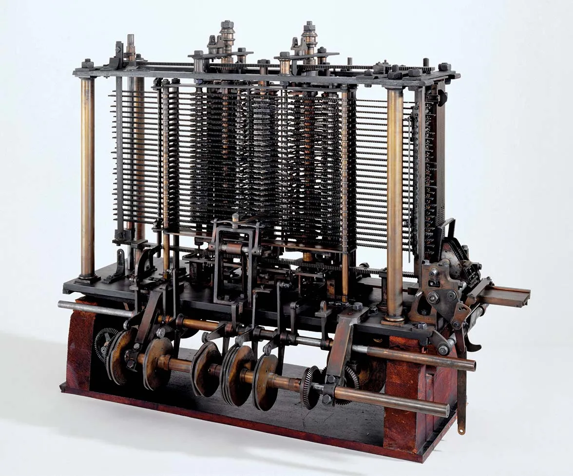
The First Computer Programmer
Image credits : Britannica
Notes:
Augusta Ada King-Noel, Countess of Lovelace (10 December 1815 – 27 November 1852)
English mathematician and writer, and published the first algorithm intended to be carried out by a machine. Wrote an algorithm to compute Bernoulli numbers on the Analytical Engine.
Sadly engine was never completed and algorithm was never tested.
Charles Babbage adopted the use of punched cards around 1830 to control his Analytical Engine.

Slide 3
What is Programming?
The ability to define a set of instructions for a non-living device to carry out.
Examples:
Joseph Marie Jacquard – Loom that weaves differently depending on input.
RoboCup – Robot Soccer!
Computer programs.
Application Development (apps on phones/laptops).
Notes:
The Jacquard loom, which Joseph Marie Jacquard developed in 1801, uses a series of pasteboard cards with holes punched in them. The hole pattern represented the pattern that the loom had to follow in weaving cloth. The loom could produce entirely different weaves using different sets of cards.

Slide 4
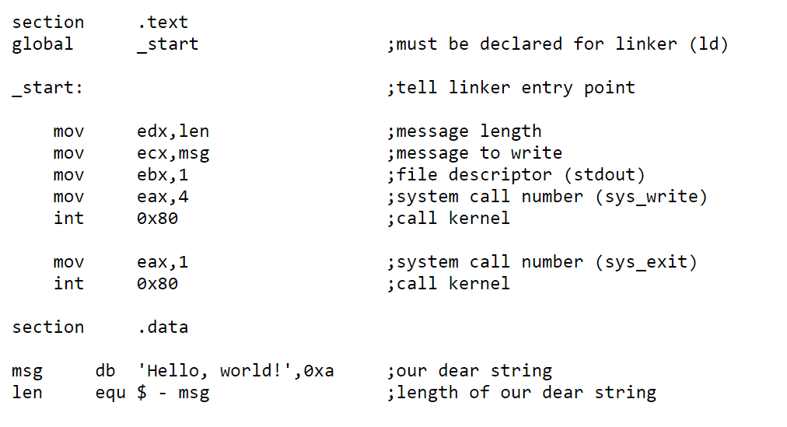
Computer Programming
Scripting Languages
High Level Languages
GATE
Low Level Languages
Assembly Language
Dielectric
Source
Channel
Drain
Machine Code (Binary/Hexadecimal)
Notes:
Machine code (machine language) – usually written in binary, lowest level of software.
Assembly language – strong correspondence between commands and machine code instructions. An assembler is used to convert assembly language to machine code.
Low-level language – Low level of abstraction, procedural (at first, C was considered a high-level language. Now, it is considered to be low-level).
High-level language – High level of abstraction (OOP), uses a lot of common computer science concepts (easier to understand than machine code, but less efficient)

Slide 5
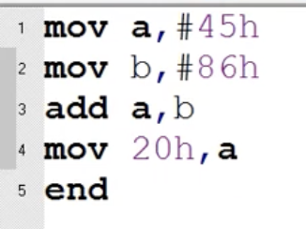
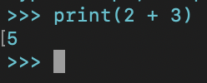
Computer Programming
Task : Add 2 + 3
In Binary
In Assembly
In Python
$$2→10$$
$$3→11$$
$$5→101$$
Notes:
Machine code (machine language) – usually written in binary, lowest level of software.
Assembly language – strong correspondence between commands and machine code instructions. An assembler is used to convert assembly language to machine code.
Low-level language – Low level of abstraction, procedural (at first, C was considered a high-level language. Now, it is considered to be low-level).
High-level language – High level of abstraction (OOP), uses a lot of common computer science concepts (easier to understand than machine code, but less efficient)

Slide 6
Computer Programming
How does Python behave differently from C++?
Hello.cpp
GCC
Hello.o
GCC
Hello.exe
Hello.py
python
Hello.pyc
Notes:
GCC – GNU compiler collection
.o file – object file (essentially contains low-level machine code)
The rules of how Python as a language should operate is defined in a reference manual.
The rules of the language can be implemented in many ways using different languages. The official implementation however is Cpython. Which is the one that gets downloaded from the Python website.
The compiler reads your code and creates Python bytecode file (.pyc) . The Python bytecode contains machine readable instructions and is executed by a virtual machine.
Think of it as a bridge between source code and machine execution. Not platform specific.
python interpreter – reads python code and executes it (compilers do not execute code)
.pyc file – contains compiled bytecode

Slide 7
Hello World!
Python hello world in terminal
Notes:
Give example of writing python directly in the python interpreter (within the terminal/command prompt). Discuss whitespace.
Give example of .py file
File extensions
Comments

Slide 8
Variables
int – An integer (-2, 3, 0, 1230, …)
float – A floating point number (3.234, -1.312, 68.342, …)
str – A sequence of characters that we want to let the program know is text
“This is a string”
“3.233”
Special cases of str (quotation marks):
“\”Hello World\”” will let you print Hello World with “ ”
‘”Hello World”’ will do the same thing!
Notes:
Ints, floats, and strings
Type() function
Typecasting
Appropriate variable names

Slide 9
Variables
Lists are arrays (think back to math, <x1, x2, x3, …, xn>)
Lists can hold any kind of variable! This is a nice way of storing data!
Quickly make ranges of data using the range function:
Note, in Python 3, range returns a generator, not a list. We can use typecasting to change the variable type.

Slide 10
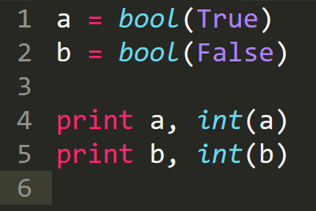
Variables
Booleans:
A bool holds one of two values: True or False
Casting to an integer, it holds: 1 or 0
Booleans help us simplify logic using conditionals such as:
If …
If … else…
If … elif… else…
If … elif … elif … elif … (etc…) … else …

Slide 11
Conditionals
Joe and Jenn are in prison, trading letters in secret. Using a computer, they have access to functions like “send_letter()” and “is_guard_watching()”. How do they write their code to only send a message when the guard is not looking?
Hint – You can invert a bool with the not keyword. That is:

Slide 12
Loops
What if we want to print the lyrics to “99 bottles of beer on the wall”?
We can print them out entirely.
OR
We can be lazy (like good programmers) and print out using a loop!
Loops:
While loops
For loops

Slide 13
While Loops
Examples of “some_condition”
var1 < var2
bool returned from a function (like “is_guard_watching”)
Notes:
Also show while True:

Slide 14
For Loops
range(0, 100) is a function that returns the list [0, 1, 2, 3, …, 98, 99]. NOTE! It is only lower-bound inclusive. That is, it gives the list [0, 100).
Examples of other “ranges”
Lists (of any data type): [“a”, “b”, “c”, “d”]
Dictionaries (of any data type)

Slide 15
Loops
Looping is vital to coding!
Loops help remove tedious tasks from data manipulation.
Loops let us do iterative algorithms.
Fun case:
Joe and Jenn can’t keep re-running code until the guard isn’t watching, that would be suspicious! Let them enter the code into a loop instead!

Slide 16
While Loops

Slide 17
For Loops

Slide 18
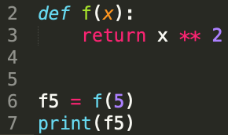
Functions
A block of code that only runs when it is called.
It can have input arguments that you specify and can also have an output result.

