Slide 1
EN.540.635 Software Carpentry Lecture 4 More Python Basics and the Python Imaging Library

Slide 2
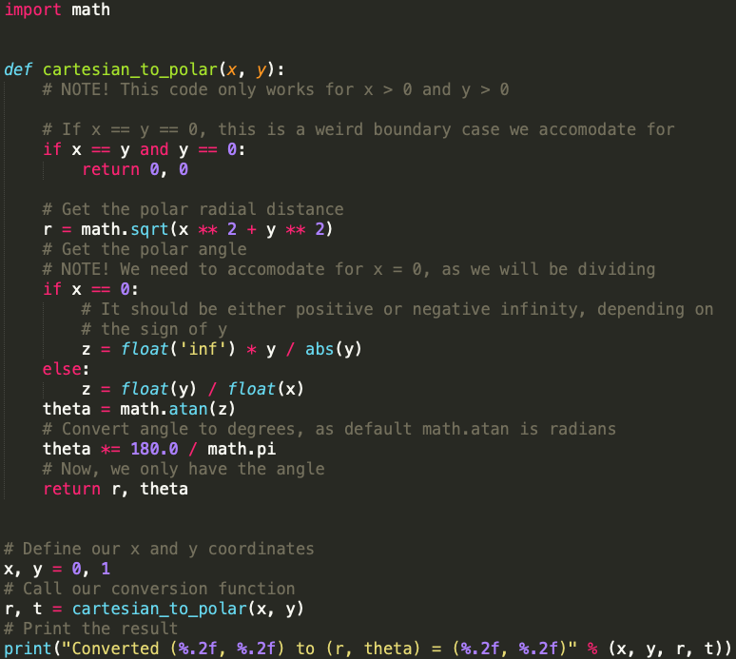
What We’ve Covered So Far…
Variables
Conditionals
Loops
Functions
To be covered:
Code readability
PEP 8
Python Imaging Library

Slide 3
Code Readability
It is important that your code runs as intended, but it is also important that your code can be easily understood by others.
Important things that can improve the readability of your code:
Good variable/function names
Good code organization
Comments and docstrings
Proper code formatting
Notes:
Tom Scott – the Consequences of Your Code: https://www.youtube.com/watch?v=LZM9YdO_QKk

Slide 4
Variable and Function Names
Variable names should be as short as possible while still properly conveying what data the variable holds.
Avoid using indistinguishable characters as single-character variable names (“l”, “O”, “I”).
It is common practice to use all lowercase characters, with words separated by underscores for both variable and function names.
The example code on slide 2 is a good example of proper naming.
Notes:
Certain constant values or flags can be written in all uppercase letters.

Slide 5
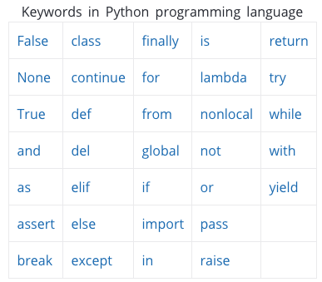
Python Keywords
Python has a list of keywords that are commonly used in code.
These keywords cannot be used as variable or function names:

Slide 6
Code Organization
“I have always felt that programming is telling a computer a story. If your story is good, the computer will execute it efficiently, if the story sucks, the execution sucks. I write code like I would write a technical paper, it has direction and flow, and you can tell when you have reached the conclusion of the story.”
- from Dan Bader’s Python newsletter
Simple code organization strategy for a Python script:
Import statements
Functions
The main code you want to run
(again, the example code on Slide 2 is a good example).

Slide 7
Comments
Explain what your code is doing!
For yourself:
If you have to go back to code you’ve written a long time ago, it is good to have good comments so you can easily remember what your code does.
For others:
Writing code can be a collaborative experience.
It is important that other people can easily understand your code.
Rule of thumb: use good variable and function names, and then add comments when necessary.

Slide 8
Docstrings
Documentation strings (docstrings) are comments for functions, with a specific format:
What does the function do?
What values need to be input to the function?
What are the output values of the function?
Simple functions (1 or 2 lines) only need a quick description. Longer functions should have a description, along with the required inputs and outputs.

Slide 9
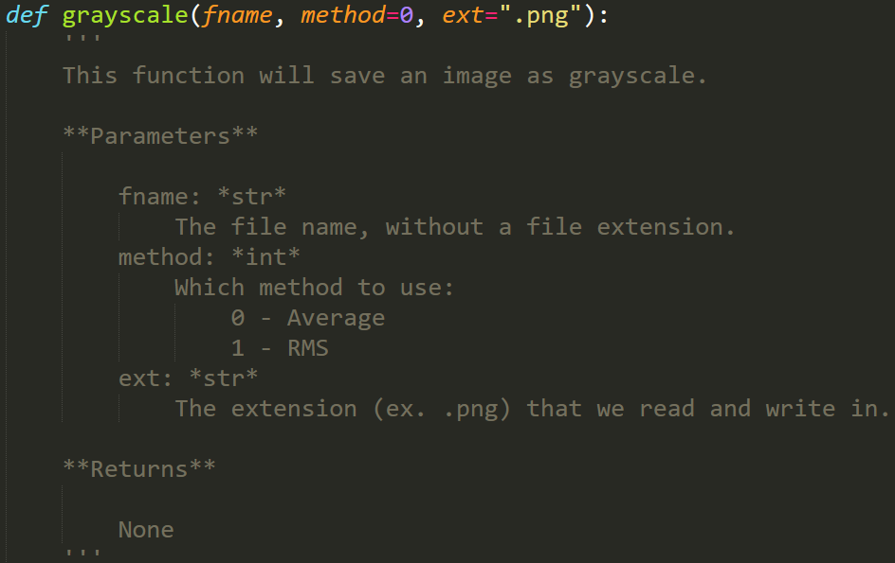
Docstrings
Description
Input Parameters
Output Values

Slide 10
PEP 8 Styling
PEP 8 is the agreed-upon style guide for how to format Python code.
The main purpose of a style guide is to have good readability and consistency.
A lot of rules regarding:
Indentation
Blank lines
Whitespace
Comments
Naming Conventions
Pretty much everything discussed in the previous slides is part of PEP 8 styling.
Notes:
https://www.python.org/dev/peps/pep-0008/
(Python Enhancement Proposal)

Slide 11
PEP 8 Styling
There are a lot of rules to remember, and it can be annoying to have to worry about formatting things when you are writing code.
Linters – tools that analyze code and flag for programming errors and formatting issues.
Many text editors geared towards programming have linters built into them.

Slide 12
Linters in Sublime
If you install the Anaconda package in Sublime Text, it comes with a linter and a tool to help with automatic formatting.

Slide 13
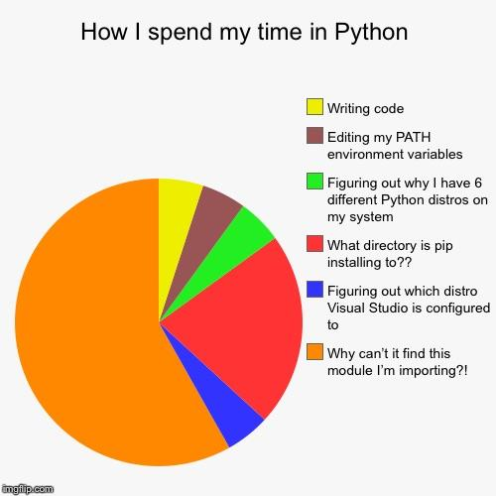
Python Modules
Python has many existing libraries that are available for us to use (especially if we’ve downloaded Anaconda).
A module is a file with Python definitions and statements that we can use for our own code.
Some examples include math, random, PIL, …

Slide 14
Python Imaging Library
This library is useful for image processing and manipulation using Python. It contains several different modules, each with its own functions.
The module we will be focusing on is the Image Module:
Opening images
Manipulating images (at the pixel level)
Creating new images
Saving images
Notes:
http://omz-software.com/pythonista/docs/ios/PIL.html
https://pillow.readthedocs.io/en/stable/reference/Image.html

Slide 15
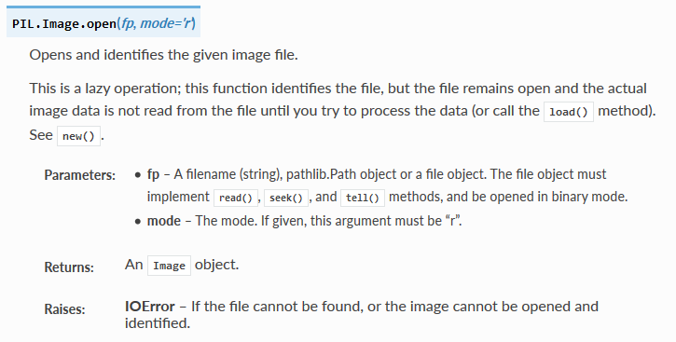
Python Imaging Library: Opening an Image

Slide 16
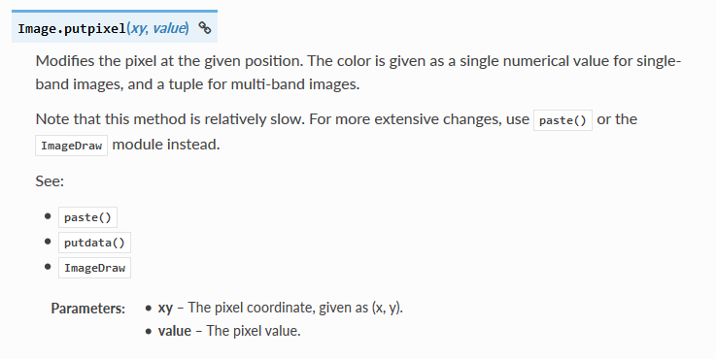
Python Imaging Library: Pixel Manipulation

Slide 17
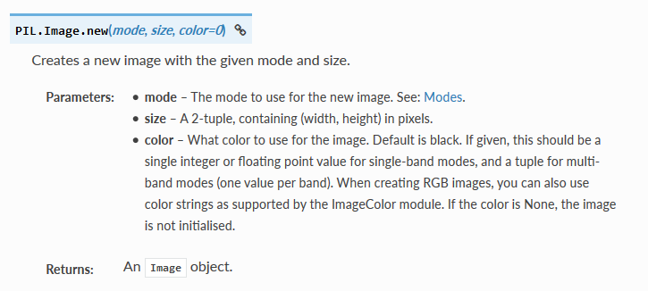
Python Imaging Library: Creating a New Image

Slide 18
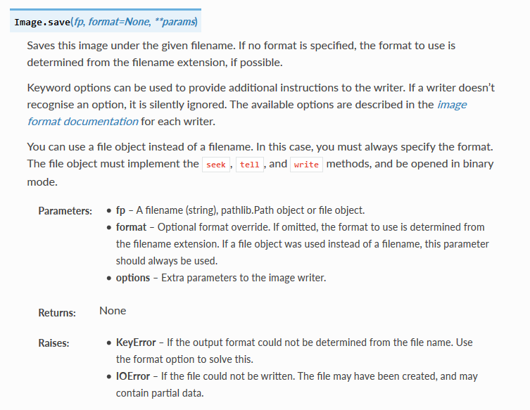
Python Imaging Library: Saving an Image

Slide 19
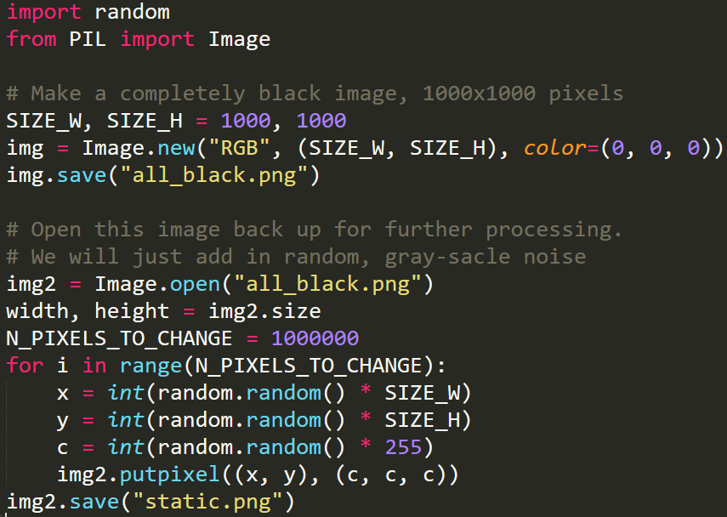
Basic Example

Slide 20
Basic Example
all_black.png
static.png

