Slide 1
EN.540.635 Software Carpentry Lecture 5 Modular Arithmetic | RSA Encryption | Exceptions
Notes:
In today’s lecture, we will be talking about another python data structure called Dictionaries. A certain type of binary operation between integers called the modulo operation. And finally we will also be talking about some of the different types of errors that pop while writing code, how to debug them or catch them to make sure that your program is working correctly.

Slide 2

Encryption
Use a key to encode your data so that only those with the keys can decode them. The encoded data is then impossible to comprehend/read unless it is decoded.
A “secret” encryption key, produced using algorithms can unscramble the data and is only in the possession of the user and the recipient
Notes:
So we’ll be applying our brand new knowledge on modular arithmetic and try to apply it and write functions that extensively use it on a topic called encryption.
While using the internet a lot of personal information is sent and received that we would rather not fall into the hands of certain ‘unsavory’ individuals and prevents interference from people who could potentially intercept our data. Only authorized people are able decipher what the actual data is. Encryption therefore is a technique that is used to modify your information or data such that other people would not be able to understand the true form of the data. Encrypted data that is not meant for you looks like gibberish, but can only be decrypted by the right person. The idea behind encryption is…
We want to look into encryption and try an reproduce it on a smaller case. This application will allow you to become familiar with a lot of programming concepts and build up your knowledge and skills.

Slide 3
RSA Encryption
It is a type of asymmetric encryption and uses 2 different keys
Implementation:
One key you can use to encode a message
One key you can use to decode a message
Make it such that if key 1 encodes, key 2 decodes, and the other way around.
Keep key 1 private and secure (we will call this your private key)
Share key 2 with websites/servers you trust (we will call this your public key)
Notes:
Encryption is done via an algorithm and there are many different ways someone could encrypt information. One key thing to keep in mind is that it should not be easily breakable. At the same time, it should be able to be decoded. One such algorithm is RSA. Here are some of the properties of RSA encryption.
For example you have a text file that contains your personal diary entries. You obviously do not want the raw text of the file to be readable to anyone who gets their hands on it. Therefore the message in this case would be the contents of the text file, loaded as a string. Using the first key, this string would be encoded using the RSA algorithm into a list of numbers. If someone encounters these numbers, they would not be able to discern your deepest darkest secrets. Using the second keys, the list of numbers can then be reconverted back to the original text.

Slide 4
RSA Encryption
Goal:
Devise a key that encodes and decodes a message.
Challenges:
What does encoding and decoding actually mean?
Turning letters and symbols into numbers. How?
What mathematical property can we take advantage of?
The easiest way of handling problem 1 is to simply enumerate the characters and symbols. This has already been done and is known as ASCII encoding!
Notes:
So on this program that we want to write, we will implement the RSA encryption algorithm. Encryption would convert the string or any important data into a bunch of numbers. And decryption would convert them back to the correct or original value. In order to achieve the first step, we need a mapping from all the letters in the English language (on a larger scale we would need a mapping of all kinds of characters that we expect to encounter while implementing the algorithm depending on who we are providing our encryption services to). One such mapping that already exists is called ASCII encoding.

Slide 5
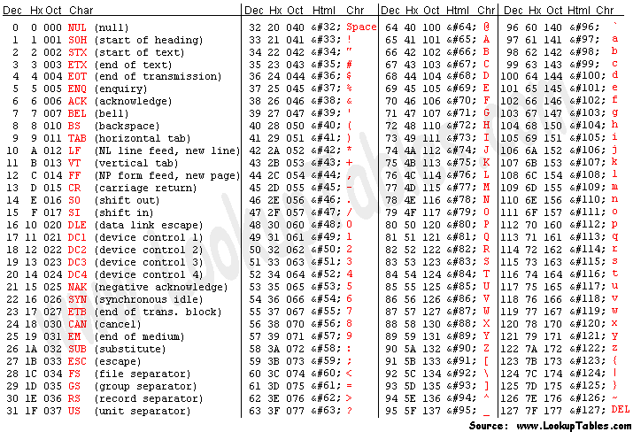
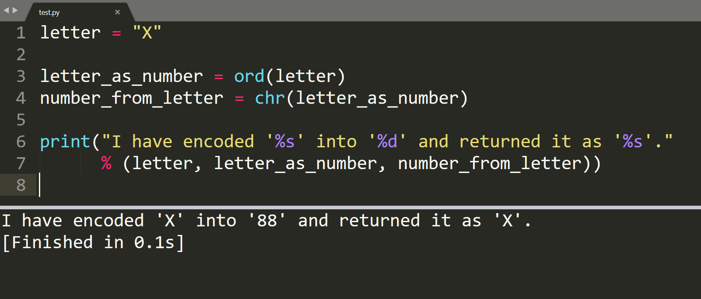
ASCII
ord() will return the unicode code of a unicode character
chr() will return the unicode character of a unicode code
Ref : https://www.vertex42.com/ExcelTips/unicode-symbols.html
Notes:
ASCII encoding maps the letters of the English alphabets and some more commonly encountered specia characters to numbers. The mapping starts off with the special characters followed by the numerical digits. The capital letters of the English alphabet start at 65 and then the lowercase letters start at 97.
DEMO

Slide 6
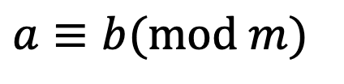

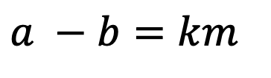
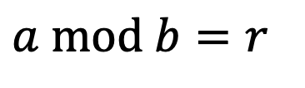

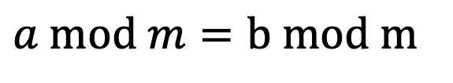
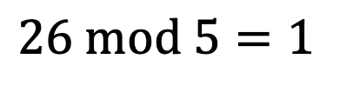
Modular Arithmetic
$$a=q∗b+r$$
In python we can get the remainder using the ‘%’.
$$26\%5$$
$$a mod b=r$$
$$26 mod 5=1$$
Congruence Modulo :
$$a −b=km$$
written as
$$a≡b(mod m)$$
Congruence Modulo asserts that ‘a’ and ‘b’ have same remainder when / by m
$$a mod m=b mod m$$
https://en.wikipedia.org/wiki/Modular_arithmetic#Congruence
Notes:
‘m’ is the divisor of the difference between ‘a’ and ‘b’. In this case we have no remainder.
Consider a = q1m + r1 and b = q2m +r2 then
a – b = km
q1m + r1 - q2m - r2 = km
(q1 – q2)*m + r1 – r2 = km
r1 = r2

Slide 7
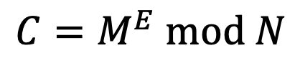
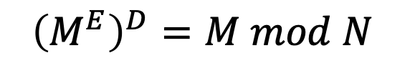
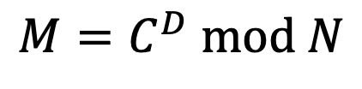
RSA Encryption
To encrypt a message in RSA do the following operation :
$$C=M^{E} mod N$$
To decrypt a message in RSA do the following operation :
$$M=C^{D} mod N$$
We can simplify and write as follows:
(E, N) -> Public key
$${\left(M^{E}\right)}^{D}=M mod N$$
(D, N) -> Private key
Challenge : How to find E,D,N such that the above equation holds ?

Slide 8

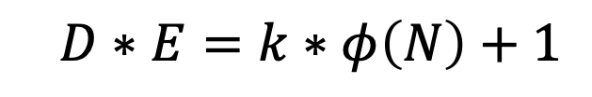
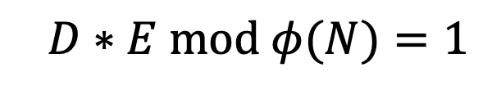
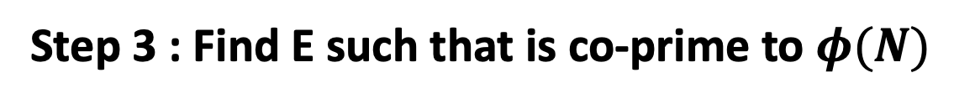
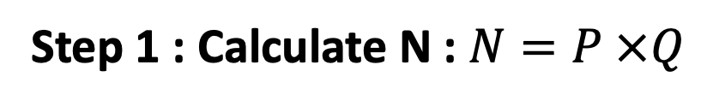
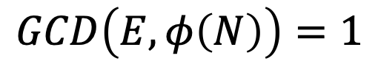
RSA Encryption: The Keys
Step 1 : Calculate N : $N=P ×Q$
Choose large P & Q. Can only encode ASCII character encoding < N
Step 2 : Find number of co-primes to N
$$φ\left(N\right)=φ\left(P\right)∗φ\left(Q\right)=\left(P−1\right)∗(Q−1)$$
Euler’s $φ$ function
Step 3 : Find E such that is co-prime to $φ(N)$
$$GCD\left(E,φ\left(N\right)\right)=1$$
Step 4 : To find D we want the following condition to be satisfied :
$$D∗E=k∗φ\left(N\right)+1$$
$$D∗E mod φ(N)=1$$
For some integer ‘k’
https://www.cryptool.org/en/cto/rsa-step-by-step/
Notes:
P and Q should be chosen at random, be large and have a big difference. These numbers should be kept as secret.
Co primes (also called relative primes) are integers which have only 1 as the greatest common divisor. This is usually represented by $φ(n)$. Ex : $φ\left(12\right)=11,7,5,1$
E is free to choose.
If you do not understand every detail behind the steps and why these specific steps results in the previous property being satisfied, it is not important. The maths behind this, if you are interested, is detailed a little bit more in the handout related to the weekly challenge. It is sufficient to know that if you follow these steps, you arrive at 3 numbers N, E and D that can be used to encrypt and decrypt messages.
Class Demo for key generation – Nice segway into lab on Tuesday and Weekly Challenge
Take any two primes to start off with : P=13,Q=29 (Code hint : Need to write function that checks for primes)
N = 377
$φ\left(N\right)=\left(13−1\right)∗\left(29−1\right)=12∗28=336$
E = 11 (Code hint : prime factorize $φ\left(N\right)$ and select any prime not in the factorization as E)
$D=\frac{(9∗336+1)}{11}=275$(Code hint : Iterate through ‘k’ until you get an int)

Slide 9



RSA Encryption
If we take $M^{E}$ or $M^{D}$, we can see that this value will be incredibly large.
To handle this, and to make it even harder to brute force, let’s also have an N that is incredibly large. We can generate N as the multiple of two large prime numbers, P and Q
For a particular N, E, D
‘Message’
‘Message’
ASCII
Encoding (‘ord’)
ASCII
Decoding (‘chr’)
$$C ≡M^{E}(mod N)$$
M$≡C^{D}(mod N)$
Encryption
Decryption
Notes:
This is what the flow chart of encryption and decryption looks like. You will be implementing the RSA encryption algorithm step-by-step during this lab and ultimately submitting it as a homework assignment. While this does seem like a abstract task still, the problem statement will further be broken down into smaller units and then different parts of it will connect and give you the end result.

Slide 10
RSA Encryption: Example
Let M be a letter to encrypt: M = ord(‘x’) = 120
Encryption method: C = ME % N
Decryption method: M = C^{D} % N
Ex.
E = 7 D = 10103 N = 17947
M = 120 encodes to C = 11262
We get M back from C by 11262¹⁰¹⁰³ % 17947
Notes:
Here is an example of what encrypting would look like on a single letter of your message. You would repeat this for all letters in the message to encode the entire message.

Slide 11
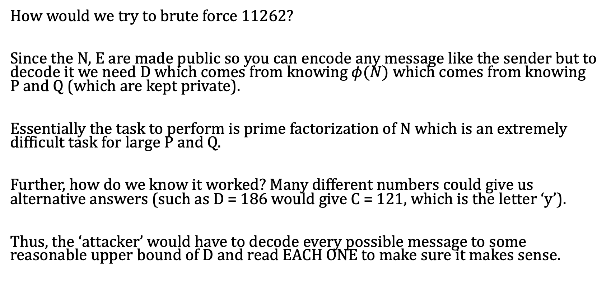
RSA Encryption: Why it works
How would we try to brute force 11262?
Since the N, E are made public so you can encode any message like the sender but to decode it we need D which comes from knowing $φ(N)$ which comes from knowing P and Q (which are kept private).
Essentially the task to perform is prime factorization of N which is an extremely difficult task for large P and Q.
Further, how do we know it worked? Many different numbers could give us alternative answers (such as D = 186 would give C = 121, which is the letter ‘y’).
Thus, the ‘attacker’ would have to decode every possible message to some reasonable upper bound of D and read EACH ONE to make sure it makes sense.
Notes:
- Usually P and Q are 2048 long binary numbers.
If someone really, really wants to get access to sensitive information they can generate there own triplets of N, E and D and try to ‘brute force your message’. This is the reason that it is recommended that P and Q be random large prime numbers. This results in large values for the triplets.

Slide 12
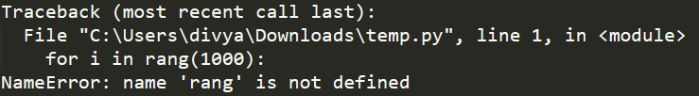
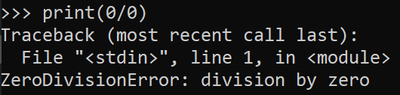
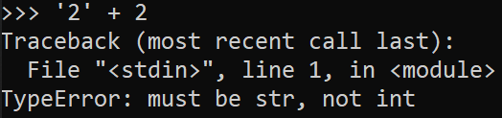
Syntax Errors vs Exceptions
SYNTAX ERRRORS:
When the python compiler encounters a wrong statement while parsing through a script and therefore cannot be executed
EXCEPTIONS:
Our code is syntactically correct
Errors caused when an attempt is made to execute it
Informs what type of exception that you have run into
Built-in exceptions as well as self-defined exceptions
Notes:
Now that you are going to be writing bigger programs different segments that build off of each other, it is also a good idea to get a better idea of the different types of errors that you might encounter in the way. Understanding errors will help you to be better and faster at debugging them. The first type of error that you might see of if you just use the wrong command. How do you tell what’s wrong. In the case of sublime text or other IDEs there will be section of the screen that will describe what wen wrong. For example it tells you that the error is in line 1 and the type of error is a NameError because it doesn’t know that rang is.
Apart from errors, you will also encounter exceptions. These occur when you’ve types everything correctly but you’ve used it wrong or you’ve used it ina way that it was not expecting to be used. For example if you have variables a and b, and you try to calculate a/b. The syntax is still correct. But during execution, if it turns out that the denominator is 0, it will exit out of the program and tell you that you made try to divide by 0, which cannot be done.

Slide 13
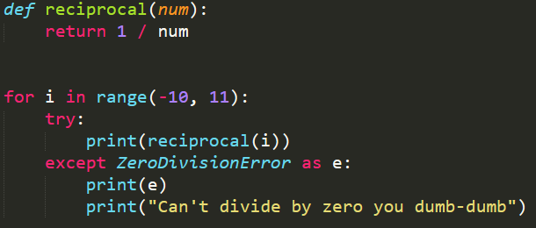
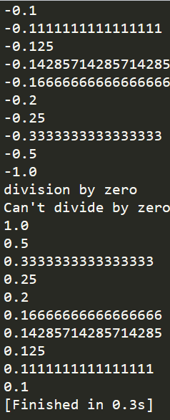
Exception Handling
The ‘try-except’ block can be used to catch and handle select exceptions
It is not good programming practice to use an all encompassing ‘except’ clause as it may bypass a critical issue in the logic of your code
Notes:
While you are writing bigger programs you need to be able to account for the kinds of exceptions that you expect the application or program to run into. For example, you wrote a program that is a calculator app and requires user input. The user input the values 1 and 0 for a division operation. Your program should be robust enough that it will not crash when it runs into such errors. It should return something informative to the user on what the did wrong while using the program.
This is done using the try/except block.
DEMO

Slide 14
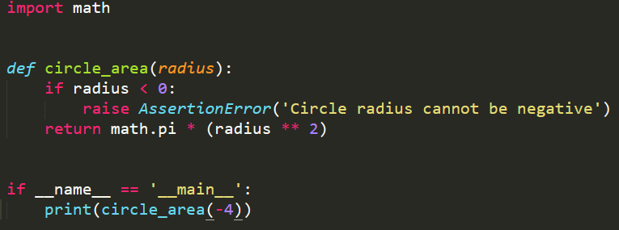
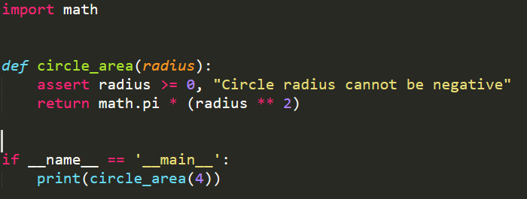
‘raise’ and ‘assert’
‘raise’
Manually throw/raise an exception if a defined condition is met
Avoid throwing generic exceptions
Try to be as specific as possible
‘assert’
Create debug messages when a condition is not specified
Throws ‘AssertionError’
Useful for debugging
https://docs.python.org/3/tutorial/errors.html
Notes:
In some cases, you might want to wrote your program such that you make sure that all the different components in a function are exactly what they should. You would like to assert that they are as expected and if not you would like to raise a warning or ‘AssertionError’ to warn the user that something is wrong. For example in this case, even though the function circle area will technically return a value, negative radius values do not make sense. As such the programmer wrote that program in such a way that negative values for the radius parameter are not accepted.

