Slide 1
EN.540.635 Software Carpentry Lecture 6 Functions, Classes, and Graphing with Matplotlib

Slide 2
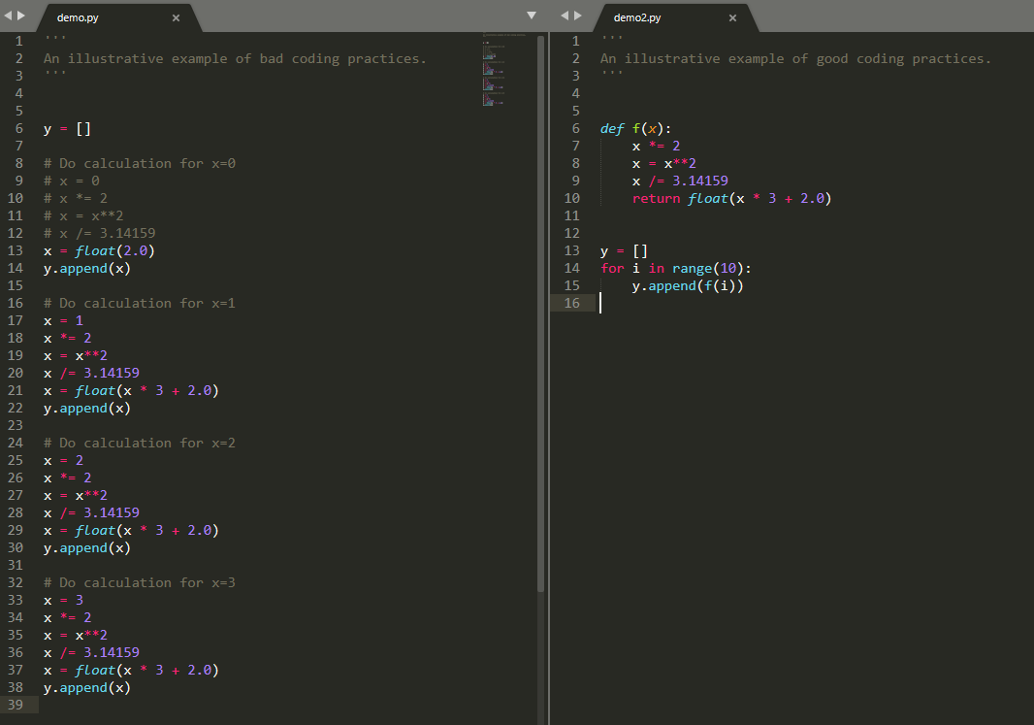
What’s Wrong Here?
Notes:
We want to apply a mathematical function to a bunch of numbers ranging from 0 – 9.

Slide 3
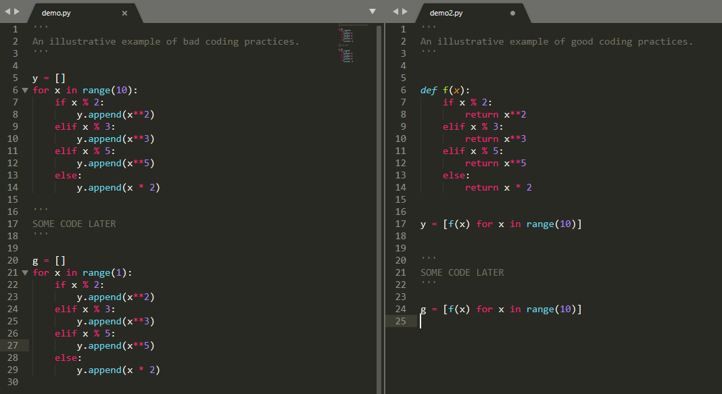
What’s Wrong Here?
Notes:
We want to return a certain number based on certain numerical conditionals.

Slide 4
What’s Wrong Here?
Notes:
Change a bunch of numbers to strings.
List comprehension

Slide 5
General Rules for Functions
If some logic is repeated throughout your code, use a function:
With less repeated code, you can minimize copy-paste errors. Further, if the logic changes, you need only change one aspect of the code, not N aspects of it (where N is each copied instance).
Exception: If the logic/action is repeated, but an alternative function already exists, use that instead. Don’t re-invent the wheel!
If some logic is only run once, then it makes no difference to have or not have a function and can in fact be detrimental to reading the code if a function is made and displaced from said segment of code.

Slide 6
Lambda Functions
A lambda function is an anonymous function that we define without a name. We use the keyword lambda to indicate a lambda function.
We can call the lambda function just like we would call any other function. We generally use them whenever we have very short functions that we can write in a single line (especially math functions).
Input variable
Function expression

Slide 7
Procedural Programming
Most of what we’ve done so far in Python has been centered around the use of functions:
PIL – blurring, setting luminance, etc.
RSA Encryption – encrypting, decrypting, generating keys, etc.
For small, simple Python scripts, this procedural approach works well!

Slide 8
An Idea
During the 1950s – 1980s, computer programs and software systems were advancing forward and increasing in size and complexity (quite rapidly).
By the mid-1980s, there was a new programming approach that became the main way to write new software – Object-Oriented Programming.
Using this approach makes it easier to write and modify large, complex programs.

Slide 9
What Are Objects?
Objects contain both data and functions.
A useful analogy for understanding this is to relate objects to physical objects/concepts in the real world, where the functions that operate on an object correspond to how real-world objects interact.

Slide 10
The Tenants of Object-Oriented Programming
Abstraction
Polymorphism
Encapsulation
Inheritance

Slide 11
Abstraction
Abstraction is the idea that the underlying logic of something does not necessarily need to be known (the black box analogy).
Abstraction allows the user to only have to deal with the basics.
Ex: PIL allowed you to load an image just by running:
img = Image.load(“cat.jpeg”).
How was the file read in?
How did it know it was a .jpeg instead of a .png?
Further, the object img has methods such as img.getpixel((x, y)). We used this function quite a lot without having to worry about what the function is actually doing.

Slide 12
Polymorphism
Polymorphism is the idea that your code should be robust and extensible in regards to handling different types of data.
Ex: PIL’s Image.load function works for .png, .jpeg, and other image file types.

Slide 13
Encapsulation
Encapsulation is the idea that the class is “well-contained” and can be easily moved.
Because of encapsulation, we can quickly import a module and make use of its functions without needing to install a bunch of other things.
Everything needed to make the code work should be within the class itself.
Any internal data is handled by the code in the class, and the end-user doesn’t see any of it.

Slide 14
Inheritance
Inheritance is the idea that we can easily “extend” our objects and create many of them at once.
Ex: Imagine we have a class that has 500 lines of code. We want to make 20 instances of this object with slightly different parameters, but we want them to have all the same functionalities. Which approach would work best?
Repeat the same 500 lines of code 20 times, changing the parameters each time.
OR
Initialize 20 objects from the original 500 lines of code, and change the parameters each time.

Slide 15
The Tenants of Object-Oriented Programming
Abstraction – the logic is hidden, but it works.
Polymorphism – it works robustly.
Encapsulation – it is easy to move around and hard to break.
Inheritance – we can make many of them.

Slide 16
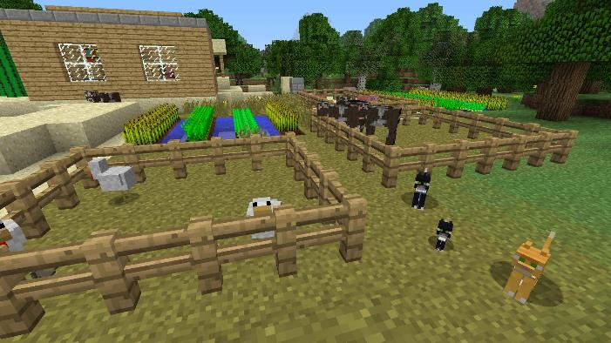
Minecraft Example

Slide 17
Classes
In Python, a class is how we can make an object.
To get started, let’s use something extremely simple as our first example of creating a class – a point in 2D space.
What parameters do you need to fully define a point?
X-coordinate
Y-coordinate
Notes:
__str__ → for End Users, to be pretty output
__repr__ → for programmers, to be used for debugging purposes (as much info as possible)

Slide 18
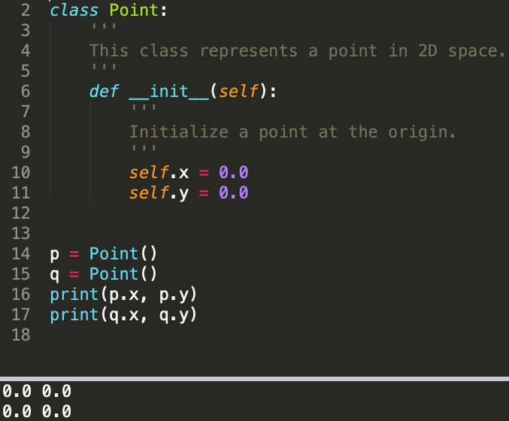
Initializer Method (Constructor)
__init__ method (initializer method):
This function is automatically called whenever we create an instance of the Point class.
In this method, we define all the important attributes/parameters that we need for the object to be fully defined.
The “self” parameter is automatically set to reference our newly-created object.
Every class NEEDS to have this method.
Here, we are creating Point objects p and q. We can reference each object’s attributes using this type of syntax.
Notes:
Naming convention - CamelCase

Slide 19
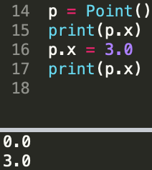
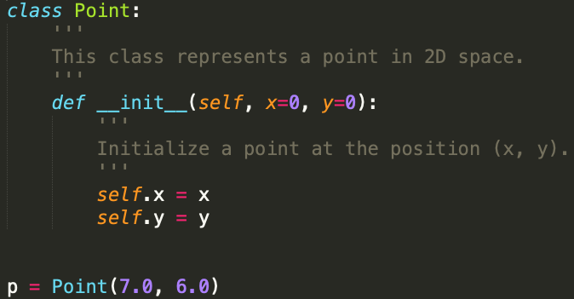
Class Attributes
We can modify an object’s attributes:
But we can also change our modify our constructor to make it more extensible:

Slide 20
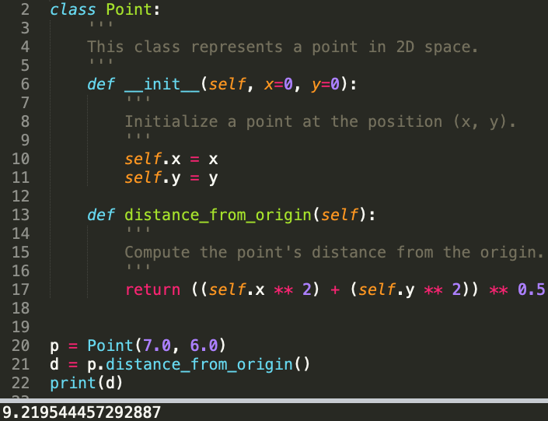
Class Methods
The advantage of using a class is that we can also put functions in it and easily make use of them.
For example, let’s say we want to write a function that will calculate the distance between a point and the origin:

Slide 21
Default Class Methods
When we use specific operators or functions, how does Python know how to handle them?
Ex: the + operator
3 + 5 will return a different result than “3” + “5”
From our Point class example, what would happen if we were to add the points together?
For any user-defined class that we write, we can define how Python will handle specific operators and functions. These are known as underscore or default methods.
http://www.siafoo.net/article/57 has an organized list of the many different default methods that are available for our use.
Notes:
Everything in Python is a class.

Slide 22
Creating, Calling, and Destroying
__init__(self, …)
Called whenever you instantiate the class.
__call__(self, …)
Called whenever we call the instantiated class object.
__del__(self)
Called whenever we are destroying the class.

Slide 23
String Representations
__repr__(self)
This should return a string representation of the class or instance with as much information as possible (generally used for debugging).
__str__(self)
This should return an informal, user-friendly string describing the class or instance.

Slide 24
Comparison Operators
Function Operator
__eq__(self, other) ==
__ne__(self, other) !=
__lt__(self, other) <
__le__(self, other) <=
__gt__(self, other) >
__ge__(self, other) >=

Slide 25
Binary Operators
Function Operator
__add__(self, other) +
__sub__(self, other) -
__mul__(self, other) *
__truediv__(self, other) /
__floordiv__(self, other) //
__mod__(self, other) %
__pow__(self, other [, mod]) **

Slide 26
Matplotlib
Matplotlib is a plotting library that can be used to generate graphs and charts.
Designed to have similar functions and usability comparable to MATLAB’s plotting functions.

Slide 27
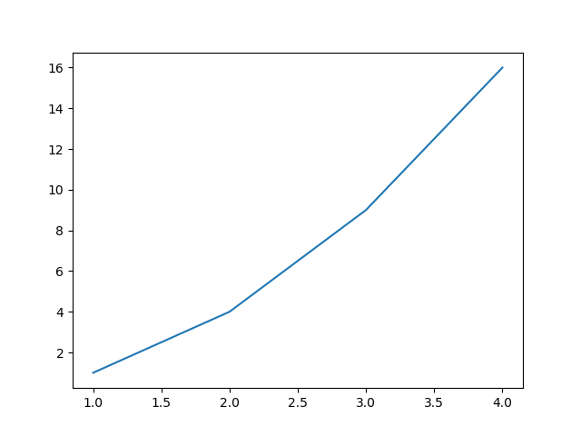
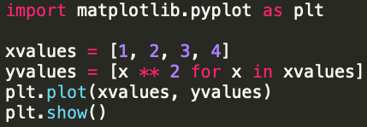
Plotting Functions

