Slide 1
EN.540.635 Software Carpentry Lecture 7 Variable Scope | Recursion | Data Structures

Slide 2
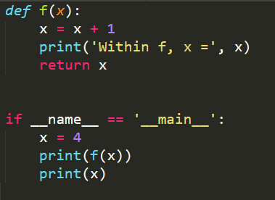
Variable Scope
Scope is the environment in a program from which a particular Python object is accessible
When you enter a function, a new ‘scope’ is created

Slide 3
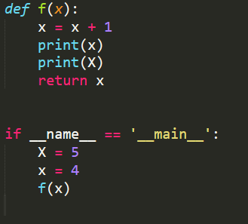
Variable Scope
Global Scope
f Scope
f
x
4
Some code
5
X
5
x
4
Use of global variables is frowned upon. You can use them as constants (GLOBAL_CONSTANT)
https://stackoverflow.com/questions/19158339/why-are-global-variables-evil

Slide 4
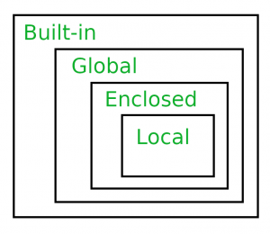
Variable Scope
In python, the LEGB rule is used to decide the order in which the namespaces are checked:
Local: Inside function/ class
Enclosed : Defined inside enclosing functions (parent/ nesting) function
Global: Uppermost Level
Built-In
Python tutor:
http://pythontutor.com/

Slide 5
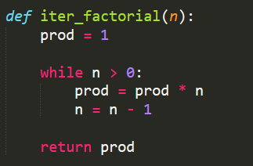
Recursion
A programming technique in which a program calls itself
An iterative solution to a problem can also be solved recursively
Base case

Slide 6
Fibonacci Sequence
A recursion approach is sometimes more intuitive than the iterative approach to solve a problem. Towers of Hanoi is one such problem.

Slide 7
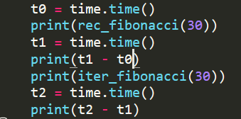
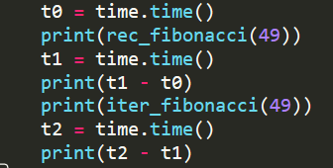
Recursion vs Iteration
Recursion is almost definitely always slower than the iterative solution as the size of the input increases

Slide 8
Why Data Structures?
Optimize the processing of data via:
Algorithms
Data Structures
Data Structures help in:
Organization: Instead of having N variables, we can have one variable that holds N values
Speed: It can be MUCH faster to search (ex. smallest value) in a data structure
Math: Custom data structures (classes and objects) and default/in-built functions can help in mathematical operations (ex: Matrices)

Slide 9
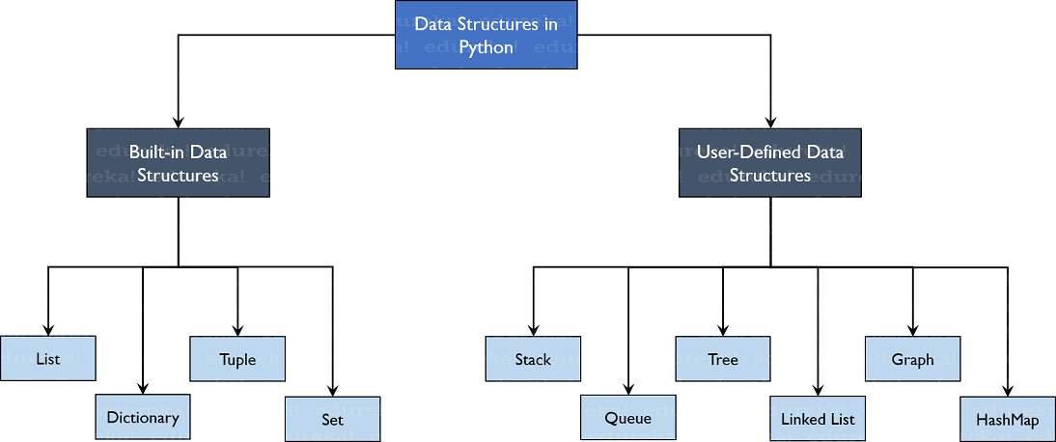
Common Data Structures
Things we’ve already seen:
Lists
Tuples
Dictionaries
Strings
New concepts in this class:
Linked Lists
Binary Trees
Stacks and Queues
https://d1jnx9ba8s6j9r.cloudfront.net/blog/wp-content/uploads/2019/10/TreeStructure-Data-Structures-in-Python-Edureka1.png

Slide 10
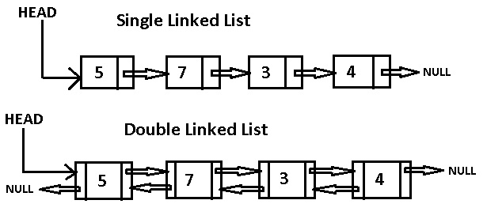
Linked Lists
A list of objects, with each element “pointing” to the next
A double linked list also points backwards
Not commonly used in python

Slide 11
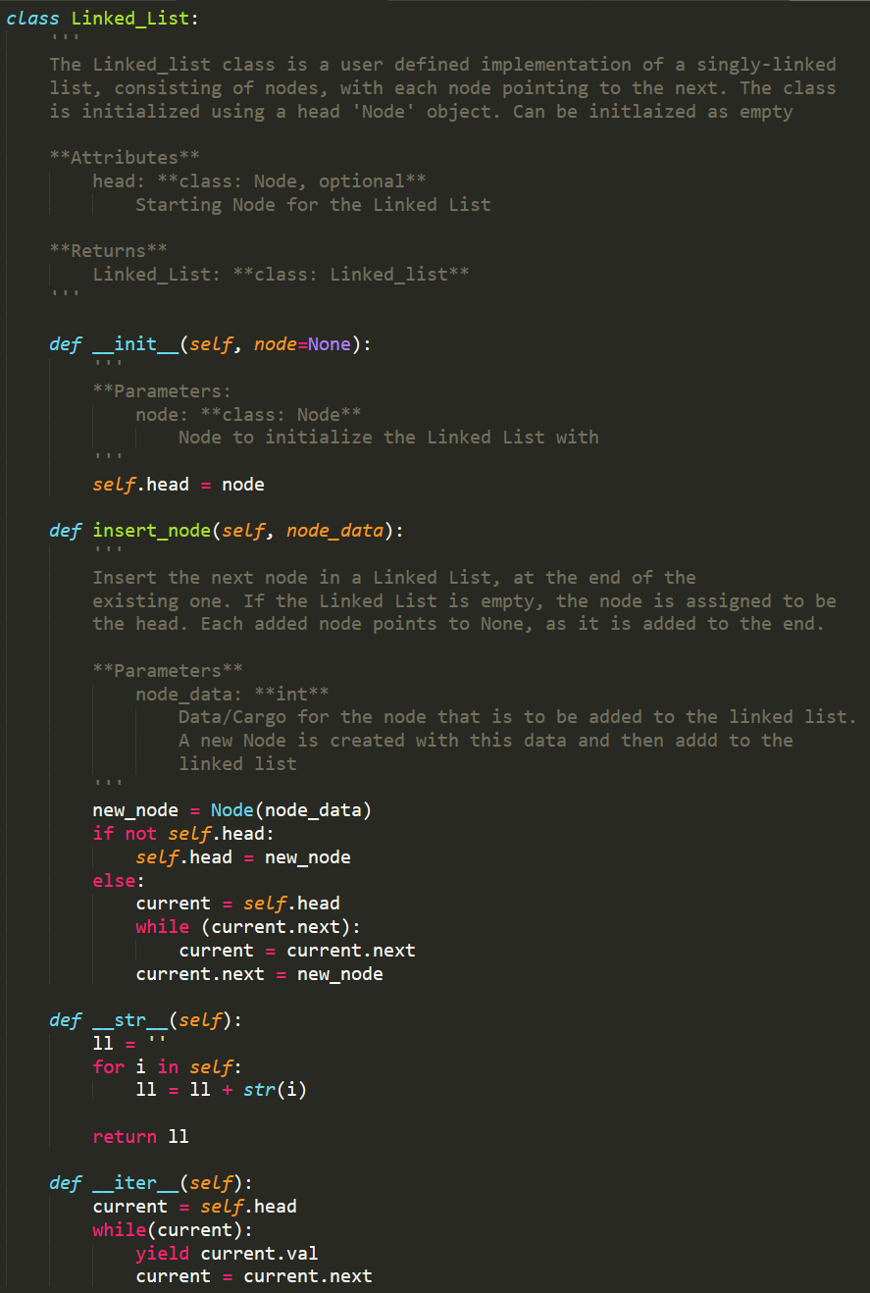
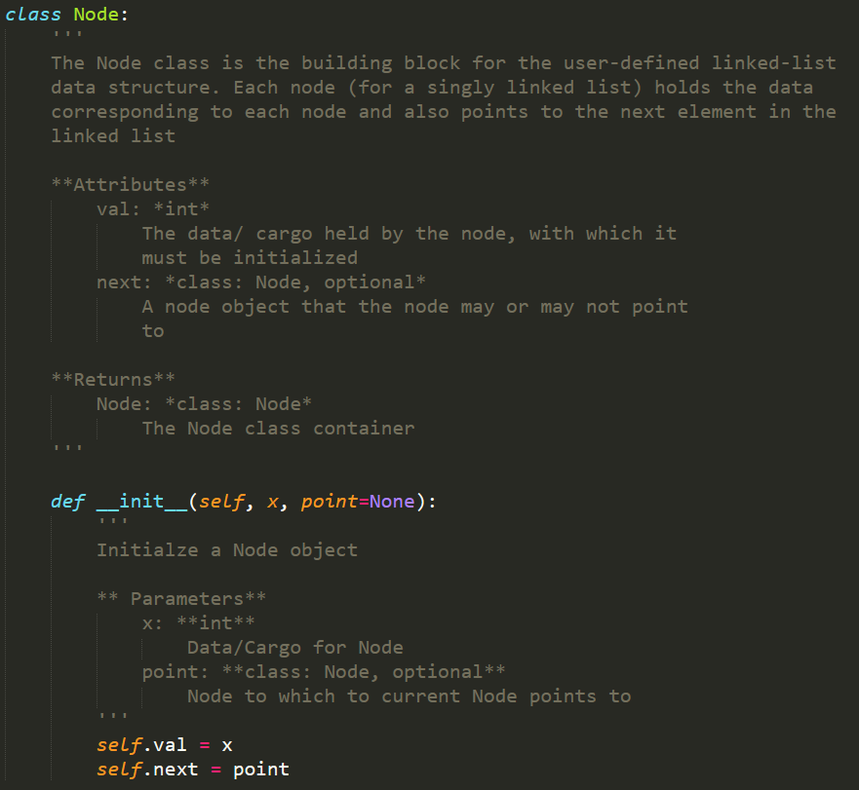
Linked Lists

Slide 12
Binary Trees
A form of data organization
Each element has a maximum of 2 children nodes
A binary tree can insert, delete, and traverse nodes.
5
3
12
1
4
7
23
6

Slide 13
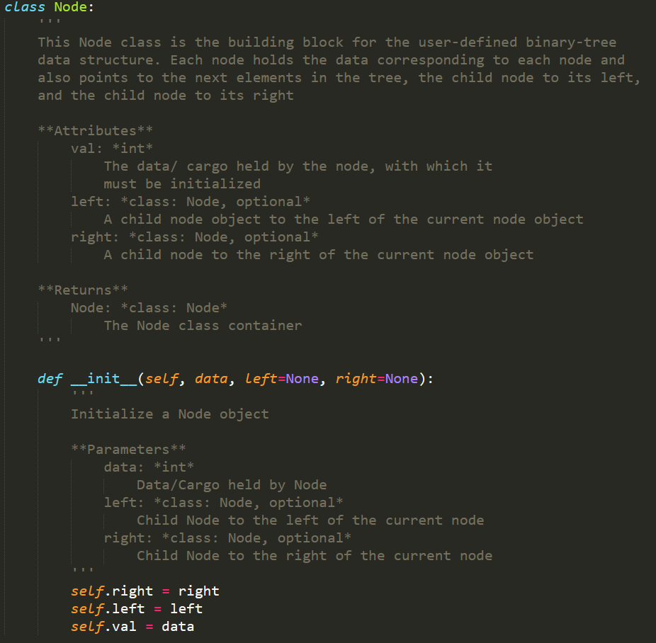
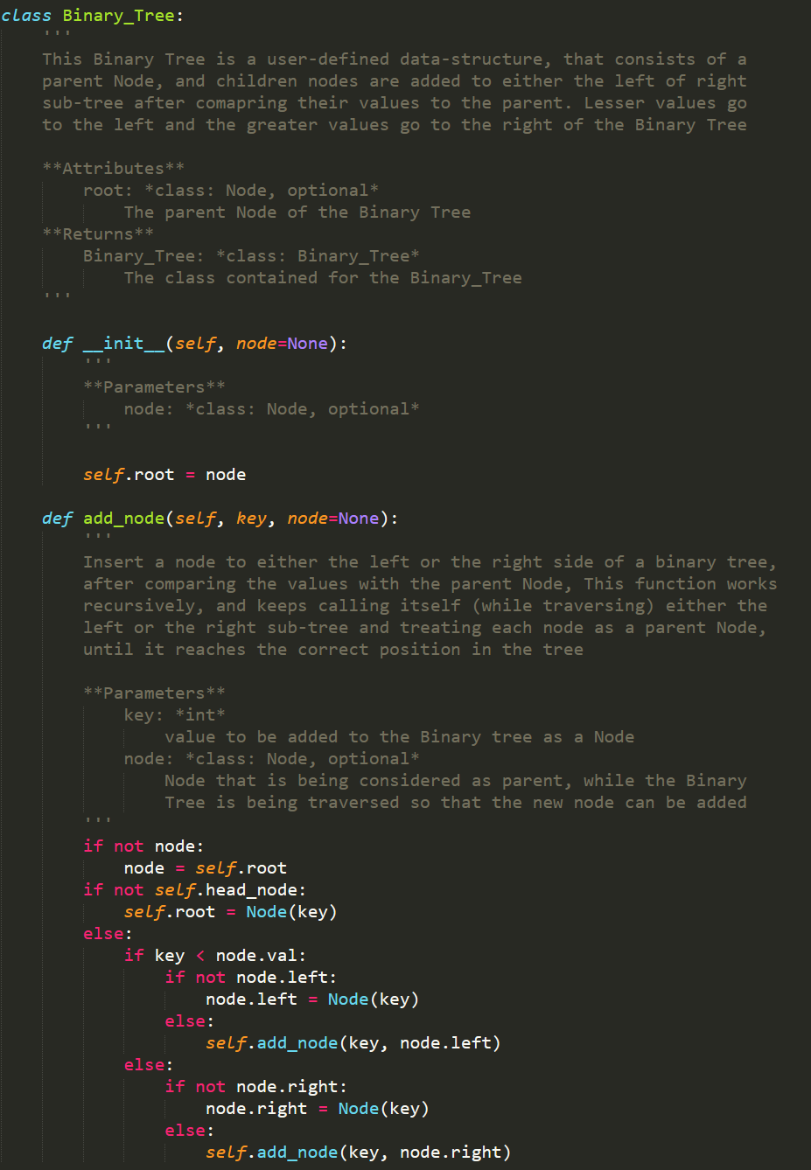
Binary Trees

Slide 14
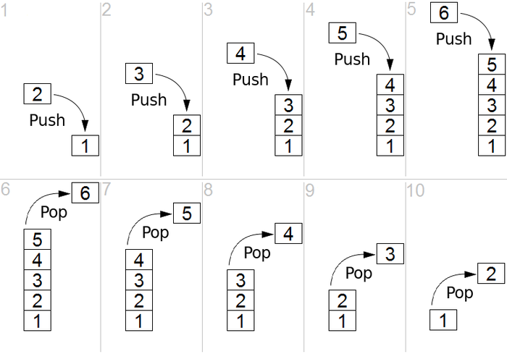
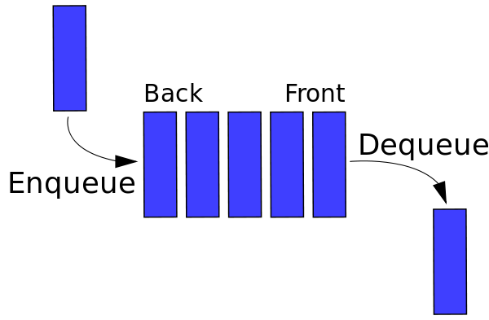
Stacks and Queues
STACK
Referred to as First In Last Out(FILO)
Operations that can be performed are ‘push’ and ‘pop’
QUEUE
Referred to as First In First Out(FILO)
Operations that can be performed are ‘enqueue’ and ‘dequeue’
https://miro.medium.com/max/875/1*4Pn00ch_p4DTCb4r3naCDQ.png
https://miro.medium.com/max/750/1*FwL7mJ4qpQWZnommC5tsFQ.png

Slide 15
As Lists
STACK
QUEUE

Slide 16
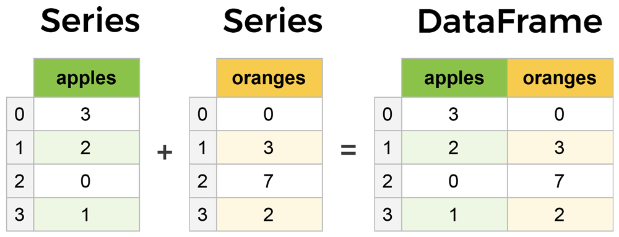
Useful Tools: Pandas
Pandas is python library that you can import that offers the use of complex data structures like Series and Dataframes
Using pandas, you can read in and write tabular data using the key data structure of Dataframe; data analysis and data visualization capabilities are also integrated

