Slide 1
EN.540.635
Software Carpentry
Lecture 7
Variable Scope | Recursion | Data Structures
Notes:
"Good morning/afternoon everyone. Today we're going to cover three important topics in Software Carpentry: variable scope, recursion, and data structures. These are fundamental concepts that will help you write better, more organized code. By the end of this lecture, you'll understand how Python manages variables in different contexts, how functions can call themselves to solve problems elegantly, and how to organize your data efficiently."

Slide 2
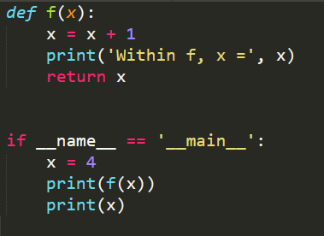

Variable Scope
Scope is the environment in a program from which a particular Python object is accessible
When you enter a function, a new ‘scope’ is created
Notes:
"Let's start with variable scope. So what exactly is scope? Scope is the environment in a program from which a particular Python object is accessible. Think of it as the 'visibility' of a variable - where in your code can you actually see and use that variable?
Here's the key concept: when you enter a function, a new scope is created. This is really important because it means variables inside a function exist in their own little world, separate from the rest of your program. This isolation is actually a feature, not a bug - it helps prevent unexpected interactions between different parts of your code."

Slide 3
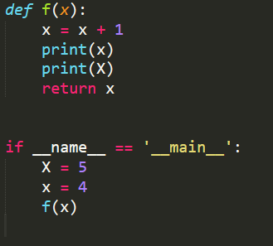
Variable Scope
Global Scope
f Scope
f
x
4
Some code
5
X
5
x
4
Use of global variables is frowned upon. You can use them as constants (GLOBAL_CONSTANT)
https://stackoverflow.com/questions/19158339/why-are-global-variables-evil
Notes:
"Now let's look at a concrete example to see scope in action. This is actually the code from the image you showed me earlier - it's a perfect example of scope issues!
Here we have a function f that takes a parameter x. Inside the function, we're doing something interesting: we're reassigning x to x + 1. Then we try to print lowercase x and uppercase X, and finally return x.
Down in our main code, we define uppercase X as 5 and lowercase x as 4, then call f(x).
What do you think happens here? This is a classic scope problem. When we call f(x), we're passing the value 4 into the function. Inside the function, the parameter x is a local variable - it's completely separate from both the lowercase x and uppercase X outside the function.
So when we do x = x + 1 inside the function, we're modifying the local x, which becomes 5. The first print statement prints 5. But the second print statement tries to print uppercase X - and here's where we hit a problem. That uppercase X is defined in the global scope, not inside the function, and Python can't find it in the function's local scope. This will actually raise a NameError.
This example perfectly illustrates why understanding scope is so important!"

Slide 4
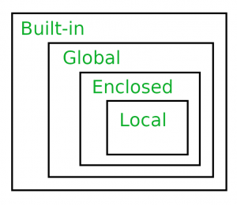
Variable Scope
In python, the LEGB rule is used to decide the order in which the namespaces are checked:
  Local: Inside function/ class
  Enclosed : Defined inside enclosing functions (parent/ nesting) function
  Global: Uppermost Level
  Built-In
Python tutor:
  http://pythontutor.com/
Notes:
"Let me show you a visual representation of what's happening. On the left, we have the global scope - this is the main body of our program. We can see uppercase X equals 5 and lowercase x equals 4 here. On the right, we have the function f's scope, which is created when we call the function. Inside that scope, we only have the local x which equals 4, then 5 after the addition.
Now, there's a systematic way Python decides where to look for variables, and it's called the LEGB rule:
L for Local: Python first looks inside the current function or class
E for Enclosed: If not found, it looks in any enclosing functions - think nested functions
G for Global: Then it checks the uppermost level of your script
B for Built-in: Finally, it checks Python's built-in namespace - things like print, len, etc.
One important note about global variables: their use is generally frowned upon in programming. They can make code harder to understand and debug because any part of your program can modify them. If you must use them, use them as constants - variables that never change - and name them in ALL_CAPS like GLOBAL_CONSTANT to make it clear they're special.
I've included a link to a Stack Overflow discussion about why global variables are problematic - it's worth reading. And if you want to visualize how scope works step-by-step, check out Python Tutor at pythontutor.com. You can paste in code and watch how variables are created and destroyed in different scopes.“
When using lists and objects, you can see that they behave differently within scopre
It happens because of how Python handles list assignment.
temp_list = original_list
This does not create a new independent list — it just creates another reference (alias) to the same list in memory. So temp_list and original_list both point to the same underlying list object.
When you update temp_list[i], you’re actually updating the same memory that original_list points to. That’s why list1 (the original) also gets modified.

Slide 5
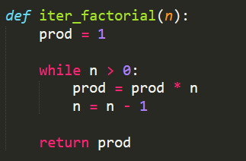
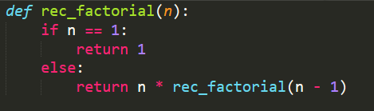
Recursion
A programming technique in which a program calls itself
An iterative solution to a problem can also be solved recursively
Base case
Notes:
Now let's move on to our second major topic: recursion. Recursion is a programming technique where a function calls itself. Now, you might be thinking, 'Wait, a function calling itself? Won't that run forever?' And you're right to worry about that! That's why every recursive function needs what we call a base case.
The base case is the condition that tells the function when to stop calling itself. Without a base case, you'd have infinite recursion, which would crash your program with a stack overflow error.
An important point: any problem you can solve iteratively - meaning with loops - can also be solved recursively. Sometimes the recursive solution is more elegant and easier to understand, though not always more efficient, as we'll see.

Slide 6
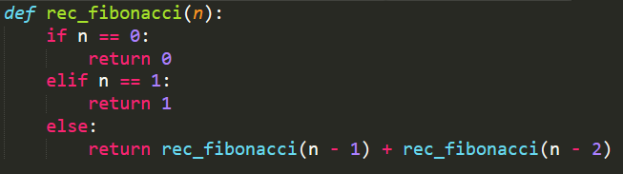
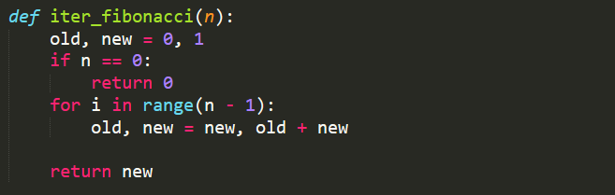
Fibonacci Sequence
A recursion approach is sometimes more intuitive than the iterative approach to solve a problem. Towers of Hanoi is one such problem.
Notes:
The Fibonacci sequence is a classic example of recursion. In the Fibonacci sequence, each number is the sum of the two preceding numbers: 0, 1, 1, 2, 3, 5, 8, 13, and so on.
Looking at this code, our function fib(n) calculates the nth Fibonacci number. Our base cases are when n equals 0 or 1 - we simply return n. These base cases are crucial! They're what stop the recursion from going on forever.
For any other value of n, we return fib(n-1) + fib(n-2). So the function calls itself twice, each time with a smaller value, until eventually we hit those base cases.
Let's trace through an example: if we call fib(4), it calls fib(3) and fib(2). fib(3) calls fib(2) and fib(1). And so on. Eventually all these calls resolve back to our base cases, and the results bubble back up.
As the diagram shows, this creates a tree-like structure of function calls. You can see how quickly the number of calls grows - this is actually one of the drawbacks of this particular recursive implementation, which leads us to our next slide.

Slide 7
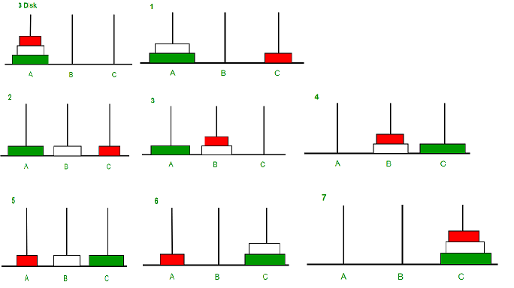
Tower of Hanoi
https://www.geeksforgeeks.org/dsa/c-program-for-tower-of-hanoi/
Notes:
So why learn recursion at all? Well, for some problems, the recursive solution is much more intuitive and easier to code, even if it's slower. The Towers of Hanoi problem mentioned here is a perfect example - the recursive solution is elegant and matches how we think about the problem, while the iterative solution is complex and hard to follow.
The key is knowing when to use each approach. For production code where performance matters, you might choose iteration. For problems where clarity matters more than speed, or where the recursive solution is naturally elegant, recursion might be the better choice. And there are advanced techniques like memoization that can speed up recursive solutions, which you might encounter in more advanced courses."

Slide 8
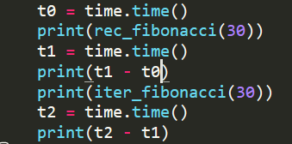

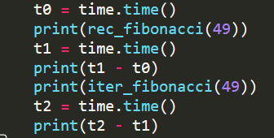

Recursion vs Iteration
Recursion is almost definitely always slower than the iterative solution as the size of the input increases
Notes:
"Here's an important reality check: recursion is almost always slower than iteration as the input size increases. Look at this graph - the recursive solution's time complexity grows exponentially while the iterative solution grows linearly.
For the Fibonacci example we just saw, when calculating fib(5), we're recalculating fib(3), fib(2), and fib(1) multiple times! That's a lot of wasted computation. An iterative solution using a loop would calculate each value just once.

Slide 9
Why Data Structures?
Optimize the processing of data via:
  Algorithms
  Data Structures
Data Structures help in:
  Organization: Instead of having N variables, we can have one variable that holds N values
  Speed: It can be MUCH faster to search (ex. smallest value) in a data structure
  Math: Custom data structures (classes and objects) and default/in-built functions can help in mathematical operations (ex: Matrices)

Slide 10
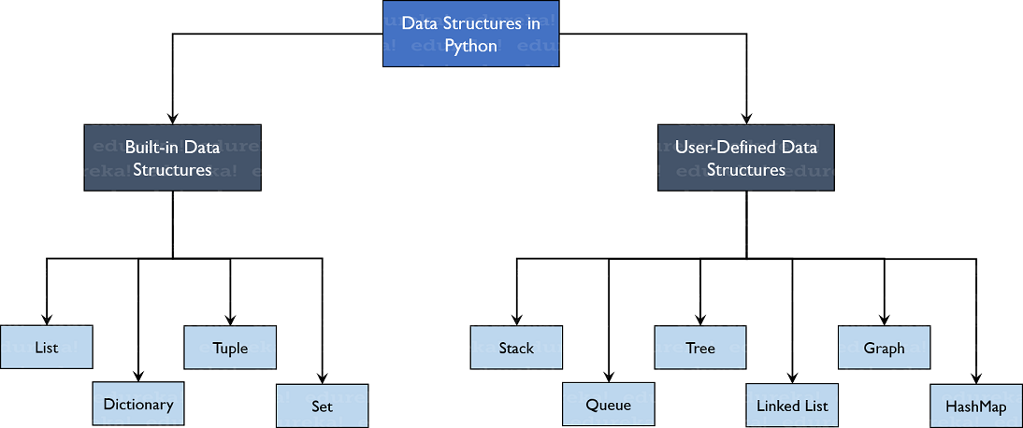
Common Data Structures
Things we’ve already seen:
  Lists
  Tuples
  Strings
New concepts in this class:
  Dictionaries
  Linked Lists
  Binary Trees
  Stacks and Queues
https://d1jnx9ba8s6j9r.cloudfront.net/blog/wp-content/uploads/2019/10/TreeStructure-Data-Structures-in-Python-Edureka1.png
Notes:
"Let's survey some common data structures. Some of these you've already seen:
Lists - ordered collections that can change. You can add, remove, and modify elements.
Tuples - similar to lists but immutable, meaning once created, they can't be changed. Great for data that shouldn't be modified.
Strings - sequences of characters. Yes, strings are data structures too!
Now, in this class, we'll be introducing some new concepts:
Dictionaries - these store key-value pairs, perfect for looking up information.
Linked Lists - elements connected like a chain, where each element points to the next.
Binary Trees - hierarchical structures where each element can have up to two children.
Stacks and Queues - specialized structures for managing data in specific orders.
Each of these has particular strengths and use cases, and we'll explore them in detail today."

Slide 11

Dictionary
Data structure that holds data as a key: value pair
Useful for retrieving information corresponding to a particular key
Key
Value
Notes:
Let's start with dictionaries. A dictionary is a data structure that holds data as key-value pairs. Think of it like an actual dictionary: you look up a word (the key) to find its definition (the value).
Dictionaries are incredibly useful for retrieving information corresponding to a particular key. For example, if you're managing student records, you might use student IDs as keys and student information as values. Need to find a student's information? Just look them up by their ID - it's instant, regardless of how many students you have.
The syntax in Python is straightforward: you use curly braces, and separate keys from values with colons. For example: grades = {'Alice': 95, 'Bob': 87, 'Charlie': 92}. To access Alice's grade, you just write grades['Alice'].
Like I mentioned dictionaries are another type of data structure that python has in addition of lists, tuples and sets. You have already seen how to access the contents of a list. Dictionary however are indexed by ‘keys’ not by index. The keys can be any immutable type. Immutable is something that is used in programming and computer science to describe objects that cannot be changed. Lists cannot be used as keys as they are mutable. Mutable means that the data inside can be changed once the object is created, however immutable cannot be. Since lists can be changed using list functions or list indices. The keys should be unique. You can use ‘del’ to delete a key: value pair
DEMO: dictionary declaration and initialization; accessing the keys and values. Looping through dictionaries. Adding elements to dictionaries. Changing values for specific keys.

Slide 12
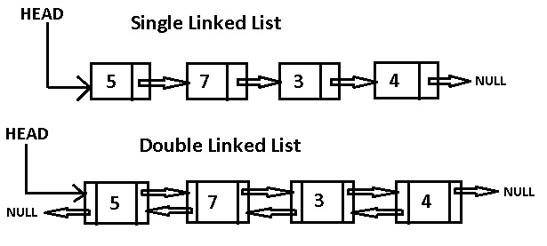
Linked Lists
A list of objects, with each element “pointing” to the next
A double linked list also points backwards
Not commonly used in python
Notes:
"A linked list is a list of objects where each element 'points' to the next. Unlike arrays or Python lists where elements are stored in contiguous memory, linked list elements can be scattered anywhere in memory - they're connected by these pointers.
Each element in a linked list is typically called a 'node', and it contains two things: the actual data, and a reference (or pointer) to the next node.
A double linked list goes a step further - each node points both forward to the next node AND backward to the previous node. This makes it easy to traverse the list in either direction, though it uses more memory.
Now, here's an important note: linked lists aren't commonly used in Python. Why? Because Python's built-in list is so efficient and flexible that there's rarely a need for linked lists. However, they're still important to learn about because they're fundamental to understanding how data structures work, and they're heavily used in languages like C and C++. Plus, understanding linked lists helps you understand more complex data structures."

Slide 13
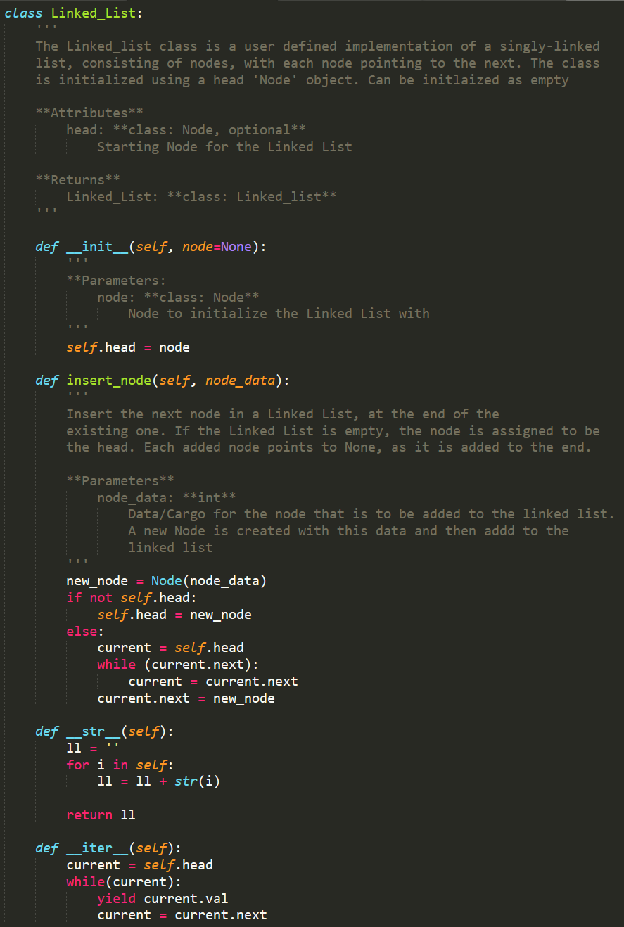
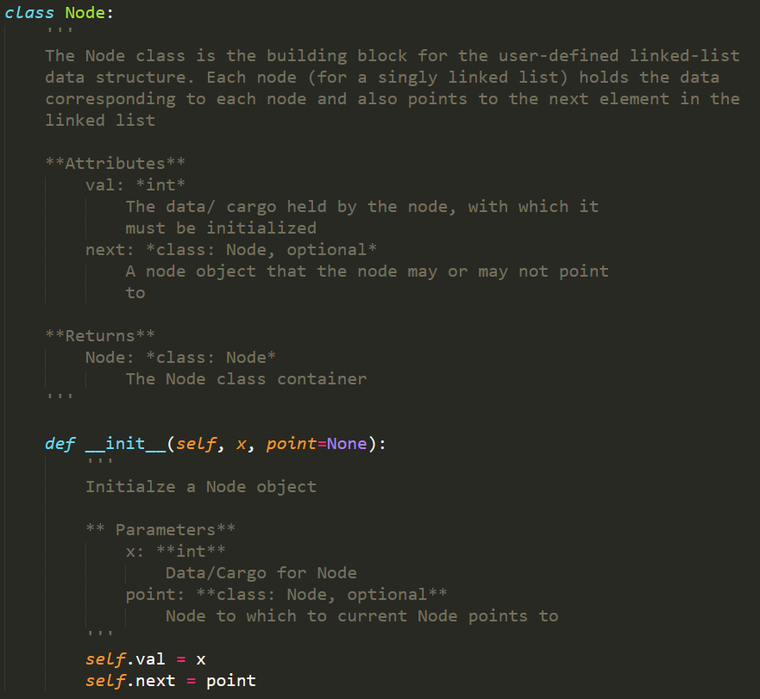
Linked Lists
Notes:
"Let's visualize a linked list. Here we see a series of nodes, each containing some data and a pointer to the next node. The first node is called the 'head' - it's your entry point into the list. The last node points to 'null' or 'None', indicating the end of the list.
Notice how this is different from an array. In an array, if you want the third element, you can jump directly to it. In a linked list, you have to start at the head and follow the pointers: first node, then second node, then third node. This makes accessing elements slower.
However, linked lists have advantages too! Inserting a new element in the middle of an array requires shifting all subsequent elements. In a linked list? You just change a couple of pointers. Same with deletion. So linked lists excel at insertion and deletion but are slower at random access.
The diagram shows this chain-like structure clearly. Each box represents a node, and the arrows represent the pointers. In a double linked list, you'd see arrows going both directions."

Slide 14
Binary Trees
A form of data organization
Each element has a maximum of 2 children nodes
A binary tree can insert, delete, and traverse nodes.
5
3
12
1
4
7
23
6
Notes:
Binary trees are a hierarchical form of data organization. Unlike lists which are linear - one element after another - trees branch out.
In a binary tree, each element (called a node) has a maximum of two children nodes - that's why it's called 'binary'. We typically call these the left child and the right child.
The top node is called the root. Nodes with no children are called leaves. And we describe the relationships using family terms: parent, child, sibling, ancestor, descendant.
Binary trees can perform three main operations: insert (add a new node), delete (remove a node), and traverse (visit all nodes in some order).
Looking at this specific example, we have a binary search tree - a special type where values are organized: for any node, all values in its left subtree are smaller, and all values in its right subtree are larger. This organization makes searching very efficient - you can eliminate half the remaining nodes with each comparison!"
"Here's a visual representation of the binary tree from the previous slide. The number 5 at the top is our root node. It has two children: 1 on the left and 23 on the right.
Following the left branch, 1 has two children: 4 and 7. Following the right branch from the root, 23 has one child: 6.
Notice how this is organized as a binary search tree. From the root 5: numbers less than 5 (like 1, 4) go to the left, numbers greater than 5 (like 23, 7) go... wait, actually this tree isn't perfectly organized as a binary search tree because 7 is greater than 5 but appears in the left subtree. This actually highlights an important point: not all binary trees are binary search trees! This is just a binary tree with that particular structure.
Binary trees are used everywhere in computer science: file systems, decision trees in AI, game trees in chess programs, expression evaluation in compilers. They're incredibly versatile data structures."

Slide 15
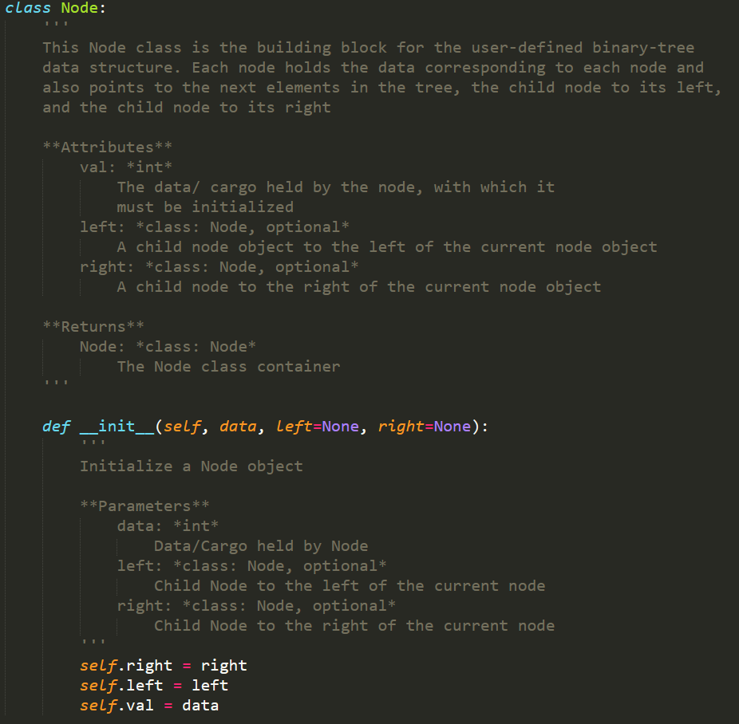
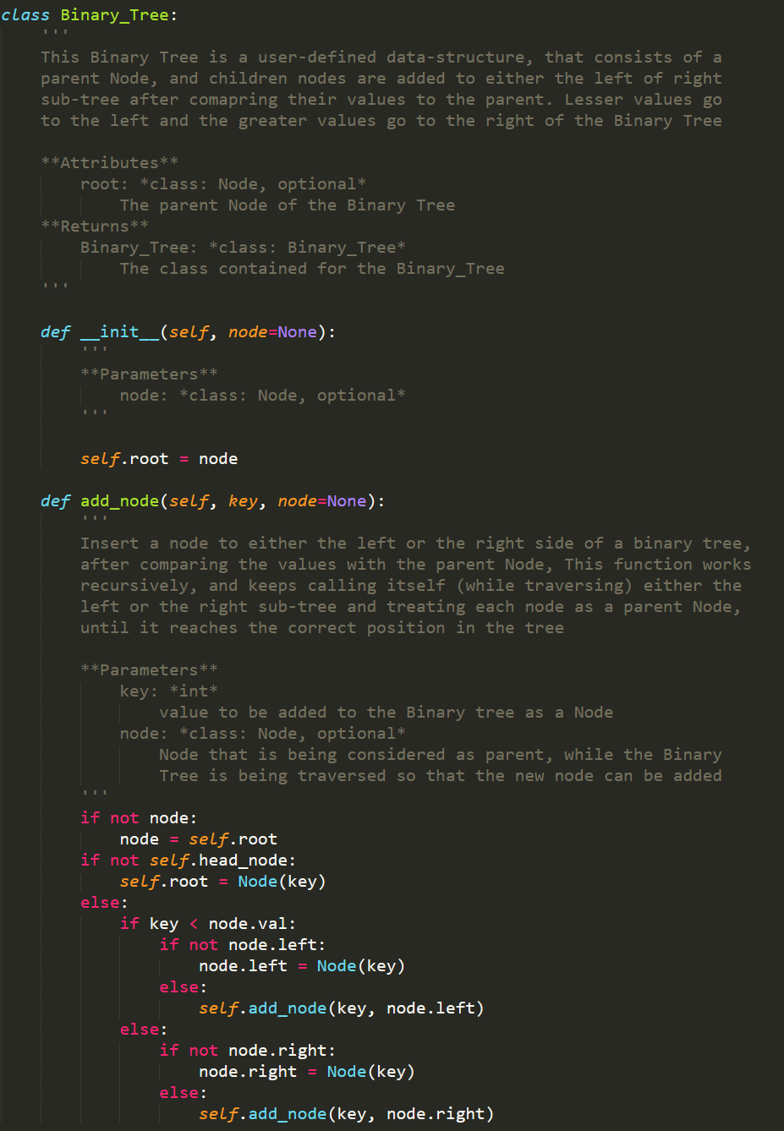
Binary Trees

Slide 16
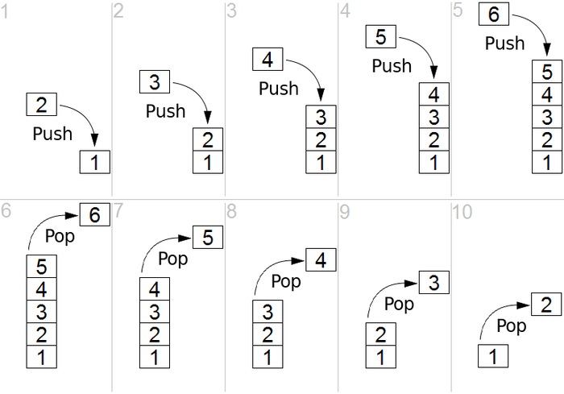
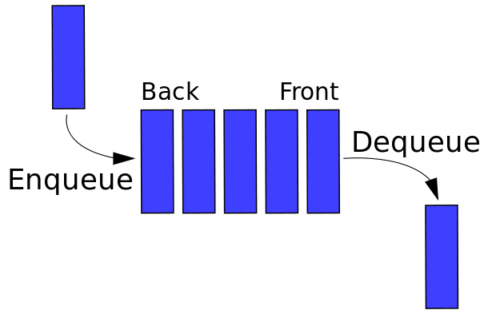
Stacks and Queues
STACK
Referred to as First In Last Out(FILO)
Operations that can be performed are ‘push’ and ‘pop’
QUEUE
Referred to as First In First Out(FILO)
Operations that can be performed are ‘enqueue’ and ‘dequeue’
https://miro.medium.com/max/875/1*4Pn00ch_p4DTCb4r3naCDQ.png
https://miro.medium.com/max/750/1*FwL7mJ4qpQWZnommC5tsFQ.png
Notes:
"Now let's talk about two specialized data structures: stacks and queues. These are both linear data structures, but they control the order in which you can access elements.
A stack is Last In, First Out - or LIFO, though the slide says FILO (First In Last Out), which means the same thing. Think of a stack of plates: you add plates to the top and remove plates from the top. The last plate you put on is the first one you take off.
The two main operations on a stack are:
Push: add an element to the top
Pop: remove and return the top element
Looking at the diagram, you can see items being added from the bottom up, with operations happening at the top.
A queue is First In, First Out - FIFO. Think of a line at a coffee shop: the first person in line is the first person served.
The two main operations on a queue are:
Enqueue: add an element to the back
Dequeue: remove and return the element at the front
The diagram shows items flowing through, entering on one side and leaving from the other.
When would you use these? Stacks are perfect for things like undo functionality, backtracking algorithms, and parsing expressions. Queues are ideal for task scheduling, breadth-first search, and managing requests in order."

Slide 17
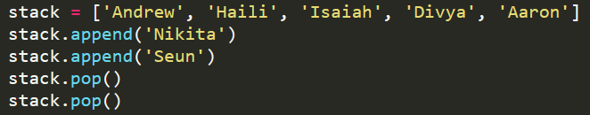
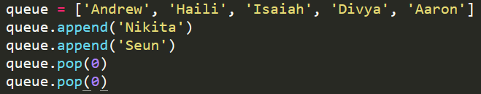
As Lists
STACK
QUEUE

Slide 18
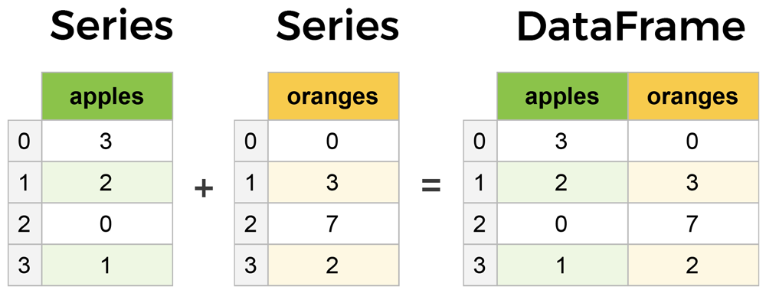
Useful Tools: Pandas
Pandas is python library that you can import that offers the use of complex data structures like Series and Dataframes
Using pandas, you can read in and write tabular data using the key data structure of Dataframe; data analysis and data visualization capabilities are also integrated

