Slide 1
EN.540.635
Software Carpentry
Lecture 9
Building Graphical User Interface with TKinter
Notes:
Hello everyone. Welcome to software carpentry. Today we will be talking about one of the properties of Object Oriented Programming that Isaiah touched upon in a previous lecture. Following that we will be talking about incorporating more advanced user interface functionality into your code, which you might find useful if you want incorporate such a thing into your final projects.

Slide 2
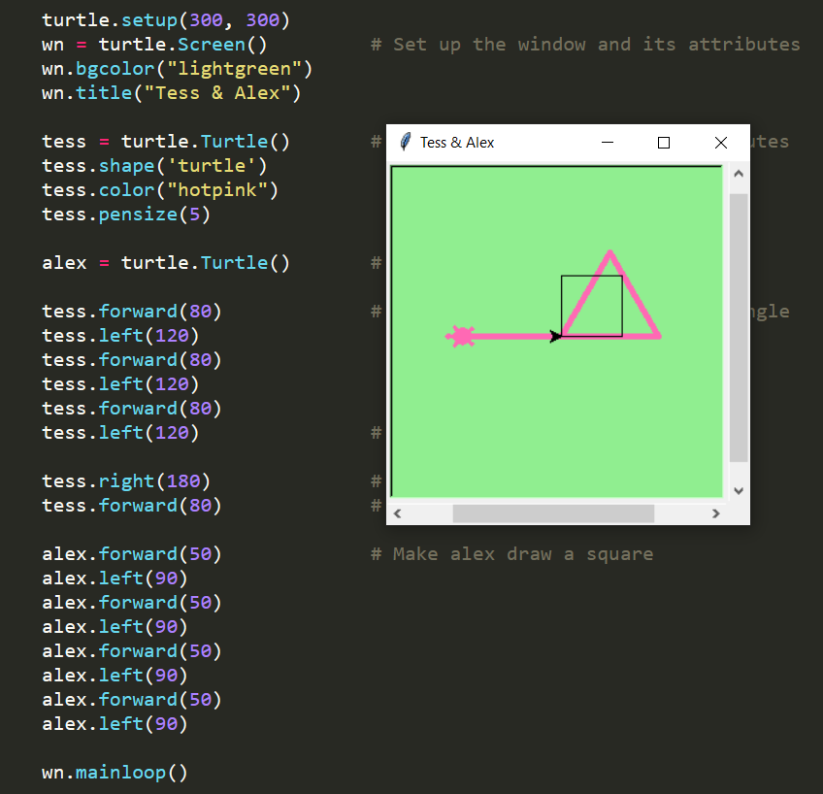
Python’s Turtle
An in-built functionality present in python that helps when introducing programming to beginners
Originally part of and is based off of an old programming language called LOGO

Slide 3
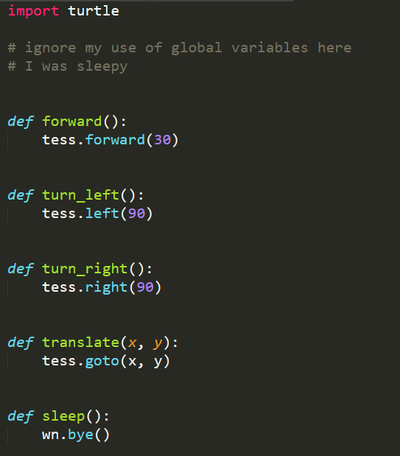
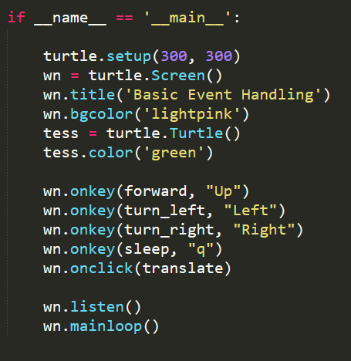
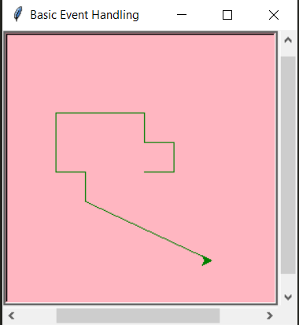
Event Handling
Example adapted from ‘How to think like a computer scientist’

Slide 4
What is TKinter
It is the standard Python interface to the Tk GUI toolkit. Tkinter is just a wrapper of code around the Tk module with added functionality to make it more Pythonic
Tk is standard GUI toolkit for many dynamics languages like Tcl (Tool Command Line), Python, Javascript, Lua and Ruby.
Turtle uses the built python library Tkinter to interact with the user
There are many other GUI packages for python : Kivy, PyQT, WxPython
Internally Tk uses the facilities of underlying OS : Xlib on Unix/Linux, Cocoa on Mac, GDI on Windows
Notes:
Tkinter is Python’s standard interface to something called the Tk GUI toolkit. This is not specific to python itself and is a software available on most Unix platforms and also on Windows. Tkinter the python module allows you to interface with it create your GUIs for the programs or applications that you are writing. There are others that allow similar functionality and may also have more advanced functionalities.
Tk implemented in C

Slide 5
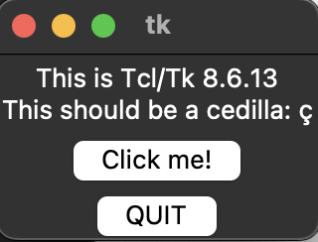

What is TKinter
Under the hood
Tcl Command
String
_tkinter binary
module
Xlib/
Cocoa/
GDI
generates
passes
command
calls
TCL
Interpreter
calls
Tk
module
calls
Tkinter
Terminal
username@machinename $\sim$ python3 –m tkinter
Notes:
_tkinter : A binary module that contains the low-level interface to Tcl/Tk. It is automatically imported by the main tkinter module, and should never be used directly by application programmers. It is usually a shared library (or DLL), but might in some cases be statically linked with the Python interpreter.
The last part in the workflow is similar to how in Python the interpreter calls the relevant python modules.

Slide 6
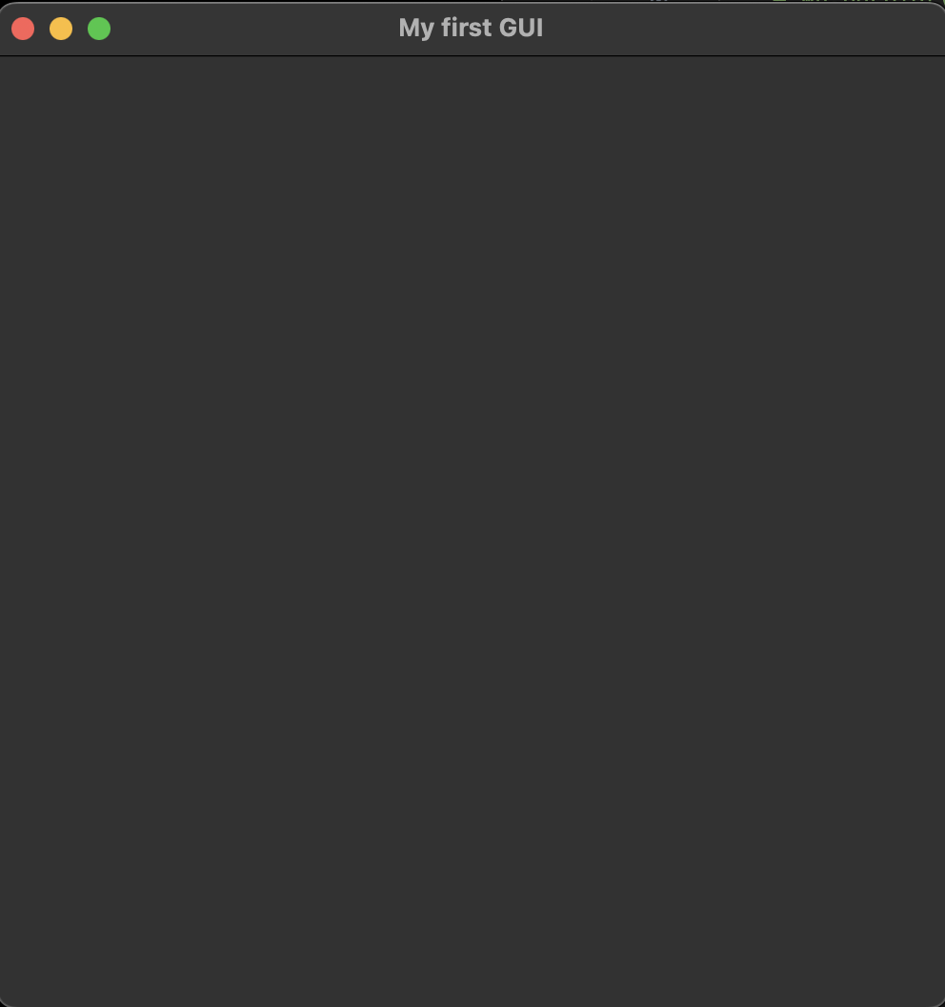
Your First Tkinter Application
my_first_tkinter_app.py
import tkinter as tk
if __name__ == ‘__main__’:
root = tk.Tk()
root.title(‘My first GUI’)
root.resizable(False, False)
root.geometry(‘500x500’)
root.mainloop()
Creating alias
Launches the TCL interpreter,
creates window for app
Add title to GUI
Does not allow window resize
Set the size of the window
Displays the window and responds to user input until window terminated

Slide 7
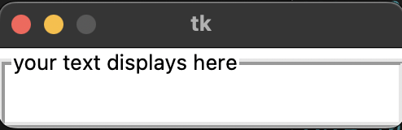
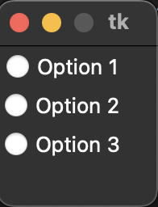
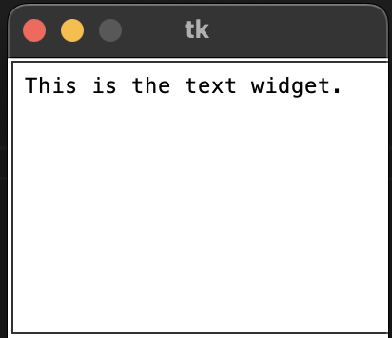
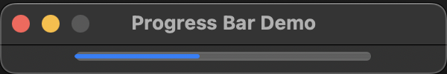
Tkinter widgets
Widgets add fuctionality to your App.
Tkinter offers several types of widgets:
  Frame : A container for other widgets
  LabelFrame : Displays a label on the border of the frame.
  Label : Displays text and images
  Text : A complete text editor inside a window
  Radiobutton : Single choice selection
LabelFrame
Radiobutton
Text
An event occurs when a user interacts with anything inside the GUI.
Events trigger event handlers that respond to the event.
Progressbar
For each widget there is a function called bind that links the event handler to the event.
my_first_tkinter_app.py
#When you hit enter, the submit event hand is called.
root.bind(‘<Return>’, submit)
Notes:
Examples of events are mouse clicks or hovers.

Slide 8
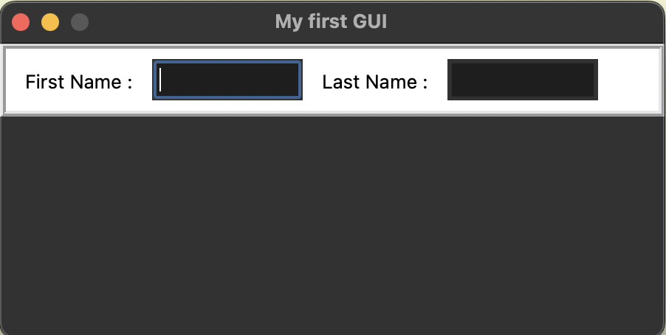
Adding widgets to the GUI
my_first_tkinter_app.py
import tkinter as tk
if __name__ == ‘__main__’:
root = tk.Tk()
root.title(‘My first GUI’)
root.resizable(False, False)
root.geometry(‘450x200’)
frame = tk.Frame(root, bg='white', bd=4, relief='ridge’, height=50, width=450)
frame.grid()
frame.grid_propagate(0)
fn_label = tk.Label(frame, fg=‘black’, bg=‘white’, text=‘First Name:’)
fn_lablel.grid(row=0, column=0, padx=10, pady=10)
fn = tk.StringVar()
fn_entry = tk.Entry(frame, textvariable=fn, width=10)
fn_entry.grid(row=0, column=1)
ln_label = tk.Label(frame, fg=‘black’, bg=‘white’, text=‘Last Name:’)
ln_label.grid(row=0, column=2, padx=10, pady=10)
ln = tk.StringVar()
ln_entry = tk.Entry(frame, textvariable=ln, width=10)
ln_entry.grid(row=0, column=3)
root.mainloop()
450 pixels
Container in which
frame is placed in
Border width & design
Geometry manager
200 pixels
Disables auto adjustment
Place label inside frame
Adds Left and right padding outside widget
Variable to hold first name
Store user entered val. in this variable

Slide 9
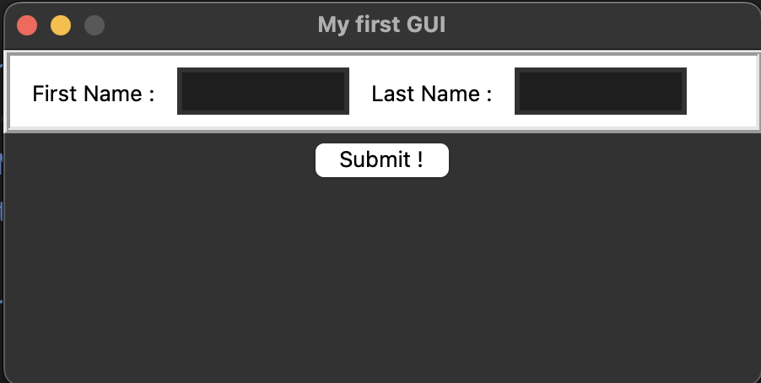
Adding Buttons …
my_first_tkinter_app.py
import tkinter as tk
if __name__ == ‘__main__’:
.
.
.
def submit(event):
print(‘Submitted !’)
submit_button = tk.Button(root, text=‘Submit !’,
command=lambda : print(‘Submitted ! (from button)’)
submit_button.grid(row=1, column=0)
root.bind(‘<Return>’, submit)
root.mainloop()
450 pixels
200 pixels
Event handler, must always an argument. Here we name it as event.
Whenever enter key is pressed in the root frame, calls the event handler

Slide 10
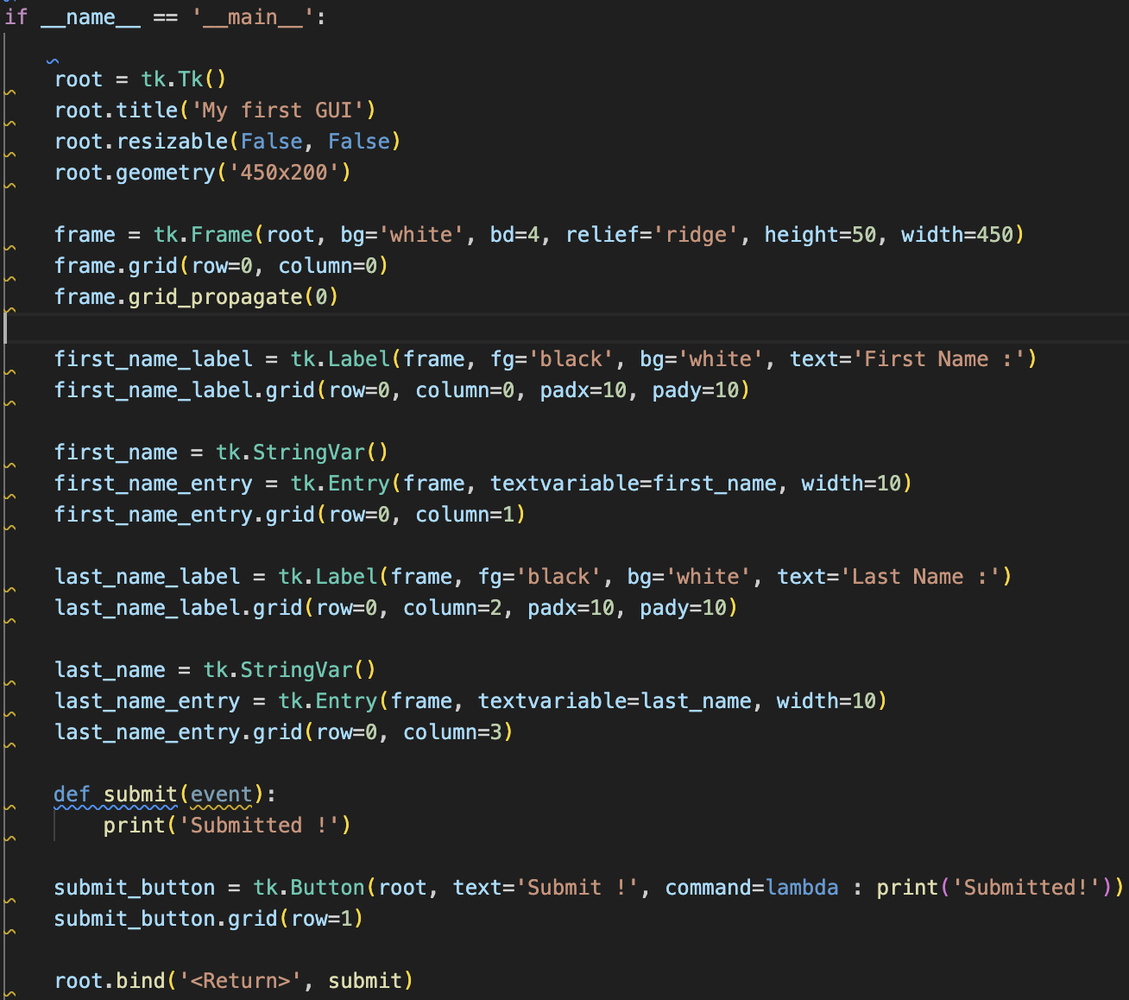
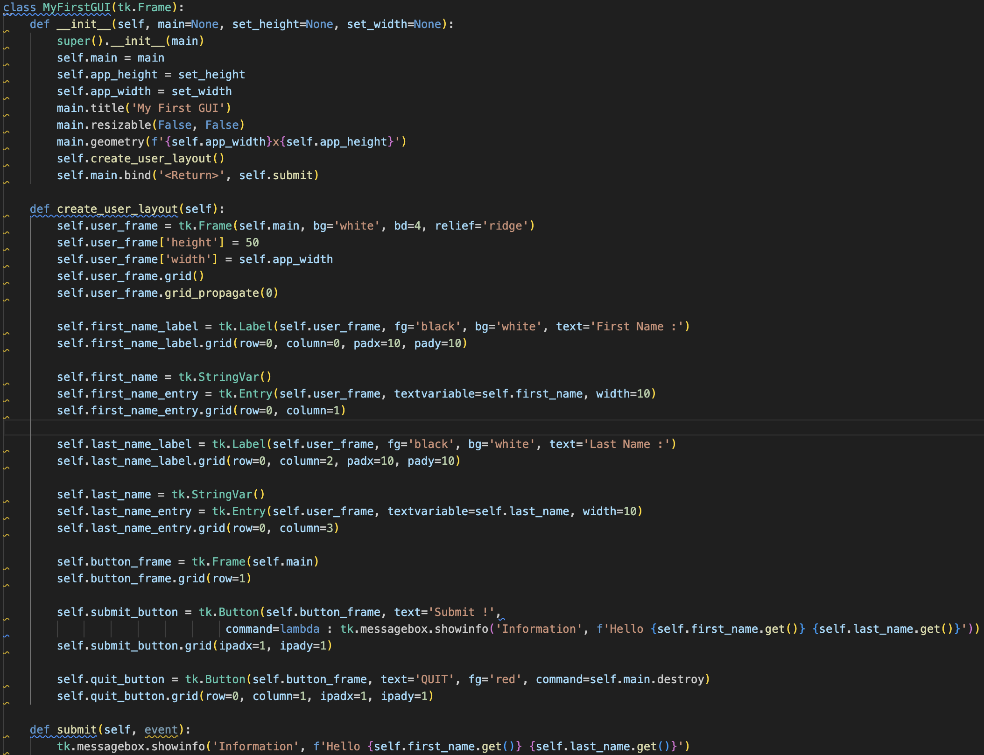
Writing Tkinter Application Using Classes
Written in procedural format.
Makes use of global variables.
Cannot be imported into other python scripts
Allows importing into other python scripts.
Can easily extend and add more UI elements through inheritance.
Getting User Input through .get() function
Event handler uses messagebox

Slide 11
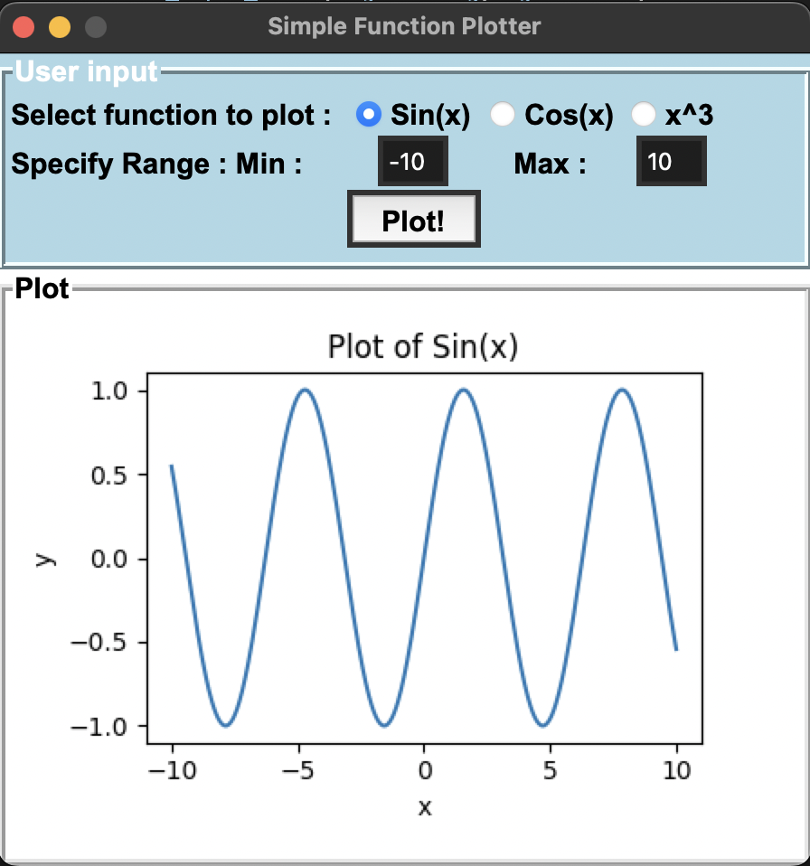
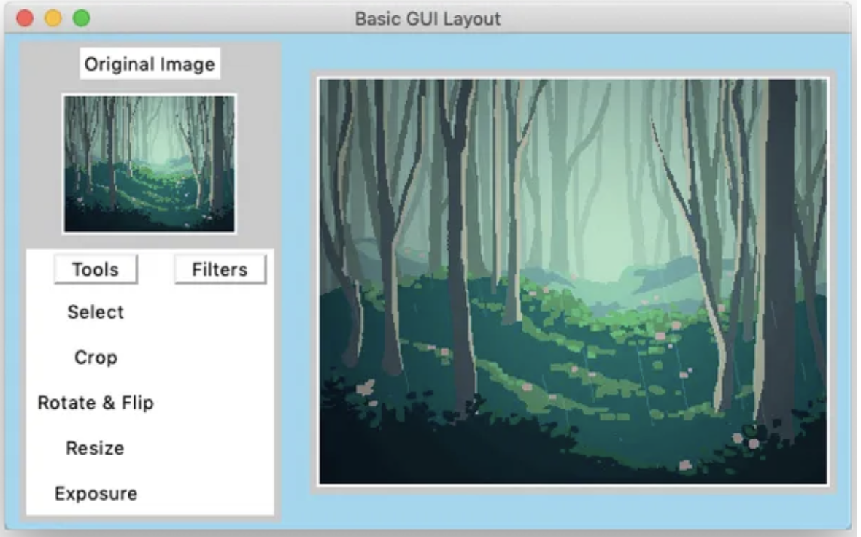
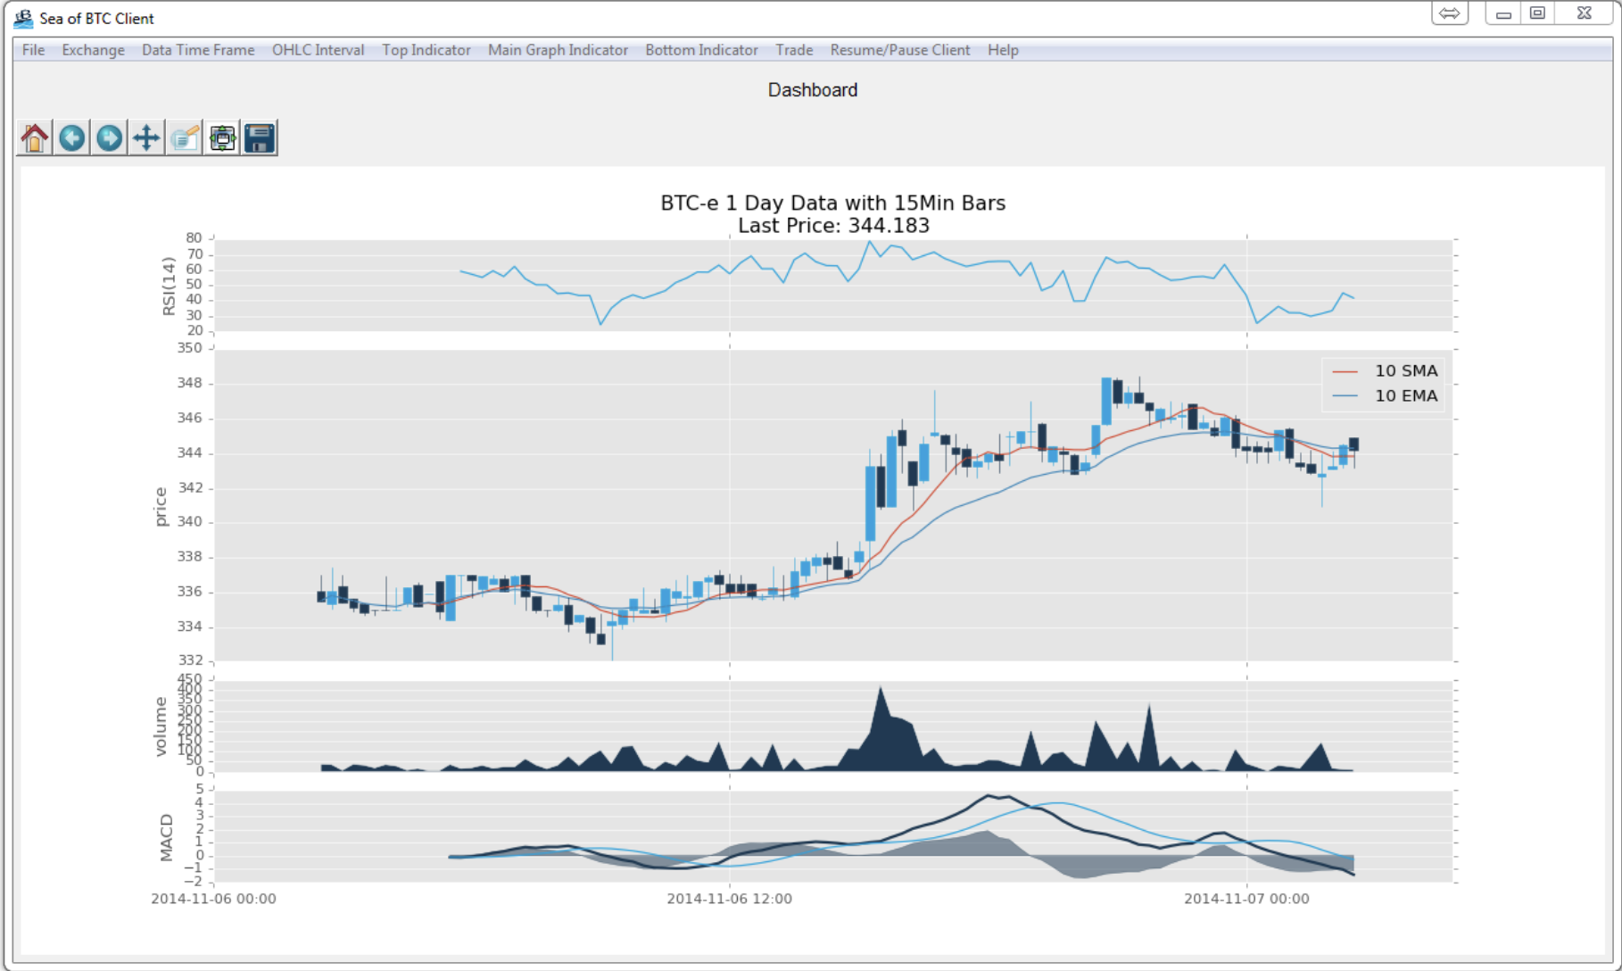
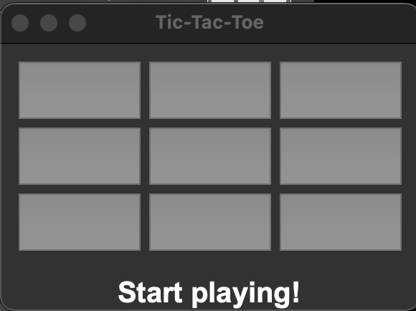
Some Examples of Applications Using Tkinter
Ref : https://www.pythonguis.com/faq/pack-place-and-grid-in-tkinter/
Ref : https://github.com/SarcasticMinion/Tic_Tac_Toe
Ref : https://pythonprogramming.net/tkinter-depth-tutorial-making-actual-program/

Slide 12
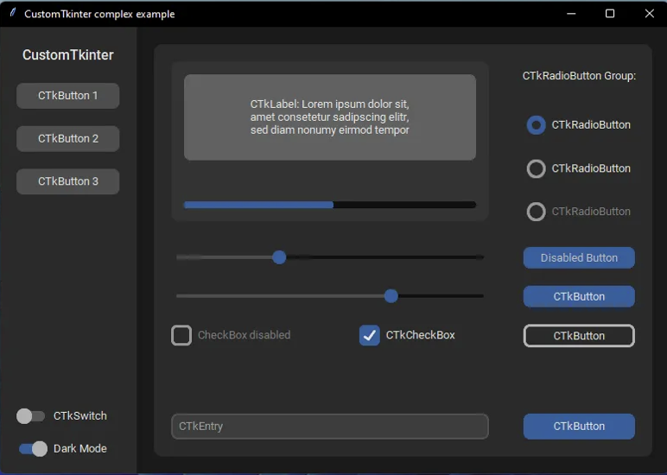
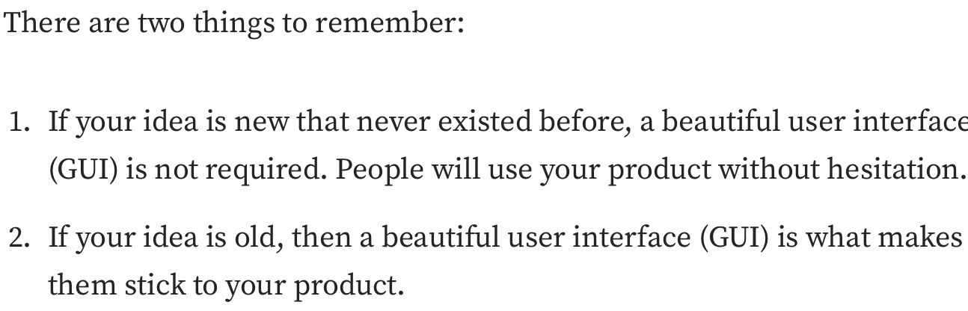
Some Examples of Applications Using Tkinter (Cont.)
Ref : https://medium.com/@fareedkhandev/modern-gui-using-tkinter-12da0b983e22
References:
[1] https://tkdocs.com/shipman/tkinter.pdf
[2] https://docs.python.org/3/library/tk.html
Oct 29 : Demo – Building a simple calculator using Tkinter !

