Slide 1
EN.540.635
Software Carpentry
Mini Lecture
Testing

Slide 2
Unit Testing
“Tests” that are written in order to check the smallest part of your code: a single function
Benefits
  Helps find bugs early!
  Especially useful with multiple developers — ensure a change doesn’t break someone else’s code
  Can be automated
Disadvantages
  Takes time to write
  False sense of confidence — only as good as the tests themselves!
Many frameworks to help keep unit tests organized

Slide 3
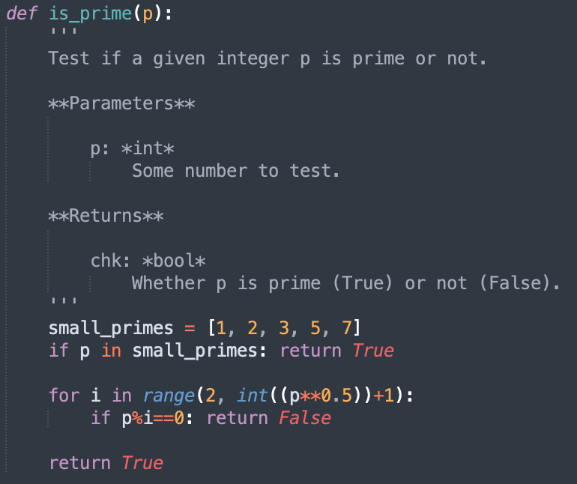
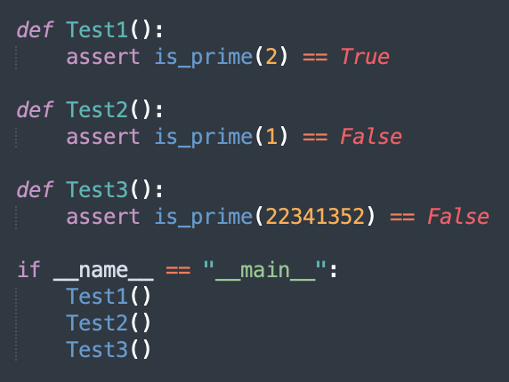
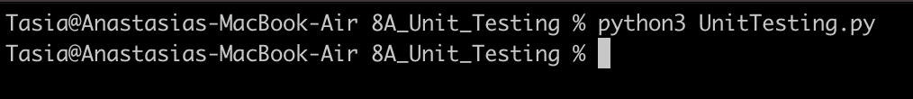
Unit Testing - Example

Slide 4
Testing Frameworks (or Test Runners)
unittest (built-in)
  Requires tests to be stored as class
  Uses special assertion statements available in unittest.TestCase class
nose2
pytest

Slide 5
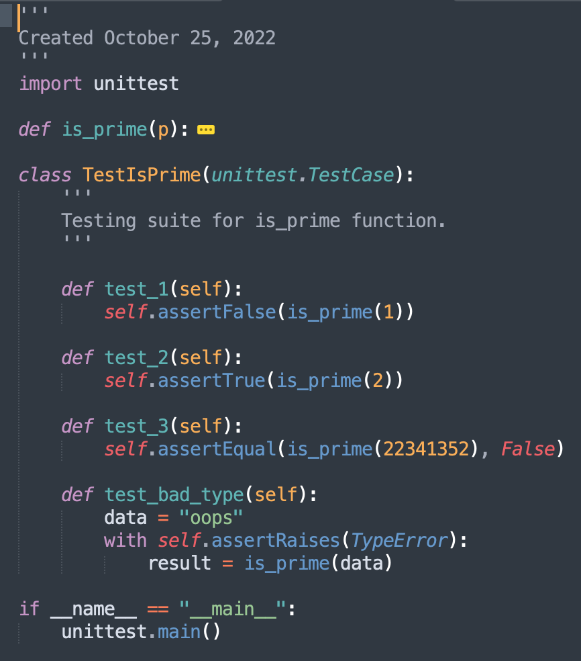
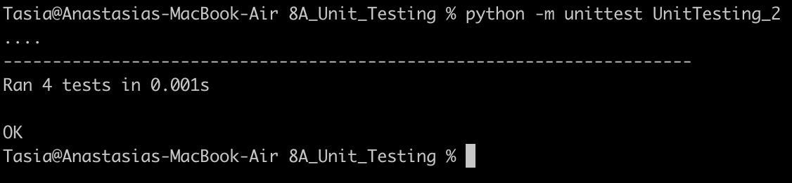
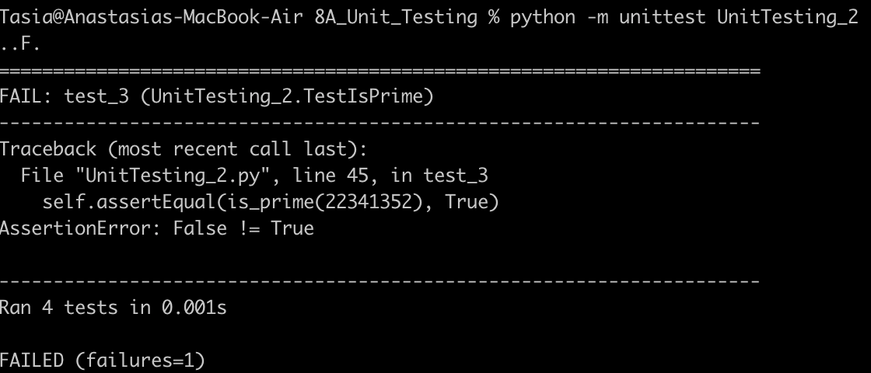
unittest
must begin with “test_”

Slide 6
Side Effects!
Functions that perform multiple tasks (such as potentially changing a state) may be hard to unit test!
Single Responsibility Principle: Each unit test “should be responsible for one, and only one, actor”
  Single call to testing function
  Single logical assertion (checking multiple aspects of a single object is okay)
  Unit test does not depend on state
  Don’t duplicate tests!

Slide 7
Integration Testing
“Tests” to see if different components are working with each other
Databases, other files, jpg images can be stored out in folder
Most unit tests & integration tests are separated

Slide 8
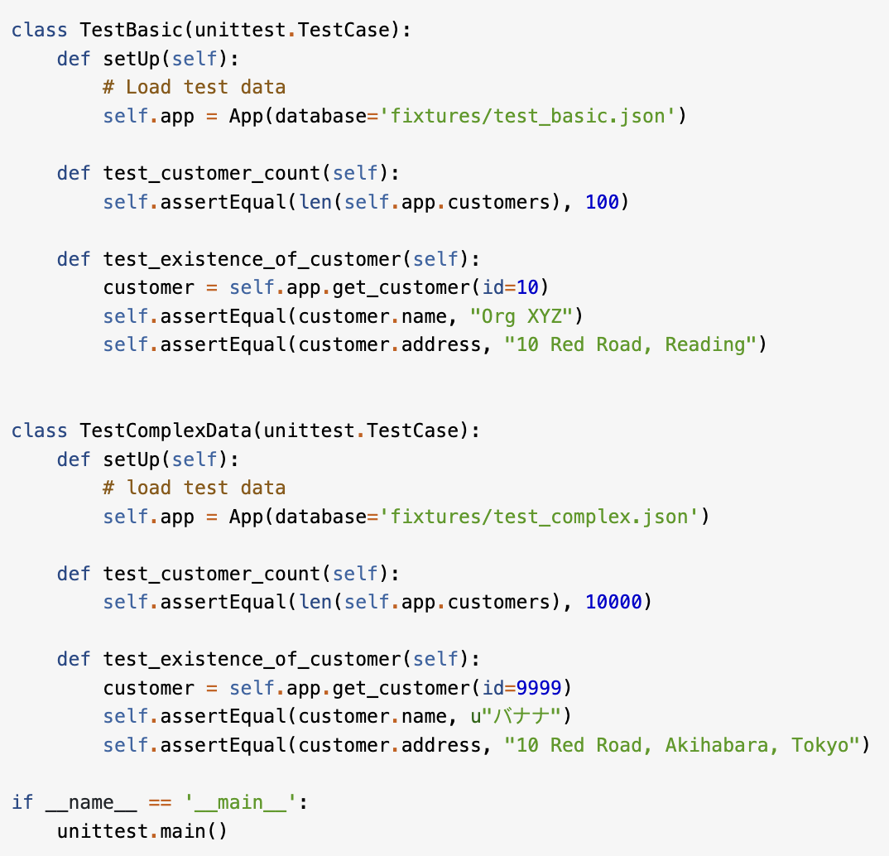
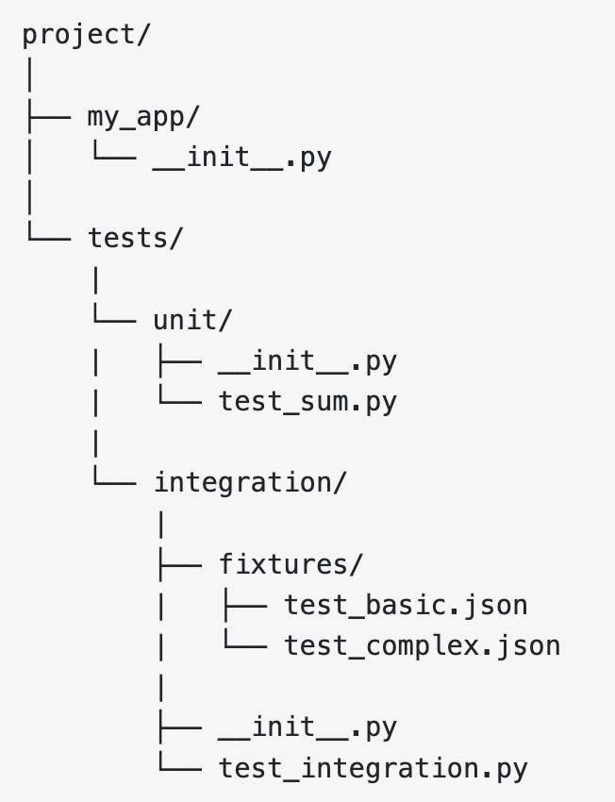
Integration Testing - Example
https://realpython.com/python-testing/#writing-integration-tests

Slide 9
Additional Resources
https://realpython.com/python-testing/
https://docs.python.org/3/library/unittest.html#

